Slide 1
Chapter 2-1
Bits,Bytes and Data Types
计算机系统概论
Introduction to Computing Systems
（ CS1002A.01 ）
计算机科学与技术学院
School of Computer Science and Technology

Slide 2
Outline
1
How do we represent data in a computer?
2
Integer Data Types
3
2’Complement Integers
4
Binary-Decimal Conversion

Slide 3
Outline
1
How do we represent data in a computer?
2
Integer Data Types
3
2’Complement Integers
4
Binary-Decimal Conversion

Slide 4
How do we represent data in a computer?

Slide 5
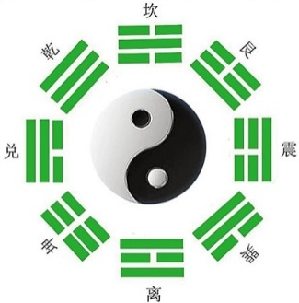
How do we represent data in a computer?
Great Idea from Ancient Chinese Philosophy
All things come into being, all things come into nothing
_{天下万物生于有, 有生于无}
《老子·四十章》
《易经》
_{太极生两仪，}
_{两仪生四象，}
_{四象生八卦，}
_{八卦演万物。}

Slide 6
How do we represent data in a computer?
At the lowest level, a computer is an electronic machine.
  works by controlling the flow of electrons
Easy to recognize two conditions:
  presence of a voltage – we’ll call this state “1”
  absence of a voltage – we’ll call this state “0”
Could base state on value of voltage, but control and detection circuits more complex.
  compare turning on a light switch to measuring or regulating voltage
We’ll see examples of these circuits in the next chapter.
放大一亿倍，看芯片内部的工作原理！（完整篇）

Slide 7
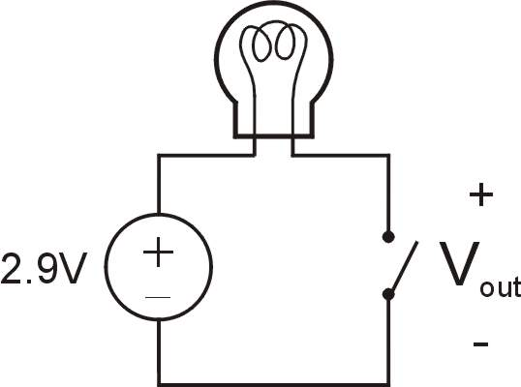
Simple Switch Circuit
Switch open:
  No current through circuit
  Light is off
  V_{out} is +2.9V
Switch closed:
  Short circuit across switch
  Current flows
  Light is on
  V_{out} is 0V
Switch-based circuits can easily represent two states:
on/off, open/closed, voltage/no voltage.
Notes:
7

Slide 8
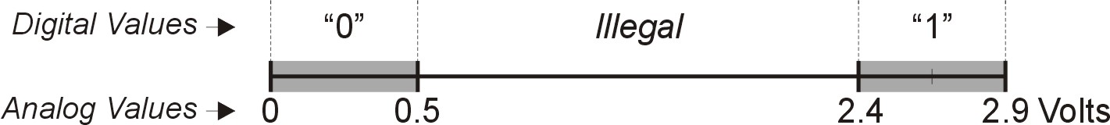
Computer is a binary digital system.
Digital system:
  finite number of symbols
Binary (base two) system:
  has two states: 0 and 1
Basic unit of information is the binary digit, or bit.
Values with more than two states require multiple bits.
  A collection of two bits has four possible states:
  00, 01, 10, 11
  A collection of three bits has eight possible states:
  000, 001, 010, 011, 100, 101, 110, 111
  A collection of n bits has 2^{n} possible states.
Notes:
8

Slide 9
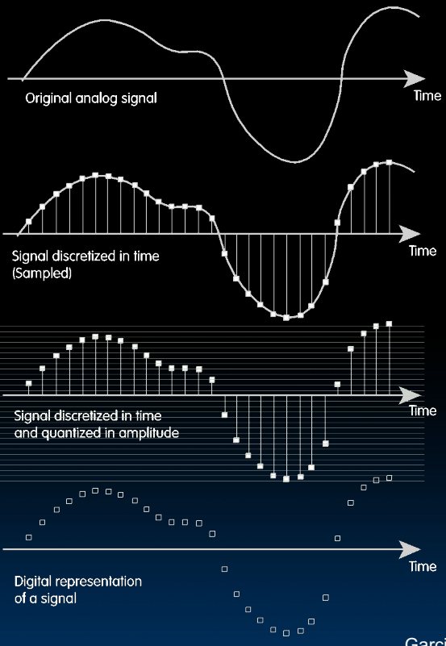
Data input: Analog → Digital
Real world is analog!
To import analog information, we must do two things
  Sample
    E.g., for a CD, every 44,100 ths of a second, we ask a music signal how loud it is.
  Quantize
    For every one of these samples, we figure out where, on a 16-bit (65,536 tic-mark)
Notes:
模拟信号是指用连续变化的物理量表示的信息，其信号的幅度，或频率，或相位随时间作连续变化，或在一段连续的时间间隔内，其代表信息的特征量可以在任意瞬间呈现为任意数值的信号。

Slide 10

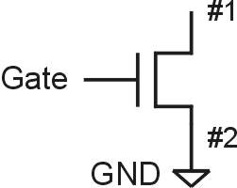
N-type MOS Transistor
Gate = 1
Gate = 0
Terminal #2 must be
connected to GND (0V).
MOS = Metal Oxide Semiconductor
  two types: N-type and P-type
N-type
  when Gate has positive voltage,
  short circuit between #1 and #2
  (switch closed)
  when Gate has zero voltage,
  open circuit between #1 and #2
  (switch open)
Notes:
10
short circuit ：短路

Slide 11
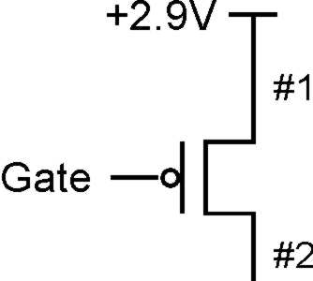
P-type MOS Transistor
Gate = 1
Gate = 0
Terminal #1 must be
connected to +2.9V.
P-type is complementary to N-type
  when Gate has positive voltage,
  open circuit between #1 and #2
  (switch open)
  when Gate has zero voltage,
  short circuit between #1 and #2
  (switch closed)
Notes:
11

Slide 12
Logic Gates
Use switch behavior of MOS transistors
to implement logical functions: AND, OR, NOT.
Digital symbols:
  recall that we assign a range of analog voltages to each digital (logic) symbol
  assignment of voltage ranges depends on
  electrical properties of transistors being used
    typical values for "1": +5V, +3.3V, +2.9V, +1.1V
    for purposes of illustration, we'll use +2.9V

Slide 13
Within the Computer: Everything is a Number.
Numbers within the Computer
  Base 10 #s: Dec(imal )
    Digits: 0,1,2,3,4,5,6,7,8,9
  Base 2 #s: Bin(ary)
    Digits: 0,1
  Base 8 #s: Oct(al)
    Digits: 0,1,2,3,4,5,6,7
  Base 16 #s: Hex(adecimal)
    Digits: 0,1,2,3,4,5,6,7,8,9,A,B,C,D,E,F
Dec(imal ) | Hex(adecimal) | Oct(al) | Bin(ary)
00 | 0 | 00 | 0000
01 | 1 | 01 | 0001
02 | 2 | 02 | 0010
03 | 3 | 03 | 0011
04 | 4 | 04 | 0100
05 | 5 | 05 | 0101
06 | 6 | 06 | 0110
07 | 7 | 07 | 0111
08 | 8 | 10 | 1000
09 | 9 | 11 | 1001
10 | A | 12 | 1010
11 | B | 13 | 1011
12 | C | 14 | 1100
13 | D | 15 | 1101
14 | E | 16 | 1110
15 | F | 17 | 1111

Slide 14
Hexadecimal Notation
Binary | Hex | Decimal
0000 | 0 | 0
0001 | 1 | 1
0010 | 2 | 2
0011 | 3 | 3
0100 | 4 | 4
0101 | 5 | 5
0110 | 6 | 6
0111 | 7 | 7
Binary | Hex | Decimal
1000 | 8 | 8
1001 | 9 | 9
1010 | A | 10
1011 | B | 11
1100 | C | 12
1101 | D | 13
1110 | E | 14
1111 | F | 15
It is often convenient to write binary (base-2) numbers
as hexadecimal (base-16) numbers instead.
  fewer digits -- four bits per hex digit
  less error prone -- easy to corrupt long string of 1’s and 0’s
Notes:
14

Slide 15
011101010001111010011010111
Notes:
15

Slide 16
Converting from Binary to Hexadecimal
Every four bits is a hex digit.
  start grouping from right-hand side
011101010001111010011010111
3
A
8
F
4
D
7
Notes:
16

Slide 17
Converting from Binary to Hexadecimal
Every four bits is a hex digit.
  start grouping from right-hand side
3
A
8
F
4
D
7
This is not a new machine representation,
just a convenient way to write the number.
Notes:
17

Slide 18
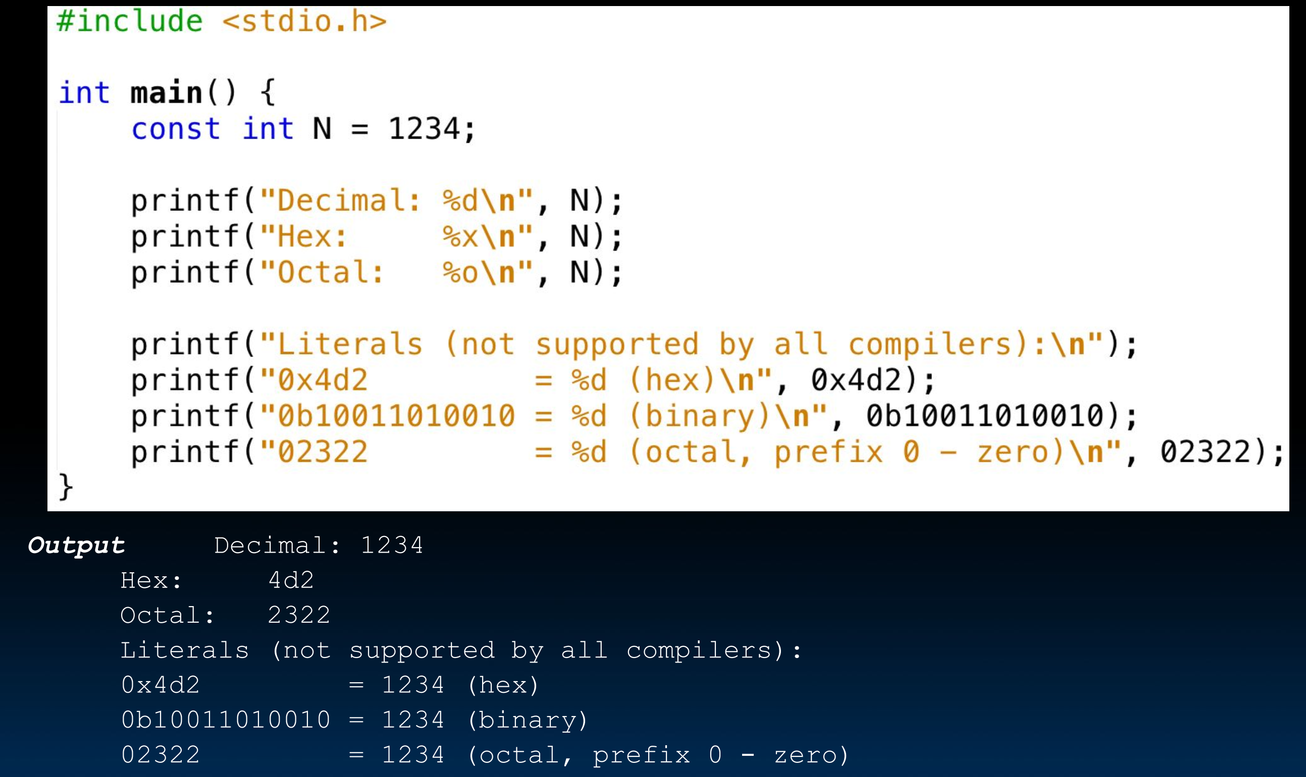
Within the Computer: Everything is a Number.
Which base do we use?
  Decimal: great for humans, especially when doing
  arithmetic
  Hex: if human looking at long strings of binary
  numbers, its much easier to convert to hex and see
  4 bits/symbol
    Terrible for arithmetic on paper
  Binary: what computers use; you will learn how computers do +, -, *, /
    To a computer, numbers always binary
    Regardless of how number is written:
    32_{ten} == 32₁₀ == 0x20 == 100000₂ == 0b100000
    Use subscripts “ten”, “hex”, “two” in book, slides when might be confusing

Slide 19
Within the Computer: Everything is a Number.
Bit(BInary digiT)
  1Bits=2things;
  2Bits=4things;
  4Bits=16things;
  8Bits=256things
  ……
Byte
  1Byte=8Bits
  A byte is 8 bits
But numbers usually stored with a fixed size
  8-bit bytes;
  16-bit half words;
  32-bit words;
  64-bit double words, ...
  And there are really only two primitive "numbers": 0 and 1 is a "bit"

Slide 20

BIG IDEA：Bits can represent anything!!!
Characters?
  26 letters ⇒ 5 bits (2⁵ = 32)
  upper/lower case + punctuation（符号） ⇒ 7 bits (in 8)(“ASCII”)
  standard code to cover all the world’s languages ⇒ 8,16,32 bits (“Unicode”) www.unicode.com
Logical values?
  0 → False, 1 → True
colors ?
  Ex: Red(00),Green(01),Blue(11)
locations / addresses?
commands?
MEMORIZE: N bits ⇔ at most 2^{N} things

Slide 21
What kinds of data do we need to represent?
Kinds of data
  Numbers – signed, unsigned, integers, floating point, complex, rational, irrational, …
  Text – characters, strings, …
  Logical – true, false
  Images – pixels, colors, shapes, …
  Sound
  Video – a series of images
  Instructions
  …
Data type: representation and operations within the computer
We’ll start with numbers…
Notes:
21

Slide 22
Outline
1
How do we represent data in a computer?
2
Integer Data Types
3
2’Complement Integers
4
Binary-Decimal Conversion

Slide 23
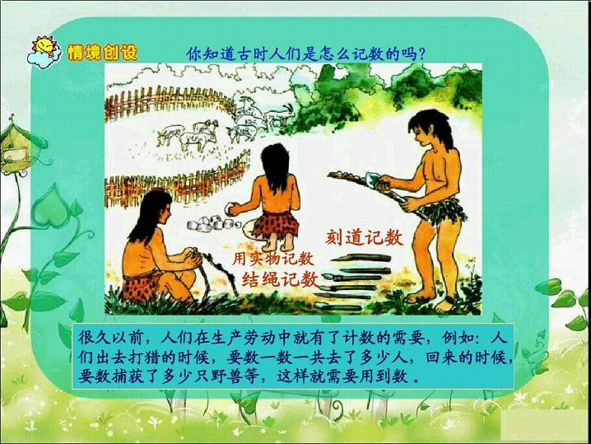
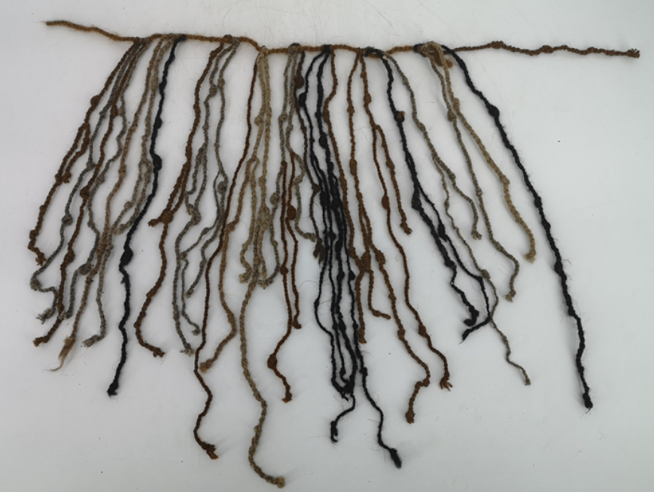
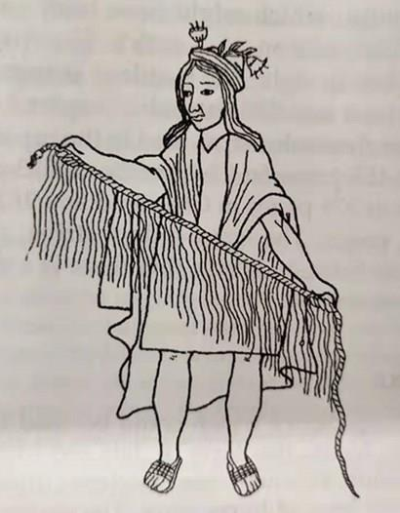
结绳记数
名称：（Quipu）基普结绳
产地：南美印加部落
时间：16世纪
Non-positional notation 非位置
  Could represent a number (“5”) with a string of ones (“11111”) problems?

Slide 24
Unsigned Integers
Weighted positional notation
  like decimal numbers: “329”
  “3” is worth 300, because of its position, while “9” is only worth 9
MSB LSB
most
significant
least
significant
329
101
10²
10¹
10⁰
2²
2¹
2⁰
3x100 + 2x10 + 9x1 = 329
1x4 + 0x2 + 1x1 = 5

Slide 25
Unsigned Integers (cont.)
2² | 2¹ | 2⁰
0 | 0 | 0 | 0
0 | 0 | 1 | 1
0 | 1 | 0 | 2
0 | 1 | 1 | 3
1 | 0 | 0 | 4
1 | 0 | 1 | 5
1 | 1 | 0 | 6
1 | 1 | 1 | 7
An n-bit unsigned integer represents 2^{n} values:
from 0 to 2^{n}-1.
Notes:
25

Slide 26
Unsigned Binary Arithmetic
Base-2 addition – just like base-10!
  add from right to left, propagating carry
carry
10010 10010 1111
+ 1001 + 1011 + 1
11011 11101 10000
10111
+ 111
Subtraction, multiplication, division,…
Notes:
26

Slide 27
Unsigned Integers (cont.)

Slide 28
Signed Integers
With n bits, we have 2^{n} distinct values.
  assign about half to positive integers (1 through 2^{n-1})
  and about half to negative (- 2^{n-1} through -1)
  that leaves two values: one for 0, and one extra
Positive integers
  just like unsigned – zero in Most Significant（MS） bit
  00101 = 5
Negative integers
  sign-magnitude (原码) – set top bit to show negative, other bits are the same as unsigned
  10101 = -5
  one’s complement (反码) – flip every bit to represent negative
  11010 = -5
  in either case, MS bit indicates sign: 0=positive, 1=negative
Notes:
符号幅度

Slide 29
Three representations of signed integers
Representation | Value Represented
 | Signed Magnitude | 1’s Complement | 2’s Complement
00000 | 0 | 0 | 0
00001 | 1 | 1 | 1
00010 | 2 | 2 | 2
00011 | 3 | 3 | 3
00100 | 4 | 4 | 4
00101 | 5 | 5 | 5
00110 | 6 | 6 | 6
00111 | 7 | 7 | 7
01000 | 8 | 8 | 8
01001 | 9 | 9 | 9
01010 | 10 | 10 | 10
01011 | 11 | 11 | 11
01100 | 12 | 12 | 12
01101 | 13 | 13 | 13
01110 | 14 | 14 | 14
01111 | 15 | 15 | 15
Representation | Value Represented
 | Signed Magnitude | 1’s Complement | 2’s Complement
10000 | ―0 | ―15 | ―16
10001 | ―1 | ―14 | ―15
10010 | ―2 | ―13 | ―14
10011 | ―3 | ―12 | ―13
10100 | ―4 | ―11 | ―12
10101 | ―5 | ―10 | ―11
10110 | ―6 | ―9 | ―10
10111 | ―7 | ―8 | ―9
11000 | ―8 | ―7 | ―8
11001 | ―9 | ―6 | ―7
11010 | ―10 | ―5 | ―6
11011 | ―11 | ―4 | ―5
11100 | ―12 | ―3 | ―4
11101 | ―13 | ―2 | ―3
11110 | ―14 | ―1 | ―2
11111 | ―15 | ―0 | ―1
原码
Signed Magnitude：
5 ― 5 = ― 10
反码
1’s Complement：
5 ― 5 = ― 0
00101 (5)
+ 10101 (-5)
11010 (-10)
00101 (5)
+ 11010 (-5)
11111 (-0)

Slide 30
Outline
1
How do we represent data in a computer?
2
Integer Data Types
3
2’Complement Integers
4
Binary-Decimal Conversion

Slide 31
Two’s Complement Representation（补码）
00101 (5) 01001 (9)
11010 (1’s comp) (1’s comp)
+ 1 + 1
11011 (-5) (-9)
If number is positive or zero,
  normal binary representation, zeroes in upper bit(s)
If number is negative,
  start with positive number
  flip every bit (i.e., take the one’s complement)
  then add one
This representation makes the hardware simple!
Notes:
31
01001 (9)
10110 (1’s c)
+ 1
---------
10111 (-9)
Mathematically, 2^n - M

Slide 32
Two’s Complement
Problems with sign-magnitude and 1’s complement
  two representations of zero (+0 and –0)
  arithmetic circuits are complex
    How to add two sign-magnitude numbers?
      e.g., try 2 + (-3)
    How to add two one’s complement numbers?
      e.g., try 4 + (-3)
Two’s complement representation developed to make circuits easy for arithmetic.
  for each positive number (X), assign value to its negative (-X), such that X + (-X) = 0 with “normal” addition, ignoring carry out
00101 (5) 01001 (9)
+ 11011 (-5) + (-9)
00000 (0) 00000 (0)
Notes:
32
Sign-magnitude 2 + (-3): convert to subtraction based on sign bit
111
0 010 010
+1 011 - 011
----------- ---------
111
result is really: 2 + (-3) + 8 (or 2^3 for last borrow) = 7
So we have to correct by subtracting from 8: 8 – 7 = 1 is correct magnitude
Hence we need to choose add vs subtract based on sign bit
Then we need to correct magnitude if a final borrow occurred
One’s complement:
If (N>M) result should be positive with magnitude N-M
N + {M} = N + (2^n – 1 – M) = (2^n – 1) + (N – M)
So to get N-M we must subtract (2^n – 1) from result,
i.e. throw out the end-carry (2^n) and add one
(end-around carry correction step)
11 000
0 100
+1 100
----------
10 000
(correction step)
+1
---------
0001
If (M>N), e.g. 3 + (-4), result (M-N)
will be negative; expressed as 1’s
complement what we want is 2^n – 1 – (M – N) = N – M + 2^n – 1
Just as above, this is what we get.
0011
+1011
---------
1110 => this is one’s complement of 1, or -1
Hence no correction step is needed, since there was no final
Borrow.

Slide 33
Two’s Complement Shortcut
011010000 011010000
100101111 (1’s comp)
+ 1
100110000 100110000
(flip)
(copy)
To take the two’s complement of a number:
  copy bits from right to left until (and including) the first “1”
  flip remaining bits to the left
Notes:
33

Slide 34
Two’s Complement Signed Integers
MS bit is sign bit – it has weight –2^{n-1}.
Range of an n-bit number: -2^{n-1} through 2^{n-1} – 1.
  The most negative number (-2^{n-1}) has no positive counterpart.
-2³ | 2² | 2¹ | 2⁰
0 | 0 | 0 | 0 | 0
0 | 0 | 0 | 1 | 1
0 | 0 | 1 | 0 | 2
0 | 0 | 1 | 1 | 3
0 | 1 | 0 | 0 | 4
0 | 1 | 0 | 1 | 5
0 | 1 | 1 | 0 | 6
0 | 1 | 1 | 1 | 7
-2³ | 2² | 2¹ | 2⁰
1 | 0 | 0 | 0 | -8
1 | 0 | 0 | 1 | -7
1 | 0 | 1 | 0 | -6
1 | 0 | 1 | 1 | -5
1 | 1 | 0 | 0 | -4
1 | 1 | 0 | 1 | -3
1 | 1 | 1 | 0 | -2
1 | 1 | 1 | 1 | -1
Notes:
34

Slide 35
Three representations of signed integers
Representation | Value Represented
 | Signed Magnitude | 1’s Complement | 2’s Complement
00000 | 0 | 0 | 0
00001 | 1 | 1 | 1
00010 | 2 | 2 | 2
00011 | 3 | 3 | 3
00100 | 4 | 4 | 4
00101 | 5 | 5 | 5
00110 | 6 | 6 | 6
00111 | 7 | 7 | 7
01000 | 8 | 8 | 8
01001 | 9 | 9 | 9
01010 | 10 | 10 | 10
01011 | 11 | 11 | 11
01100 | 12 | 12 | 12
01101 | 13 | 13 | 13
01110 | 14 | 14 | 14
01111 | 15 | 15 | 15
Representation | Value Represented
 | Signed Magnitude | 1’s Complement | 2’s Complement
10000 | ―0 | ―15 | ―16
10001 | ―1 | ―14 | ―15
10010 | ―2 | ―13 | ―14
10011 | ―3 | ―12 | ―13
10100 | ―4 | ―11 | ―12
10101 | ―5 | ―10 | ―11
10110 | ―6 | ―9 | ―10
10111 | ―7 | ―8 | ―9
11000 | ―8 | ―7 | ―8
11001 | ―9 | ―6 | ―7
11010 | ―10 | ―5 | ―6
11011 | ―11 | ―4 | ―5
11100 | ―12 | ―3 | ―4
11101 | ―13 | ―2 | ―3
11110 | ―14 | ―1 | ―2
11111 | ―15 | ―0 | ―1
Signed Magnitude：
5 ― 5 = ― 10
1’s Complement：
5 ― 5 = ― 0
2’s Complement：
5 ― 5 = 0
00101 (5)
+ 10101 (-5)
11010 (-10)
00101 (5)
+ 11010 (-5)
11111 (-0)
00101 (5)
+ 11011 (-5)
00000 (0)

Slide 36
Two’s Complement

Slide 37
Q&A
Suppose we had a 5-bit word. What integers can be represented in two’s complement?
  -32~+31
  0~+31
  -16~+15
  -15~+16
Suppose we had a 8-bit word. What integers can be represented in two’s complement?
Suppose we had a 16-bit word. What integers can be represented in two’s complement?
Suppose we had a 32-bit word. What integers can be represented in two’s complement?

Slide 38
Q&A
Suppose we had a 5-bit word. What integers can be represented in two’s complement?
  -32~+31
  0~+31
  -16~+15
  -15~+16
Suppose we had a 8-bit word. What integers can be represented in two’s complement?
Suppose we had a 16-bit word. What integers can be represented in two’s complement?
Suppose we had a 32-bit word. What integers can be represented in two’s complement?

Slide 39
Outline
1
How do we represent data in a computer?
2
Integer Data Types
3
2’Complement Integers
4
Binary-Decimal Conversion

Slide 40
Converting Binary (2’s C) to Decimal
If leading bit is one, take two’s complement to get a positive number.
Add powers of 2 that have “1” in the
corresponding bit positions.
If original number was negative,
add a minus sign.
n | 2^{n}
0 | 1
1 | 2
2 | 4
3 | 8
4 | 16
5 | 32
6 | 64
7 | 128
8 | 256
9 | 512
10 | 1024
X = 01101000two
= 2⁶+2⁵+2³ = 64+32+8
= 104ten
Assuming 8-bit 2’s complement numbers.
Notes:
40

Slide 41
More Examples
X = 00100111two
= 2⁵+2²+2¹+2⁰ = 32+4+2+1
= 39ten
n | 2^{n}
0 | 1
1 | 2
2 | 4
3 | 8
4 | 16
5 | 32
6 | 64
7 | 128
8 | 256
9 | 512
10 | 1024
X = 11100110two
-X = 00011010
= 2⁴+2³+2¹ = 16+8+2
= 26ten
X = -26ten
Assuming 8-bit 2’s complement numbers.
Notes:
41

Slide 42
Converting Decimal to Binary (2’s C)
First Method: Division
Divide by two – remainder is least significant bit.
Keep dividing by two until answer is zero,
writing remainders from right to left.
Append a zero as the MS bit; if original number negative, take two’s complement.
X = 104ten 104/2 = 52 r 0 bit 0
52/2 = 26 r 0 bit 1
26/2 = 13 r 0 bit 2
13/2 = 6 r 1 bit 3
6/2 = 3 r 0 bit 4
3/2 = 1 r 1 bit 5
X = 01101000two 1/2 = 0 r 1 bit 6
Notes:
42

Slide 43
Converting Decimal to Binary (2’s C)
Second Method: Subtract Powers of Two
Change to positive decimal number.
Subtract largest power of two
less than or equal to number.
Put a one in the corresponding bit position.
Keep subtracting until result is zero.
Append a zero as MS bit;
if original was negative, take two’s complement.
n | 2^{n}
0 | 1
1 | 2
2 | 4
3 | 8
4 | 16
5 | 32
6 | 64
7 | 128
8 | 256
9 | 512
10 | 1024
X = 104ten 104 - 64 = 40 bit 6
40 - 32 = 8 bit 5
8 - 8 = 0 bit 3
X = 01101000two
Notes:
43

Slide 44
Signed and Unsigned Integers
C, C++, and Java have signed integers, e.g., 7, -255
  int x, y, z;
C, C++ also have unsigned integers, which are used for addresses
32-bit word can represent 2³² binary numbers
Unsigned integers in 32 bit word represent 0 to 2³²-1 (4,294,967,295)

