Slide 1
Chapter 9-3
Interrupt-Driven I/O
计算系统概论A
Introduction to Computing Systems
（ CS1002A.03 ）
陈俊仕
cjuns@ustc.edu.cn
2024 Fall
计算机科学与技术学院
School of Computer Science and Technology

Slide 2
Outline
1
1
Review
Review
2
2
From ENIAC to the Stored Program Computer
Interrupt-Driven I/O
2
3
From ENIAC to the Stored Program Computer
Input/Output

Slide 3
What is Interrupt-Driven I/O?
Program A is executing instruction n
Program A is executing instruction n+1
Program A is executing instruction n+2
Program A is executing instruction n+3
Program A is executing instruction n+4
  ……
  ……
  ……

Slide 4
What is Interrupt-Driven I/O?
Program A is executing instruction n
Program A is executing instruction n+1
Program A is executing instruction n+2
Interrupt!!!
Program A is executing instruction n+3
Program A is executing instruction n+4
  ……
  ……
  ……

Slide 5
What is Interrupt-Driven I/O?
Program A is executing instruction n
Program A is executing instruction n+1
Program A is executing instruction n+2
1: Interrupt signal is detected
1: Program A is put into suspended animation
1: PC is loaded with the starting address of Program B
2: Program B starts satisfying I/O device’s needs
2: Program B continues satisfying I/O device’s needs
2: Program B continues satisfying I/O device’s needs
2: Program B finishes satisfying I/O device’s needs
3: Program A is brought back to life
Program A is executing instruction n+3
Program A is executing instruction n+4
  ……
  ……
  ……

Slide 6
When and Why to Use Interrupts
When timing of external event is uncertain
  Example: incoming packet from network
  TRAP vs. Interrupt, 12.5s vs. 0.00001s @ 100 char read from KB
When device operation takes a long time
  Example: start a disk transfer,
  disk interrupts when transfer is finished
  processor can do something else in the meantime
When event is rare but critical
  Example: building on fire -- save and shut down!

Slide 7
How to implement an interrupt
To implement an interrupt mechanism, we need:
  A way for the I/O device to signal the CPU that an interesting event has occurred.
  A way for the CPU to test whether the interrupt signal is set.
Generating Signal
  Software sets "interrupt enable(IE)" bit in device register.
  When ready bit is set and IE bit is set, interrupt is signaled.
interrupt enable bit
15
0
14
13
ready bit
KBSR
interrupt signal
to processor

Slide 8
Interrupt-Driven I/O
Testing for Interrupt Signal
  CPU looks at signal between STORE and FETCH phases
  If not set, continues with next instruction
  If set, transfers control to Interrupt Service Routine(ISR)
F
NO
D
interrupt
signal?
Transfer to
ISR
YES
EA
OP
EX
More details in Chapter 10.
S

Slide 9
Interrupt-Driven I/O
Timing of I/O controlled by device
  1. Report: Tells processor when something interesting happens
    Example: when character is entered on keyboard
    Example: when monitor is ready for next character
    Example: when block has been transferred from disk to memory
  2. Processing: Processor interrupts its normal instruction processing and executes a Interrupt Service Routine(ISR) (like a TRAP)
    1. Figure out what device is causing the interrupt
    2. Execute routine to deal with event
    3. Resume execution
No need for processor to poll device
  Can perform other useful work
Interrupt is an unscripted subroutine call,
triggered by an external event

Slide 10
How is Interrupt Signaled?
External interrupt signal by Devices: INT
  Device sets INT=1 when it wants to cause an interrupt
Interrupt vector: INTV
  8-bit signal for device to identify itself
  Also used as entry into Interrupt Vector Table, which gives starting address of Interrupt Service Routine (ISR)
    Just like Trap Vector Table and Trap Service Routine
    TVT: x0000 to x00FF
    IVT: x0100 to x01FF

Slide 11
Memory Model in the LC-3
0x0000
Trap Vector Table
0x00FF
IVT
0x0100
Interrupt Vector Table
0x01FF
0x0200
Operating System
and Supervisor Stack
0x2FFF
0x3000
Program Text
PC
Global data section
R4(Global pointer)
Function1
R6
Heap (for dynamically
allocated memory)
R5
Function2
R6
R5
Run-time stack
R6 (stack pointer)
0xFDFF
R5 (frame pointer)
Function3
R6
0xFE00
Device Register
Addresses
0xFFFF
R5

Slide 12
Interrupt Signal to CPU
Several things must be true for an I/O device to actually interrupt the processor (ALL the three elements are present)
  The I/O device must want service(ready bit = 1)
  The device must have the right to request the service(interrupt enable bit = 1).
  The device request must be more urgent than what the processor is currently doing.

Slide 13
Interrupt Signal to CPU
At the device side(I/O device set)
  Control register has “Interrupt Enable” bit
  Must be set for interrupt to be generated
At the processor(CPU set)
  Sometimes have “Interrupt Mask” register (LC-3 does not)
  When set, processor ignores INT signal
  Why? - Example: may not want to be interrupted while in ISR
CPU set: interrupt enable bit
15
0
14
13
I/O device set: ready bit
KBSR
interrupt signal
to processor(INT)

Slide 14
The Processor State Register(PSR)
The Processor Status Register
15
14
13
12
11
10
9
8
7
6
5
4
3
2
1
0
Pr
PL
N
Z
P
PSR
Priv Mode
Priority Level
Cond Codes
PSR[15]
  0, privileged (supervisor) mode
  1, unprivileged(user)mode
The Priority Level of a program being executed
  PL[10:8]
  0(最低)~7(最高)

Slide 15
Generation of the Interrupt Signal to CPU
What if more than one device wants to interrupt?
  External logic controls which one gets to drive signals
14
0
13
PL1
Device
Priority encoder
PL of executing program
14
0
13
PL2
Device
B
A
INT
?
A>B
…...
14
0
13
PL7
Device
Notes:
PL；Priority Level

Slide 16
Testing for Interrupt Signal
CPU looks at signal between STORE and FETCH phases
If not set, continues with next instruction
If set, transfers control to interrupt service routine
F
NO
D
interrupt
signal?
Transfer to
ISR
YES
EA
OP
EX
S

Slide 17
How Does Processor Handle It?
Examines INT signal just before starting FETCH phase
  If INT=1, don’t fetch next instruction
  Instead
    Save program state (PC, PSR (privilege and CCs)) on stack
    Update PSR (set privilege bit)
    Index INTV into IVT to get start address of ISR (put in PC)
After service routine
  RTI instruction restores PSR and PC from stack
  Need a different return instruction, because
    RET gets PC from R7 and doesn’t update PSR
Processor only checks between STORE and FETCH phases -- Why?

Slide 18
Supervisor Mode and the Stack
Problem
  PC and PSR shouldn’t be saved on user stack
  What if R6 is uninitialized?
  What if user has set R6 to refer to OS memory?
  User could see OS data (when trap returns)
Solution
  Create two versions of R6 (stack pointer) in register file
    One is user stack pointer (what we’ve been using all along)
    The other is supervisor stack pointer
  Extra register file logic selects the appropriate register based on privilege bit in current PSR
  Bottom line: OS code always uses its own stack

Slide 19
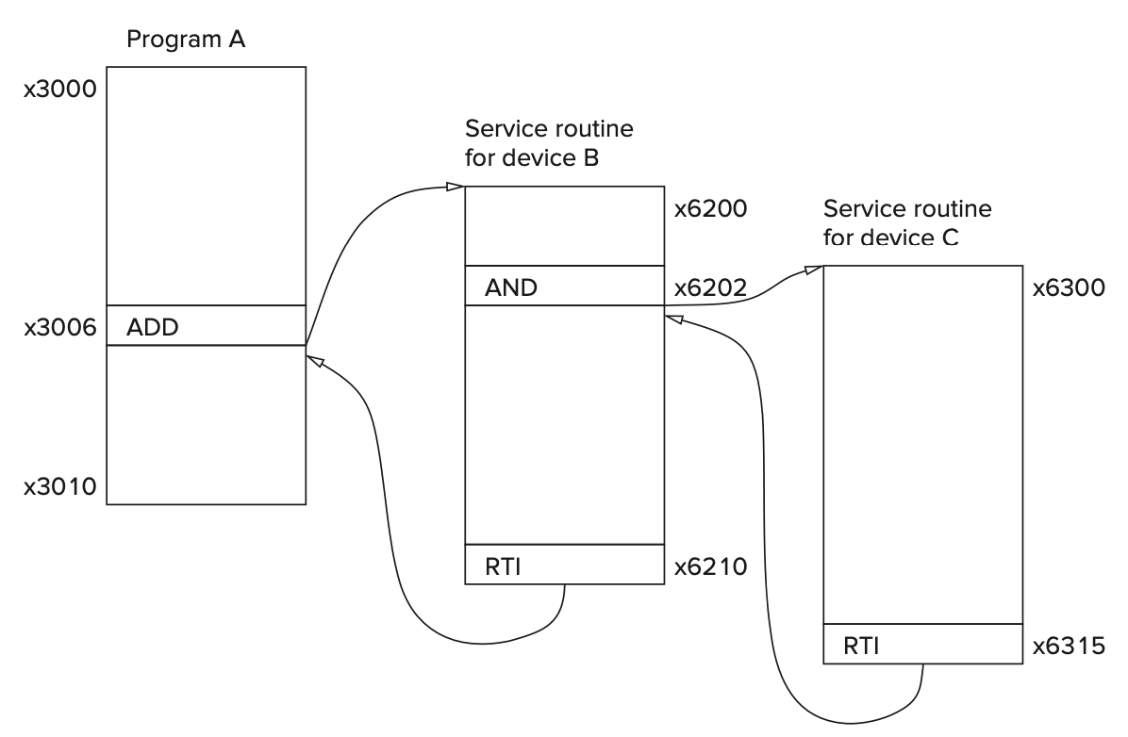
An Example (0)

Slide 20
An Example (1)
x8001

Slide 21
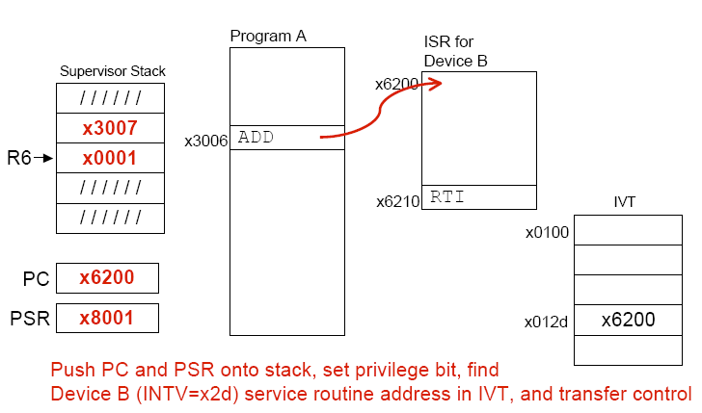
An Example (2)
x8001
x0001

Slide 22
An Example (3)
x8001
x0002

Slide 23
An Example (4)
x8001
x0002
x0002

Slide 24
An Example (5)
x8001
x0002
x0002

Slide 25
An Example (6)
x8001
x8001

