Slide 1
Chapter 16
Pointers and Arrays
计算系统概论A
Introduction to Computing Systems
（ CS1002A）
苗付友 fy@ustc.edu.cn
2024 Fall
计算机科学与技术学院
School of Computer Science and Technology

Slide 2
Outline
1
1
Review
Review
2
2
From ENIAC to the Stored Program Computer
Pointers
2
3
From ENIAC to the Stored Program Computer
Arrays
2
4
From ENIAC to the Stored Program Computer
Summary

Slide 3
Outline
1
1
Review
Review
2
From ENIAC to the Stored Program Computer
Pointers
3
From ENIAC to the Stored Program Computer
Arrays
4
From ENIAC to the Stored Program Computer
Summary

Slide 4
Memory Model in the LC-3
0x0000
Trap Vector Table
0x00FF
0x0100
Interrupt Vector Table
0x01FF
0x0200
Operating System
and Supervisor Stack
0x2FFF
0x3000
Program Text
PC
Global data section
R4(Global pointer)
Function1
R6
Heap (for dynamically
allocated memory)
R5
Function2
R6
R5
Run-time stack
R6 (stack pointer)
0xFDFF
R5 (frame pointer)
Function3
R6
0xFE00
Device Register
Addresses
0xFFFF
R5

Slide 5
Run-Time Stack
1 int main(void)
2 {
3 int a;
4 int b;
5
6 b = Watt(a); // main calls Watt first
7 b = Volt(a, b); // then calls Volt
8 }
9
10 int Watt(int a)
11 {
12 int w;
13
14 w = Volt(w, 10); // Watt calls Volt
15
16 return w;
17 }
18
19 int Volt(int q; int r)
20 {
21 int k;
22 int m;
23
24 return k;
25 }

Slide 6
Run-time stack when execution starts
1 int main(void)
2 {
3 int a;
4 int b;
5
6 b = Watt(a); // main calls Watt first
7 b = Volt(a, b); // then calls Volt
8 }
9
10 int Watt(int a)
11 {
12 int w;
13
14 w = Volt(w, 10); // Watt calls Volt
15
16 return w;
17 }
18
19 int Volt(int q; int r)
20 {
21 int k;
22 int m;
23
24 return k;
25 }
x0000
Memory
R6
main
R5
xFFFF

Slide 7
Run-time stack when Watt executes
1 int main(void)
2 {
3 int a;
4 int b;
5
6 b = Watt(a); // main calls Watt first
7 b = Volt(a, b); // then calls Volt
8 }
9
10 int Watt(int a)
11 {
12 int w;
13
14 w = Volt(w, 10); // Watt calls Volt
15
16 return w;
17 }
18
19 int Volt(int q; int r)
20 {
21 int k;
22 int m;
23
24 return k;
25 }
x0000
Memory
R6
Watt
R5
main
xFFFF

Slide 8
Run-time stack when Volt executes
1 int main(void)
2 {
3 int a;
4 int b;
5
6 b = Watt(a); // main calls Watt first
7 b = Volt(a, b); // then calls Volt
8 }
9
10 int Watt(int a)
11 {
12 int w;
13
14 w = Volt(w, 10); // Watt calls Volt
15
16 return w;
17 }
18
19 int Volt(int q; int r)
20 {
21 int k;
22 int m;
23
24 return k;
25 }
x0000
Memory
R6
Volt
R5
Watt
main
xFFFF

Slide 9
Run-time stack after Volt completes
1 int main(void)
2 {
3 int a;
4 int b;
5
6 b = Watt(a); // main calls Watt first
7 b = Volt(a, b); // then calls Volt
8 }
9
10 int Watt(int a)
11 {
12 int w;
13
14 w = Volt(w, 10); // Watt calls Volt
15
16 return w;
17 }
18
19 int Volt(int q; int r)
20 {
21 int k;
22 int m;
23
24 return k;
25 }
x0000
Memory
R6
Watt
R5
main
xFFFF

Slide 10
Run-time stack after Watt completes
1 int main(void)
2 {
3 int a;
4 int b;
5
6 b = Watt(a); // main calls Watt first
7 b = Volt(a, b); // then calls Volt
8 }
9
10 int Watt(int a)
11 {
12 int w;
13
14 w = Volt(w, 10); // Watt calls Volt
15
16 return w;
17 }
18
19 int Volt(int q; int r)
20 {
21 int k;
22 int m;
23
24 return k;
25 }
x0000
Memory
R6
main
R5
xFFFF

Slide 11
Run-time stack when Volt executes
1 int main(void)
2 {
3 int a;
4 int b;
5
6 b = Watt(a); // main calls Watt first
7 b = Volt(a, b); // then calls Volt
8 }
9
10 int Watt(int a)
11 {
12 int w;
13
14 w = Volt(w, 10); // Watt calls Volt
15
16 return w;
17 }
18
19 int Volt(int q; int r)
20 {
21 int k;
22 int m;
23
24 return k;
25 }
x0000
Memory
R6
Volt
R5
main
xFFFF

Slide 12
Run-time stack after Volt completes
1 int main(void)
2 {
3 int a;
4 int b;
5
6 b = Watt(a); // main calls Watt first
7 b = Volt(a, b); // then calls Volt
8 }
9
10 int Watt(int a)
11 {
12 int w;
13
14 w = Volt(w, 10); // Watt calls Volt
15
16 return w;
17 }
18
19 int Volt(int q; int r)
20 {
21 int k;
22 int m;
23
24 return k;
25 }
x0000
Memory
R6
main
R5
xFFFF

Slide 13
Function call in C
Four steps of the C-runtime stack protocol
  The caller copies arguments for the callee onto the run-time stack and passes control to the callee
  The callee function pushes space for local variables and other info. onto the run-time stack, creating its stack frame on top of the stack
  The callee executes the task
  Once it is ready to return, the callee removes, or pops, its stack frame oﬀ the run-time stack and returns the return value and control to the caller

Slide 14
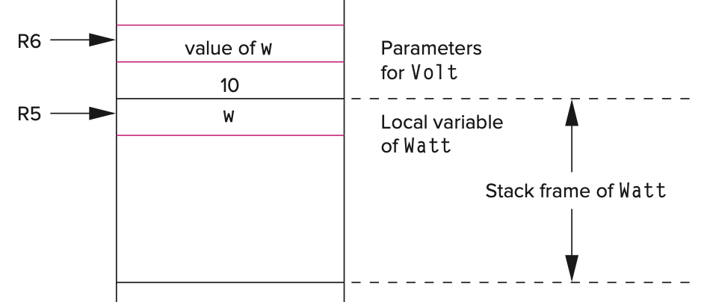
Function call in C
Four steps of the C-runtime stack protocol
  The caller copies arguments for the callee onto the run-time stack and passes control to the callee
10 int Watt(int a)
11 {
12 int w;
13
14 w = Volt(w, 10);
15
16 return w;
17 }
18
19 int Volt(int q; int r)
20 {
21 int k;
22 int m;
23
24 return k;
25 }
AND R0,R0,#0 ; R0 <- 0
ADD R0,R0,#10 ; R0 <- 10
ADD R6,R6,#-1 ;
STR R0,R6,#0 ; Push 10 onto stack
LDR R0,R5,#0 ; Load w
ADD R6,R6,#-1 ;
STR R0,R6,#0 ; Push w
JSR Volt
x0000
R6
w
Local variable
of Watt
R5
Stack frame
of Watt
xFFFF

Slide 15
Function call in C
Four steps of the C-runtime stack protocol
  The caller copies arguments for the callee onto the run-time stack and passes control to the callee
10 int Watt(int a)
11 {
12 int w;
13
14 w = Volt(w, 10);
15
16 return w;
17 }
18
19 int Volt(int q; int r)
20 {
21 int k;
22 int m;
23
24 return k;
25 }
AND R0,R0,#0 ; R0 <- 0
ADD R0,R0,#10 ; R0 <- 10
ADD R6,R6,#-1 ;
STR R0,R6,#0 ; Push 10 onto stack
LDR R0,R5,#0 ; Load w
ADD R6,R6,#-1 ;
STR R0,R6,#0 ; Push w
JSR Volt
x0000
Parameters
for Watt
R6
10
R5
w
Local variable
of Watt
Stack frame
of Watt
xFFFF

Slide 16
Function call in C
Four steps of the C-runtime stack protocol
  The caller copies arguments for the callee onto the run-time stack and passes control to the callee
10 int Watt(int a)
11 {
12 int w;
13
14 w = Volt(w, 10);
15
16 return w;
17 }
18
19 int Volt(int q; int r)
20 {
21 int k;
22 int m;
23
24 return k;
25 }
AND R0,R0,#0 ; R0 <- 0
ADD R0,R0,#10 ; R0 <- 10
ADD R6,R6,#-1 ;
STR R0,R6,#0 ; Push 10 onto stack
LDR R0,R5,#0 ; Load w
ADD R6,R6,#-1 ;
STR R0,R6,#0 ; Push w
JSR Volt
x0000
R6
value of w
Parameters
for Watt
10
R5
w
Local variable
of Watt
Stack frame
of Watt
xFFFF

Slide 17
Function call in C
Four steps of the C-runtime stack protocol
  The caller copies arguments for the callee onto the run-time stack and passes control to the callee
10 int Watt(int a)
11 {
12 int w;
13
14 w = Volt(w, 10);
15
16 return w;
17 }
18
19 int Volt(int q; int r)
20 {
21 int k;
22 int m;
23
24 return k;
25 }
AND R0,R0,#0 ; R0 <- 0
ADD R0,R0,#10 ; R0 <- 10
ADD R6,R6,#-1 ;
STR R0,R6,#0 ; Push 10 onto stack
LDR R0,R5,#0 ; Load w
ADD R6,R6,#-1 ;
STR R0,R6,#0 ; Push w
JSR Volt
x0000
R6
value of w
Parameters
for Watt
10
R5
w
Local variable
of Watt
Stack frame
of Watt
xFFFF

Slide 18
Function call in C
Four steps of the C-runtime stack protocol
  The callee function pushes space for local variables and other info. onto the run-time stack, creating its stack frame on top of the stack
10 int Watt(int a)
11 {
12 int w;
13
14 w = Volt(w, 10);
15
16 return w;
17 }
18
19 int Volt(int q, int r)
20 {
21 int k;
22 int m;
23
24 return k;
25 }
Volt:
ADD R6,R6,#-1 ; alloc. spot for the
; return value
ADD R6,R6,#-1 ;
STR R7,R6,#0 ; push R7 (return addr.)
ADD R6,R6,#-1
STR R5,R6,#0 ; push R5
; (caller's frame pointer)
ADD R5,R6,#-1 ; set frame pointer for Volt
ADD R6,R6,#-2 ; alloc. memory for
; Volt's local variables
x0000
R6
value of w
Parameters
for Watt
10
R5
w
Local variable
of Watt
Stack frame
of Watt
xFFFF

Slide 19
Function call in C
Four steps of the C-runtime stack protocol
  The callee function pushes space for local variables and other info. onto the run-time stack, creating its stack frame on top of the stack
Volt:
ADD R6,R6,#-1 ; alloc. spot for the
; return value
ADD R6,R6,#-1 ;
STR R7,R6,#0 ; push R7 (return addr.)
ADD R6,R6,#-1
STR R5,R6,#0 ; push R5
; (caller's frame pointer)
ADD R5,R6,#-1 ; set frame pointer for Volt
ADD R6,R6,#-2 ; alloc. memory for
; Volt's local variables
x0000
Stack frame
of Volt
R6
value of w
Parameters
for Watt
18
19 int Volt(int q, int r)
20 {
21 int k;
22 int m;
23
24 return k;
25 }
10
R5
w
Local variable
of Watt
Stack frame
of Watt
xFFFF

Slide 20
Function call in C
Four steps of the C-runtime stack protocol
  The callee function pushes space for local variables and other info. onto the run-time stack, creating its stack frame on top of the stack
Volt:
ADD R6,R6,#-1 ; alloc. spot for the
; return value
ADD R6,R6,#-1 ;
STR R7,R6,#0 ; push R7 (return addr.)
ADD R6,R6,#-1
STR R5,R6,#0 ; push R5
; (caller's frame pointer)
ADD R5,R6,#-1 ; set frame pointer for Volt
ADD R6,R6,#-2 ; alloc. memory for
; Volt's local variables
x0000
Bookkeeping
info
R6
Ret. value to Watt
Stack frame
of Volt
value of w
Parameters
for Watt
18
19 int Volt(int q, int r)
20 {
21 int k;
22 int m;
23
24 return k;
25 }
10
R5
w
Local variable
of Watt
Stack frame
of Watt
xFFFF

Slide 21
Function call in C
Four steps of the C-runtime stack protocol
  The callee function pushes space for local variables and other info. onto the run-time stack, creating its stack frame on top of the stack
Volt:
ADD R6,R6,#-1 ; alloc. spot for the
; return value
ADD R6,R6,#-1 ;
STR R7,R6,#0 ; push R7 (return addr.)
ADD R6,R6,#-1
STR R5,R6,#0 ; push R5
; (caller's frame pointer)
ADD R5,R6,#-1 ; set frame pointer for Volt
ADD R6,R6,#-2 ; alloc. memory for
; Volt's local variables
x0000
R6
Ret. addr. for Watt
Bookkeeping
info
Ret. value to Watt
Stack frame
of Volt
value of w
Parameters
for Watt
18
19 int Volt(int q, int r)
20 {
21 int k;
22 int m;
23
24 return k;
25 }
10
R5
w
Local variable
of Watt
Stack frame
of Watt
xFFFF

Slide 22
Function call in C
Four steps of the C-runtime stack protocol
  The callee function pushes space for local variables and other info. onto the run-time stack, creating its stack frame on top of the stack
Volt:
ADD R6,R6,#-1 ; alloc. spot for the
; return value
ADD R6,R6,#-1 ;
STR R7,R6,#0 ; push R7 (return addr.)
ADD R6,R6,#-1
STR R5,R6,#0 ; push R5
; (caller's frame pointer)
ADD R5,R6,#-1 ; set frame pointer for Volt
ADD R6,R6,#-2 ; alloc. memory for
; Volt's local variables
x0000
R6
Watt’s frame pointer
Ret. addr. for Watt
Bookkeeping
info
Ret. value to Watt
Stack frame
of Volt
value of w
Parameters
for Watt
18
19 int Volt(int q, int r)
20 {
21 int k;
22 int m;
23
24 return k;
25 }
10
R5
w
Local variable
of Watt
Stack frame
of Watt
xFFFF

Slide 23
Function call in C
Four steps of the C-runtime stack protocol
  The callee function pushes space for local variables and other info. onto the run-time stack, creating its stack frame on top of the stack
Volt:
ADD R6,R6,#-1 ; alloc. spot for the
; return value
ADD R6,R6,#-1 ;
STR R7,R6,#0 ; push R7 (return addr.)
ADD R6,R6,#-1
STR R5,R6,#0 ; push R5
; (caller's frame pointer)
ADD R5,R6,#-1 ; set frame pointer for Volt
ADD R6,R6,#-2 ; alloc. memory for
; Volt's local variables
x0000
Local variables
R5
k
R6
Watt’s frame pointer
Ret. addr. for Watt
Bookkeeping
info
Ret. value to Watt
Stack frame
of Volt
value of w
Parameters
for Watt
18
19 int Volt(int q, int r)
20 {
21 int k;
22 int m;
23
24 return k;
25 }
10
w
Local variable
of Watt
Stack frame
of Watt
xFFFF

Slide 24
Function call in C
Four steps of the C-runtime stack protocol
  The callee function pushes space for local variables and other info. onto the run-time stack, creating its stack frame on top of the stack
Volt:
ADD R6,R6,#-1 ; alloc. spot for the
; return value
ADD R6,R6,#-1 ;
STR R7,R6,#0 ; push R7 (return addr.)
ADD R6,R6,#-1
STR R5,R6,#0 ; push R5
; (caller's frame pointer)
ADD R5,R6,#-1 ; set frame pointer for Volt
ADD R6,R6,#-2 ; alloc. memory for
; Volt's local variables
x0000
R6
m
Local variables
R5
k
Watt’s frame pointer
Ret. addr. for Watt
Bookkeeping
info
Ret. value to Watt
Stack frame
of Volt
value of w
Parameters
for Watt
18
19 int Volt(int q, int r)
20 {
21 int k;
22 int m;
23
24 return k;
25 }
10
w
Local variable
of Watt
Stack frame
of Watt
xFFFF

Slide 25
Function call in C
Four steps of the C-runtime stack protocol
  The callee executes the task
10 int Watt(int a)
11 {
12 int w;
13
14 w = Volt(w, 10);
15
16 return w;
17 }
18
19 int Volt(int q; int r)
20 {
21 int k;
22 int m;
23
24 return k;
25 }

Slide 26
Function call in C
Four steps of the C-runtime stack protocol
  Once it is ready to return, the callee removes, or pops, its stack frame oﬀ the run-time stack and returns the return value and control to the caller
LDR R0,R5,#0 ; Load local variable k
STR R0,R5,#3 ; Write it in return value slot, which
; will always be at location R5 + 3
ADD R6,R5,#1 ; Pop local variables
LDR R5,R6,#0 ; Pop the frame pointer
ADD R6,R6,#1 ;
LDR R7,R6,#0 ; Pop the return address
ADD R6,R6,#1 ;
RET
x0000
R6
m
Local variables
R5
k
Watt’s frame pointer
Ret. addr. for Watt
Bookkeeping
info
Ret. value to Watt
Stack frame
of Volt
value of w
Parameters
for Watt
19 int Volt(int q; int r)
20 {
21 int k;
22 int m;
23
24 return k;
25 }
10
w
Local variable
of Watt
Stack frame
of Watt
xFFFF

Slide 27
Function call in C
Four steps of the C-runtime stack protocol
  Once it is ready to return, the callee removes, or pops, its stack frame oﬀ the run-time stack and returns the return value and control to the caller
LDR R0,R5,#0 ; Load local variable k
STR R0,R5,#3 ; Write it in return value slot, which
; will always be at location R5 + 3
ADD R6,R5,#1 ; Pop local variables
LDR R5,R6,#0 ; Pop the frame pointer
ADD R6,R6,#1 ;
LDR R7,R6,#0 ; Pop the return address
ADD R6,R6,#1 ;
RET
x0000
R6
m
Local variables
R5
k
Watt’s frame pointer
Ret. addr. for Watt
Bookkeeping
info
Ret. value to Watt (k)
Stack frame
of Volt
value of w
Parameters
for Watt
19 int Volt(int q; int r)
20 {
21 int k;
22 int m;
23
24 return k;
25 }
10
w
Local variable
of Watt
Stack frame
of Watt
xFFFF

Slide 28
Function call in C
Four steps of the C-runtime stack protocol
  Once it is ready to return, the callee removes, or pops, its stack frame oﬀ the run-time stack and returns the return value and control to the caller
LDR R0,R5,#0 ; Load local variable k
STR R0,R5,#3 ; Write it in return value slot, which
; will always be at location R5 + 3
ADD R6,R5,#1 ; Pop local variables
LDR R5,R6,#0 ; Pop the frame pointer
ADD R6,R6,#1 ;
LDR R7,R6,#0 ; Pop the return address
ADD R6,R6,#1 ;
RET
x0000
m
Local variables
R5
k
R6
Watt’s frame pointer
Ret. addr. for Watt
Bookkeeping
info
Ret. value to Watt (k)
Stack frame
of Volt
value of w
Parameters
for Watt
19 int Volt(int q; int r)
20 {
21 int k;
22 int m;
23
24 return k;
25 }
10
w
Local variable
of Watt
Stack frame
of Watt
xFFFF

Slide 29
Function call in C
Four steps of the C-runtime stack protocol
  Once it is ready to return, the callee removes, or pops, its stack frame oﬀ the run-time stack and returns the return value and control to the caller
LDR R0,R5,#0 ; Load local variable k
STR R0,R5,#3 ; Write it in return value slot, which
; will always be at location R5 + 3
ADD R6,R5,#1 ; Pop local variables
LDR R5,R6,#0 ; Pop the frame pointer
ADD R6,R6,#1 ;
LDR R7,R6,#0 ; Pop the return address
ADD R6,R6,#1 ;
RET
x0000
m
Local variables
k
R6
Watt’s frame pointer
Ret. addr. for Watt
Bookkeeping
info
Ret. value to Watt (k)
Stack frame
of Volt
value of w
Parameters
for Watt
19 int Volt(int q; int r)
20 {
21 int k;
22 int m;
23
24 return k;
25 }
10
R5
w
Local variable
of Watt
Stack frame
of Watt
xFFFF

Slide 30
Function call in C
Four steps of the C-runtime stack protocol
  Once it is ready to return, the callee removes, or pops, its stack frame oﬀ the run-time stack and returns the return value and control to the caller
LDR R0,R5,#0 ; Load local variable k
STR R0,R5,#3 ; Write it in return value slot, which
; will always be at location R5 + 3
ADD R6,R5,#1 ; Pop local variables
LDR R5,R6,#0 ; Pop the frame pointer
ADD R6,R6,#1 ;
LDR R7,R6,#0 ; Pop the return address
ADD R6,R6,#1 ;
RET
x0000
m
Local variables
k
Watt’s frame pointer
R6
Ret. addr. for Watt
Bookkeeping
info
Ret. value to Watt (k)
Stack frame
of Volt
value of w
Parameters
for Watt
19 int Volt(int q; int r)
20 {
21 int k;
22 int m;
23
24 return k;
25 }
10
R5
w
Local variable
of Watt
Stack frame
of Watt
xFFFF

Slide 31
Function call in C
Four steps of the C-runtime stack protocol
  Once it is ready to return, the callee removes, or pops, its stack frame oﬀ the run-time stack and returns the return value and control to the caller
LDR R0,R5,#0 ; Load local variable k
STR R0,R5,#3 ; Write it in return value slot, which
; will always be at location R5 + 3
ADD R6,R5,#1 ; Pop local variables
LDR R5,R6,#0 ; Pop the frame pointer
ADD R6,R6,#1 ;
LDR R7,R6,#0 ; Pop the return address
ADD R6,R6,#1 ;
RET
x0000
m
Local variables
k
Watt’s frame pointer
R6
Ret. addr. for Watt
Bookkeeping
info
Ret. value to Watt (k)
Stack frame
of Volt
value of w
Parameters
for Watt
19 int Volt(int q; int r)
20 {
21 int k;
22 int m;
23
24 return k;
25 }
10
R5
w
Local variable
of Watt
Stack frame
of Watt
xFFFF

Slide 32
Function call in C
Four steps of the C-runtime stack protocol
  Once it is ready to return, the callee removes, or pops, its stack frame oﬀ the run-time stack and returns the return value and control to the caller
LDR R0,R5,#0 ; Load local variable k
STR R0,R5,#3 ; Write it in return value slot, which
; will always be at location R5 + 3
ADD R6,R5,#1 ; Pop local variables
LDR R5,R6,#0 ; Pop the frame pointer
ADD R6,R6,#1 ;
LDR R7,R6,#0 ; Pop the return address
ADD R6,R6,#1 ;
RET
x0000
m
Local variables
k
Watt’s frame pointer
Ret. addr. for Watt
Bookkeeping
info
R6
Ret. value to Watt (k)
Stack frame
of Volt
value of w
Parameters
for Watt
19 int Volt(int q; int r)
20 {
21 int k;
22 int m;
23
24 return k;
25 }
10
R5
w
Local variable
of Watt
Stack frame
of Watt
xFFFF

Slide 33
Function call in C
Four steps of the C-runtime stack protocol
  Once it is ready to return, the callee removes, or pops, its stack frame oﬀ the run-time stack and returns the return value and control to the caller
LDR R0,R5,#0 ; Load local variable k
STR R0,R5,#3 ; Write it in return value slot, which
; will always be at location R5 + 3
ADD R6,R5,#1 ; Pop local variables
LDR R5,R6,#0 ; Pop the frame pointer
ADD R6,R6,#1 ;
LDR R7,R6,#0 ; Pop the return address
ADD R6,R6,#1 ;
RET
x0000
m
Local variables
k
Watt’s frame pointer
Ret. addr. for Watt
Bookkeeping
info
R6
Ret. value to Watt (k)
Stack frame
of Volt
value of w
Parameters
for Watt
19 int Volt(int q; int r)
20 {
21 int k;
22 int m;
23
24 return k;
25 }
10
R5
w
Local variable
of Watt
Stack frame
of Watt
xFFFF

Slide 34
Function call in C
Four steps of the C-runtime stack protocol
  Once it is ready to return, the callee removes, or pops, its stack frame oﬀ the run-time stack and returns the return value and control to the caller
JSR Volt
LDR R0,R6,#0 ; Load the return value
STR R0,R5,#0 ; w = Volt(w, 10);
ADD R6,R6,#1 ; Pop return value
ADD R6,R6,#2 ; Pop arguments
x0000
m
Local variables
k
Watt’s frame pointer
Ret. addr. for Watt
Bookkeeping
info
R6
Ret. value to Watt (k)
Stack frame
of Volt
value of w
Parameters
for Watt
10 int Watt(int a)
11 {
12 int w;
13
14 w = Volt(w, 10);
15
16 return w;
17 }
10
R5
w
Local variable
of Watt
Stack frame
of Watt
xFFFF

Slide 35
Function call in C
Four steps of the C-runtime stack protocol
  Once it is ready to return, the callee removes, or pops, its stack frame oﬀ the run-time stack and returns the return value and control to the caller
JSR Volt
LDR R0,R6,#0 ; Load the return value
STR R0,R5,#0 ; w = Volt(w, 10);
ADD R6,R6,#1 ; Pop return value
ADD R6,R6,#2 ; Pop arguments
x0000
m
Local variables
k
Watt’s frame pointer
Ret. addr. for Watt
Bookkeeping
info
R6
Ret. value to Watt (k)
Stack frame
of Volt
value of w
Parameters
for Watt
10 int Watt(int a)
11 {
12 int w;
13
14 w = Volt(w, 10);
15
16 return w;
17 }
10
R5
w
Local variable
of Watt
Stack frame
of Watt
xFFFF

Slide 36
Function call in C
Four steps of the C-runtime stack protocol
  Once it is ready to return, the callee removes, or pops, its stack frame oﬀ the run-time stack and returns the return value and control to the caller
JSR Volt
LDR R0,R6,#0 ; Load the return value
STR R0,R5,#0 ; w = Volt(w, 10);
ADD R6,R6,#1 ; Pop return value
ADD R6,R6,#2 ; Pop arguments
x0000
m
Local variables
k
Watt’s frame pointer
Ret. addr. for Watt
Bookkeeping
info
R6
Ret. value to Watt (k)
Stack frame
of Volt
value of w
Parameters
for Watt
10 int Watt(int a)
11 {
12 int w;
13
14 w = Volt(w, 10);
15
16 return w;
17 }
10
R5
w (k)
Local variable
of Watt
Stack frame
of Watt
xFFFF

Slide 37
Function call in C
Four steps of the C-runtime stack protocol
  Once it is ready to return, the callee removes, or pops, its stack frame oﬀ the run-time stack and returns the return value and control to the caller
JSR Volt
LDR R0,R6,#0 ; Load the return value
STR R0,R5,#0 ; w = Volt(w, 10);
ADD R6,R6,#1 ; Pop return value
ADD R6,R6,#2 ; Pop arguments
x0000
m
Local variables
k
Watt’s frame pointer
Ret. addr. for Watt
Bookkeeping
info
Ret. value to Watt (k)
Stack frame
of Volt
R6
value of w
Parameters
for Watt
10 int Watt(int a)
11 {
12 int w;
13
14 w = Volt(w, 10);
15
16 return w;
17 }
10
R5
w (k)
Local variable
of Watt
Stack frame
of Watt
xFFFF

Slide 38
Function call in C
Four steps of the C-runtime stack protocol
  Once it is ready to return, the callee removes, or pops, its stack frame oﬀ the run-time stack and returns the return value and control to the caller
JSR Volt
LDR R0,R6,#0 ; Load the return value
STR R0,R5,#0 ; w = Volt(w, 10);
ADD R6,R6,#1 ; Pop return value
ADD R6,R6,#2 ; Pop arguments
x0000
m
Local variables
k
Watt’s frame pointer
Ret. addr. for Watt
Bookkeeping
info
Ret. value to Watt (k)
Stack frame
of Volt
value of w
Parameters
for Watt
10 int Watt(int a)
11 {
12 int w;
13
14 w = Volt(w, 10);
15
16 return w;
17 }
10
R6
w (k)
Local variable
of Watt
R5
Stack frame
of Watt
xFFFF

Slide 39
Function call in C
Four steps of the C-runtime stack protocol
  Once it is ready to return, the callee removes, or pops, its stack frame oﬀ the run-time stack and returns the return value and control to the caller
JSR Volt
LDR R0,R6,#0 ; Load the return value
STR R0,R5,#0 ; w = Volt(w, 10);
ADD R6,R6,#1 ; Pop return value
ADD R6,R6,#2 ; Pop arguments
x0000
10 int Watt(int a)
11 {
12 int w;
13
14 w = Volt(w, 10);
15
16 return w;
17 }
R6
w (k)
Local variable
of Watt
R5
Stack frame
of Watt
xFFFF

Slide 40
Outline
1
Review
Review
2
2
From ENIAC to the Stored Program Computer
Pointers
3
Arrays
4
From ENIAC to the Stored Program Computer
Summary

Slide 41
A classic example --‘Swap’
1 #include <stdio.h>
2
3 // Swap has no return value thus is declared as void
4 void Swap(int firstVal, int secondVal);
5
6 int main(void)
7 {
8 int valueA = 3;
9 int valueB = 4;
10
11 printf("Before Swap ");
12 printf("valueA = %d and valueB = %d\n", valueA, valueB);
13
14 Swap(valueA, valueB);
15
16 printf("After Swap ");
17 printf("valueA = %d and valueB = %d\n", valueA, valueB);
18 }
19
20 void Swap(int firstVal, int secondVal)
21 {
22 int tempVal; // Holds firstVal when swapping
23
24 tempVal = firstVal;
25 firstVal = secondVal;
26 secondVal = tempVal;
27 }
x0000
Run-time stack
R6
4
valueB
R5
3
valueA
Stack frame
for main
xFFFF

Slide 42
A classic example --‘Swap’
1 #include <stdio.h>
2
3 // Swap has no return value thus is declared as void
4 void Swap(int firstVal, int secondVal);
5
6 int main(void)
7 {
8 int valueA = 3;
9 int valueB = 4;
10
11 printf("Before Swap ");
12 printf("valueA = %d and valueB = %d\n", valueA, valueB);
13
14 Swap(valueA, valueB);
15
16 printf("After Swap ");
17 printf("valueA = %d and valueB = %d\n", valueA, valueB);
18 }
19
20 void Swap(int firstVal, int secondVal)
21 {
22 int tempVal; // Holds firstVal when swapping
23
24 tempVal = firstVal;
25 firstVal = secondVal;
26 secondVal = tempVal;
27 }
x0000
Run-time stack
R6
tempVal
R5
main’s frame pointer
Return address in main
Stack frame
for Swap
Return value to main
3
firstVal
4
secondVal
4
valueB
3
valueA
Stack frame
for main
xFFFF

Slide 43
A classic example --‘Swap’
1 #include <stdio.h>
2
3 // Swap has no return value thus is declared as void
4 void Swap(int firstVal, int secondVal);
5
6 int main(void)
7 {
8 int valueA = 3;
9 int valueB = 4;
10
11 printf("Before Swap ");
12 printf("valueA = %d and valueB = %d\n", valueA, valueB);
13
14 Swap(valueA, valueB);
15
16 printf("After Swap ");
17 printf("valueA = %d and valueB = %d\n", valueA, valueB);
18 }
19
20 void Swap(int firstVal, int secondVal)
21 {
22 int tempVal; // Holds firstVal when swapping
23
24 tempVal = firstVal;
25 firstVal = secondVal;
26 secondVal = tempVal;
27 }
x0000
Run-time stack
R6
3
tempVal
R5
main’s frame pointer
Return address in main
Stack frame
for Swap
Return value to main
3
firstVal
4
secondVal
4
valueB
3
valueA
Stack frame
for main
xFFFF

Slide 44
A classic example --‘Swap’
1 #include <stdio.h>
2
3 // Swap has no return value thus is declared as void
4 void Swap(int firstVal, int secondVal);
5
6 int main(void)
7 {
8 int valueA = 3;
9 int valueB = 4;
10
11 printf("Before Swap ");
12 printf("valueA = %d and valueB = %d\n", valueA, valueB);
13
14 Swap(valueA, valueB);
15
16 printf("After Swap ");
17 printf("valueA = %d and valueB = %d\n", valueA, valueB);
18 }
19
20 void Swap(int firstVal, int secondVal)
21 {
22 int tempVal; // Holds firstVal when swapping
23
24 tempVal = firstVal;
25 firstVal = secondVal;
26 secondVal = tempVal;
27 }
x0000
Run-time stack
R6
3
tempVal
R5
main’s frame pointer
Return address in main
Stack frame
for Swap
Return value to main
4
firstVal
4
secondVal
4
valueB
3
valueA
Stack frame
for main
xFFFF

Slide 45
A classic example --‘Swap’
1 #include <stdio.h>
2
3 // Swap has no return value thus is declared as void
4 void Swap(int firstVal, int secondVal);
5
6 int main(void)
7 {
8 int valueA = 3;
9 int valueB = 4;
10
11 printf("Before Swap ");
12 printf("valueA = %d and valueB = %d\n", valueA, valueB);
13
14 Swap(valueA, valueB);
15
16 printf("After Swap ");
17 printf("valueA = %d and valueB = %d\n", valueA, valueB);
18 }
19
20 void Swap(int firstVal, int secondVal)
21 {
22 int tempVal; // Holds firstVal when swapping
23
24 tempVal = firstVal;
25 firstVal = secondVal;
26 secondVal = tempVal;
27 }
x0000
Run-time stack
R6
3
tempVal
R5
main’s frame pointer
Return address in main
Stack frame
for Swap
Return value to main
4
firstVal
3
secondVal
4
valueB
3
valueA
Stack frame
for main
xFFFF

Slide 46
A classic example --‘Swap’
1 #include <stdio.h>
2
3 // Swap has no return value thus is declared as void
4 void Swap(int firstVal, int secondVal);
5
6 int main(void)
7 {
8 int valueA = 3;
9 int valueB = 4;
10
11 printf("Before Swap ");
12 printf("valueA = %d and valueB = %d\n", valueA, valueB);
13
14 Swap(valueA, valueB);
15
16 printf("After Swap ");
17 printf("valueA = %d and valueB = %d\n", valueA, valueB);
18 }
19
20 void Swap(int firstVal, int secondVal)
21 {
22 int tempVal; // Holds firstVal when swapping
23
24 tempVal = firstVal;
25 firstVal = secondVal;
26 secondVal = tempVal;
27 }
x0000
Run-time stack
R6
3
tempVal
R5
main’s frame pointer
Return address in main
Stack frame
for Swap
Return value to main
4
firstVal
3
secondVal
4
valueB
3
valueA
Stack frame
for main
xFFFF

Slide 47
Pointers
Declaring Pointer Variables
  point to the variable whose address it contains
  Example:
    int *ptr;
    char *cp;
    double *dp;
C has two pointer-related operators
  Address operator: &
  Indirection/dereference operator: *

Slide 48
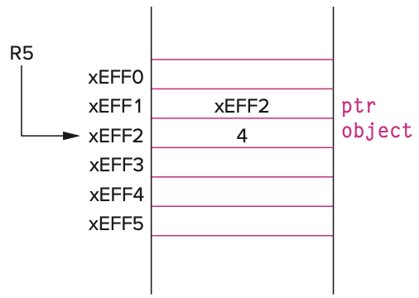
Pointer Operators (&)
The address operator: &
  Generates the memory address of its operand
  Example:
int object;
int *ptr;
object = 4;
ptr = &object;
AND R0,R0,#0 ; Clear R0
ADD R0,R0,#4 ; R0 = 4
STR R0,R5,#0 ; object = 4;
ADD R0,R5,#0 ; Generate memory
; address of object
STR R0,R5,#-1 ; Ptr = &object;

Slide 49
Pointer Operators (*)
The indirection/dereference operator: *
  Indirectly manipulate the value of a memory object
  Example:
int object;
int *ptr;
object = 4;
ptr = &object;
*ptr = *ptr + 1;
=> object = object + 1;
LDR R0,R5,#-1 ; R0 contains the
; value of ptr
LDR R1,R0,#0 ; R1 <- *ptr
ADD R1,R1,#1 ; *ptr + 1
STR R1,R0,#0 ; *ptr = *ptr + 1;
-> 5

Slide 50
Passing a Reference Using Pointers
1 #include <stdio.h>
2
3 void NewSwap(int firstVal, int secondVal);
4
5 int main(void)
6 {
7 int valueA = 3;
8 int valueB = 4;
9
10 printf("Before Swap ");
11 printf("valueA = %d and valueB = %d\n", valueA, valueB);
12
13 NewSwap(&valueA, &valueB);
14
15 printf("After Swap ");
16 printf("valueA = %d and valueB = %d\n", valueA, valueB);
17 }
18
19 void NewSwap(int *firstVal, int *secondVal)
20 {
21 int tempVal; // Holds firstVal when swapping
22
23 tempVal = *firstVal;
24 *firstVal = *secondVal;
25 *secondVal = tempVal;
26 }
Run-time stack
xEFF3
tempVal
xEFF4
main’s frame pointer
xEFF5
Return address in main
xEFF6
Return value to main
xEFF8
xEFFA
firstVal
xEFF8
xEFF9
secondVal
xEFF9
4
valueB
xEFFA
3
valueA

Slide 51
Passing a Reference Using Pointers
1 #include <stdio.h>
2
3 void NewSwap(int firstVal, int secondVal);
4
5 int main(void)
6 {
7 int valueA = 3;
8 int valueB = 4;
9
10 printf("Before Swap ");
11 printf("valueA = %d and valueB = %d\n", valueA, valueB);
12
13 NewSwap(&valueA, &valueB);
14
15 printf("After Swap ");
16 printf("valueA = %d and valueB = %d\n", valueA, valueB);
17 }
18
19 void NewSwap(int *firstVal, int *secondVal)
20 {
21 int tempVal; // Holds firstVal when swapping
22
23 tempVal = *firstVal;
24 *firstVal = *secondVal;
25 *secondVal = tempVal;
26 }
Run-time stack
xEFF3
3
tempVal
xEFF4
main’s frame pointer
xEFF5
Return address in main
xEFF6
Return value to main
xEFF8
xEFFA
firstVal
xEFF8
xEFF9
secondVal
xEFF9
4
valueB
xEFFA
3
valueA

Slide 52
Passing a Reference Using Pointers
1 #include <stdio.h>
2
3 void NewSwap(int firstVal, int secondVal);
4
5 int main(void)
6 {
7 int valueA = 3;
8 int valueB = 4;
9
10 printf("Before Swap ");
11 printf("valueA = %d and valueB = %d\n", valueA, valueB);
12
13 NewSwap(&valueA, &valueB);
14
15 printf("After Swap ");
16 printf("valueA = %d and valueB = %d\n", valueA, valueB);
17 }
18
19 void NewSwap(int *firstVal, int *secondVal)
20 {
21 int tempVal; // Holds firstVal when swapping
22
23 tempVal = *firstVal;
24 *firstVal = *secondVal;
25 *secondVal = tempVal;
26 }
Run-time stack
xEFF3
3
tempVal
xEFF4
main’s frame pointer
xEFF5
Return address in main
xEFF6
Return value to main
xEFF8
xEFFA
firstVal
xEFF8
xEFF9
secondVal
xEFF9
4
valueB
xEFFA
4
valueA

Slide 53
Passing a Reference Using Pointers
1 #include <stdio.h>
2
3 void NewSwap(int firstVal, int secondVal);
4
5 int main(void)
6 {
7 int valueA = 3;
8 int valueB = 4;
9
10 printf("Before Swap ");
11 printf("valueA = %d and valueB = %d\n", valueA, valueB);
12
13 NewSwap(&valueA, &valueB);
14
15 printf("After Swap ");
16 printf("valueA = %d and valueB = %d\n", valueA, valueB);
17 }
18
19 void NewSwap(int *firstVal, int *secondVal)
20 {
21 int tempVal; // Holds firstVal when swapping
22
23 tempVal = *firstVal;
24 *firstVal = *secondVal;
25 *secondVal = tempVal;
26 }
Run-time stack
xEFF3
3
tempVal
xEFF4
main’s frame pointer
xEFF5
Return address in main
xEFF6
Return value to main
xEFF8
xEFFA
firstVal
xEFF8
xEFF9
secondVal
xEFF9
3
valueB
xEFFA
4
valueA

Slide 54
Outline
1
Review
Review
2
From ENIAC to the Stored Program Computer
Pointers
3
3
Arrays
4
From ENIAC to the Stored Program Computer
Summary

Slide 55
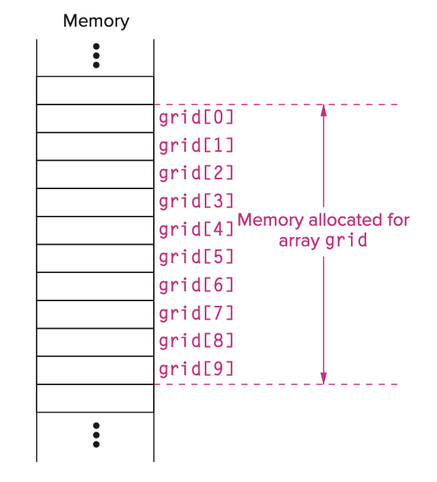
Arrays
Declaring Arrays
  Contiguous sequence of values
  Example:
    int grid[10];
  grid allocated in memory
    grid[0]…grid[9]

Slide 56
Using Arrays – Example 1
The power of arrays comes from
  compute an array index using a C integral expression
Example 1:
  grid[6] = grid[3] + 1;
ADD R0,R5,#-9 ; Put the base address
; of grid into R0
LDR R1,R0,#3 ; R1 <-- grid[3]
ADD R1,R1,#1 ; R1 <-- grid[3] + 1
STR R1,R0,#6 ; grid[6] = grid[3] + 1;
R5 →

Slide 57
Using Arrays – Example 2
Example 2:
  grid[x+1] = grid[x] + 2;
LDR R0,R5,#-10 ; Load the value of x
ADD R1,R5,#-9 ; Put the base address
; of grid into R1
ADD R1,R0,R1 ; Calc. addr. of grid[x]
LDR R2,R1,#0 ; R2 <-- grid[x]
ADD R2,R2,#2 ; R2 <-- grid[x] + 2
LDR R0,R5,#-10 ; Load the value of x
ADD R0,R0,#1 ; R0 <-- x + 1
ADD R1,R5,#-9 ; Put the base address
; of grid into R1
ADD R1,R0,R1 ; Calc. addr. of grid[x+1]
STR R2,R1,#0 ; grid[x+1] = grid[x] + 2;
x
R5 →

Slide 58
Arrays as parameters
Passing arrays between functions
  option 1: pass the entire array of values
  option 2: pass a reference to the array
  If the array contains a large number of elements
    copying each element from one stack frame onto another could be very costly in execution time
  C naturally passes arrays by reference

Slide 59
Arrays as parameters
Passing arrays between functions
  Example:
1 #include <stdio.h>
2 #define MAX_NUMS 10
3 int Average(int input_values[]);
4 int main(void)
5 {
6 int mean; // Average of numbers
7 int numbers[MAX_NUMS]; // Original input numbers
8
9 // Get input
// ...
16 mean = Average(numbers);
17 printf("The average of these numbers is %d\n", mean);
18 }
19
20 int Average(int inputValues[])
21 {
22 int sum = 0;
23 for (int index = 0; index < MAX_NUMS; index++) {
24 sum = sum + inputValues[index];
25 }
26 return (sum / MAX_NUMS);
27 }

Slide 60
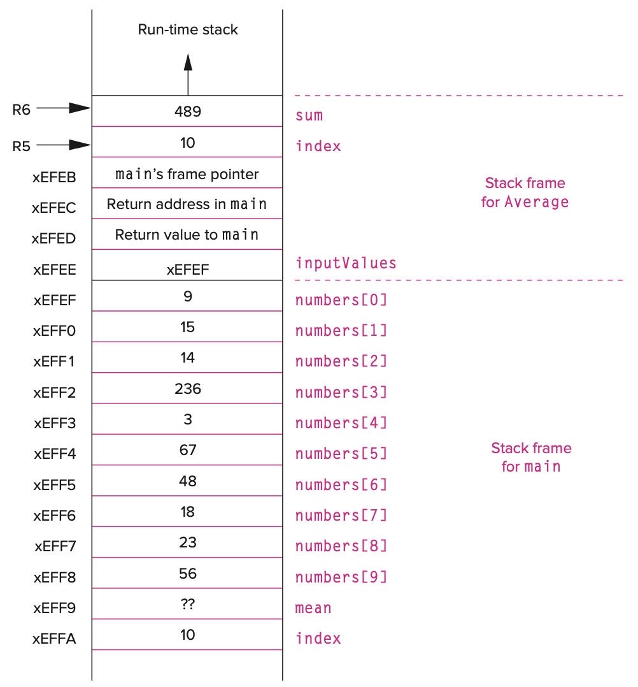
Arrays as parameters
1 #include <stdio.h>
2 #define MAX_NUMS 10
3 int Average(int input_values[]);
4 int main(void)
5 {
6 int mean; // Average of numbers
7 int numbers[MAX_NUMS]; // Original input numbers
8
9 // Get input
// ...
16 mean = Average(numbers);
17 printf("The average of these numbers is %d\n", mean);
18 }
19
20 int Average(int inputValues[])
21 {
22 int sum = 0;
23 for (int index = 0; index < MAX_NUMS; index++) {
24 sum = sum + inputValues[index];
25 }
26 return (sum / MAX_NUMS);
27 }

Slide 61
Strings in C
Strings are sequences of characters that represent text
  Example:
    char word[10];
  Array word can contain the strings
    “elephant” or “giraﬀe”, but not the entirety of “hippopotamus”
  The null character – ‘\0’ (ASCII value: 0)
    Such strings are also called null-terminated strings.
char word[10];
word[0] = 'g';
word[1] = 'i';
word[2] = 'r';
word[3] = 'a';
word[4] = 'f';
word[5] = 'f';
word[6] = 'e';
word[7] = '\0';
printf("%s", word);
char word[10] = "Hello";
printf("%s", word);

Slide 62
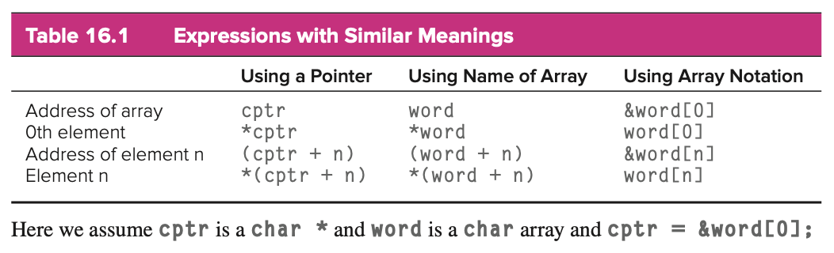
Arrays vs. Pointers in C
Example:
  Access the fourth character within the string
    word[3] or *(cptr + 3) or cptr[3]
  cptr is a variable and can be reassigned
  word is an array and cannot be reassigned
char word[10];
char *cptr;
cptr = word;

Slide 63
Variable-Length Arrays
Arrays whose sizes are variable integer expressions, rather than constants (C99 standard)
  Example:
  The size of the array data can only be determined during execution of the code, and it is not known at compile time.
Array data is still allocated on the run-time stack
  requires additional instructions during allocation and access
More general solution:
  malloc/free, new[] / delete[]
int Calculate(int len)
{
int data[len];
// ...

Slide 64
Outline
1
Review
Review
2
From ENIAC to the Stored Program Computer
Pointers
3
Arrays
4
4
From ENIAC to the Stored Program Computer
Summary

Slide 65
Summary
Two programming constructs: Pointers and arrays
  Enable us to access memory indirectly
Pointers
  Variables that contain address of other memory objects
  Indirectly access and manipulate these other objects
    Pass parameters by reference
    Construct complex data structure
Arrays
  A collection of elements that the same type arranged sequentially in memory
  Access a particular element within an array by providing an index to the element that is its offset from the beginning of the array
  A significant structure for organizing data
    Character string, vector, tensor, stack, queue, …

Slide 66
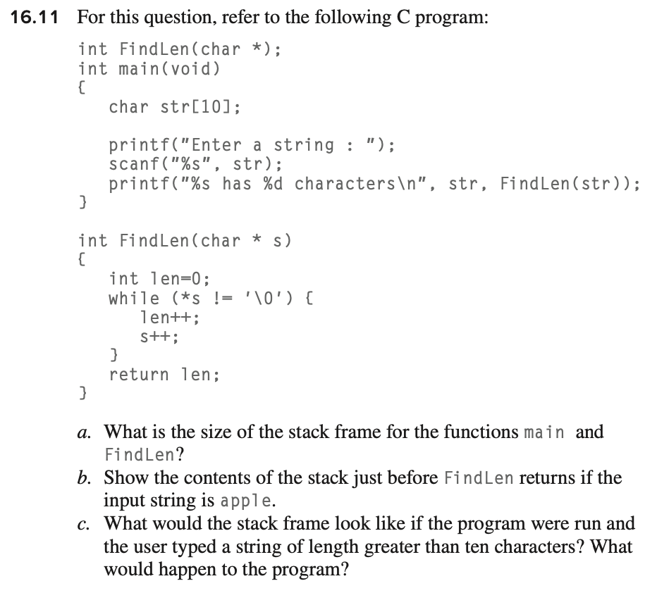
Exercise

