Slide 1
Chapters 11-13 Compiling C to Assembly – the Run-time Stack
计算系统概论A
Introduction to Computing Systems
（ CS1002A.01 ）
计算机科学与技术学院
School of Computer Science and Technology

Slide 2
Problem Transformation - levels of abstraction
How do user programs get executed?
Translation from C to Assembly
Scope of variables
Function calls
Recursion
Pointers & Arrays
Data Structures
Memory Allocation

Slide 3
Programming Languages
Assembly language is low-level.
It exposes machine instructions and details of the ISA to the programmer.
It is ISA-specific.
It is useful when the programmer needs fine-grained control of instruction flow and memory usage.
A high-level language provides a computational abstraction that is machine-independent.
Symbolic names (variables) instead of registers and memory locations.
High-level operators: multiply, divide, shift, ...

Slide 4
Why use a High-Level Language? …our choice= C
Expressiveness: say more with less effort, closer to human-level thinking
a = b * c;
 | AND R2,R2,#0
 | AND R3,R3,#0
 | LDR R0,R5,#-1 | ; b
 | BRz L3
 | BRp L1
 | NOT R3,R3
 | NOT R0,R0
L1 | ADD R0,R0,#1 LDR R1,R5,#-2 | ; c
 | BRz L5
 | BRp L2 NOT R3,R3
 | NOT R1,R1
 | ADD R1,R1,#1
L2 | ADD R2,R2,R0 | ; b * c
 | ADD R1,R1,#-1
 | BRp L2 ADD R3,R3,#0
 | BRp L3
 | NOT R2,R2
 | ADD R2,R2,#1
L3 | STR R2,R5,#0 | ; store to a
C statement
Equivalent LC-3 code
Both multiply two values together –
which is easier to understand?

Slide 5
The Evolution of Programming
Machine Assembly
Language Language
(binary)
Java Python Haskell What’s Next??
C
Simula/C++/etc

Slide 6
Quick Note: Compilation vs. Interpretation
Different ways of translating high-level language
Interpretation (LISP, Java, Python, Matlab…)
interpreter = program that executes program statements (generally one line/command at a time)
Called a Virtual Machine
easy to debug, make changes, view intermediate results
Compilation (C, C++, Pascal,…)
translates statements into machine language
does not execute, but creates executable program
performs optimization over multiple statements
Example:
X = W+W
Y = X + X
Z= Y + Y
Interpretted language: 3 instructions
Compiler optimized code: 1 instruction Z = 8*W

Slide 7
Compiling a C Program
Entire mechanism is usually called the “compiler”
Preprocessor
macro substitution
conditional compilation
“source-level” transformations
output is still C
Compiler
generates object file
machine instructions
Linker
combine object files (including libraries) into executable image
C
Source and Header Files
C Preprocessor
Compiler
Source Code Analysis
Symbol Table
Target Code Synthesis
Library Object Files
Linker
Executable Image

Slide 8
Linking, Loading,…Makefiles
Linking: produce final executable program by combining other code (libraries) used by program
Dynamic Linking: instead of linking at compile time the linking is done at run-time
Multi-file development….Makefiles assist in this
Read tutorials on makefiles
Loader: load executable image generated by linker & execute
Part of Operating system
Memory management system does the actual mapping from user space to physical addresses
.ORIG x3000 refers to user space x3000

Slide 9
Compiler
Source Code Analysis….you will learn the theory/foundation behind this in Foundations of Computing course
“front end”: parses programs to identify its pieces
variables, expressions, statements, functions, etc.
depends on language (not on target machine)
Code Generation… we will cover it implicitly in this course
“back end”: generates machine code from analyzed source
may optimize machine code to make it run more efficiently
very dependent on target machine
We will play the role of the code generation component as we discuss how different C concepts are implemented in LC3
This is what the compiler backend does
Symbol Table
map between symbolic names and items
like assembler, but more kinds of information

Slide 10
A Simple C Program
#include <stdio.h>
#define STOP 0
int scale=10;
int square(){ /* function square */
int x,y; /* two local variables */
x = scale*scale;
return(x);
}
/* Function: main */
/* Description: gets value and squares it */
main()
{ /* variable declarations */
int number, value, temp; /* three integer local variables */
/* prompt user for input */
printf("Enter a positive number: ");
scanf("%d", &value); /* read into value */
/* scale input and print */
number = value* square();
printf(”number is %d\n", number);
}

Slide 11
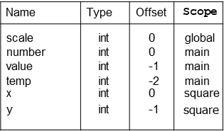
Symbol Table
Like assembler, compiler needs to know information associated with identifiers
In assembler, all identifiers are labels and information is address
Symbol table kept track of the addresses of the labels
Compiler keeps more information
Name (identifier)
Type
Location in memory
Scope

Slide 12
Implementing C: Translation from C to Assembly
Translate C to assembly
Translating operations is the easy part
Y = A*B is: MULT R3, R1, R2
Implement concept of scope
Concept of storage class
Static, Auto, Register….
Pointers
Function calls
Passing arguments to functions
…HOW ?
Starting point : How are C variables allocated to memory ?
Run-time Stack

Slide 13
Translation: Allocation of Variables
What is compiler's task?
Allocate memory for variables in a systematic way. Will build a symbol table to keep track of variable type, size, location.
Generate instruction sequences that carry out the computations specified by operators and statements.
For this class, we will compile "by hand" to get a sense of how these translations occur.

Slide 14
Start point for translation: Concept of Scope of Variable
In assembly, who has access to a memory location/variable ?
In high level programs, who has access to a variable ?
Concept of Scope of a variable
So how do we make this happen in assembly ???

Slide 15
Defining a variable in C
Identifier: references to this translate to locations
Name of the variable
Example: itslocal
Type: gives us information on data representation and space needed
Type of variable such as int, float, char…
Example: int itslocal
Scope
Where can it be accessed
Example: global variable itsglobal
Storage Class
How does C compiler allocate the storage
Does value persist or not
Two main classes in C: Automatic and Static

Slide 16
Scope: Global and Local
Where is the variable accessible?
Global: accessed anywhere in program
Local: only accessible in a particular region
Compiler infers scope from where variable is declared
programmer doesn't have to explicitly state
Symbol Table constructs this information
Variable is local to the block in which it is declared
block defined by open and closed braces { }
can access variable declared in any "containing" block
Global variable is declared outside all blocks

Slide 17
Where can you put variables….?
Local variable inside a function
Lasts only while the function is running
Local variable inside a function
Value persists throughout the life of the program
persistance
Global variable visible to all functions within a file
Global variable visible in more than one file
Block scope – inside the block (defined by { } )

Slide 18
According to the C89 Standard...
There are 4 types of scope
Prototype Scope
Just applies to prototypes
File Scope
Declared outside any function
Function Scope
only applies to labels!!!
Block Scope
includes function parameters

Slide 19
Scope vs. Lifetime
Scope
File Scope
Block Scope
Lifetime
Life of program
Life of block

Slide 20
Scope vs. Lifetime
Scope
File Scope
Block Scope
Lifetime
Life of program
Life of block
Can be overridden with “static”

Slide 21
Memory
Many languages have fixed mappings between scopes and lifetimes
In C, we have the option to decide...
void foo(void) {
int x;
static int a;
x = 42;
}
When the function goes away, x and its value go away since they were auto storage class (and placed on stack).
Setting a value into a static variable (e.g. a) means that the value is stored in a static area and will persist throughout the entire execution of the program

Slide 22
Storage Class: Automatic Variables
Local variable inside a function (lasts only while the function is running)
auto keyword (never used!)
Located on stack
Storage Class: AUTO

Slide 23
Static Variables
static
Initialized to zero (like global)
Located in static area
Value persists !
Example: foo2 being called second time
Storage Class: STATIC

Slide 24
Static Variables
Global variable visible in more than one file
Declared outside of any function in one file
Declared extern in other files (or functions/blocks)
Located in static area
Storage Class: STATIC

Slide 25
Confused?
int x;
static int y;
int main()
{
static int z;
int w;
...
static?
auto?

Slide 26
auto
int foo(int z)
{
int x;
...
if(x == z)
{
int y;
y = ...
auto variables (implicitly)

Slide 27
Static Initialization
void foo(void)
{
int x = 10;
static int y = 20;
printf (“x = %d y = %d\n”, x, y);
y += 30;
}
What prints the first time foo is called?
What prints the second time?

Slide 28
Scope can be global within a file
These are different variables with Global scope within their respective files
static int i; static int i;
int foo(...)
{
...
}
int main()
{
...
}
int bar(...)
{
...
}
int baz(...)
{
...
}

Slide 29
Scope can be global across all files
int i;
extern int i;
void f() {
extern int i;
...
...
}
These are the same variable!

Slide 30
Other goodies
register
Suggests to compiler that this variable should be kept in a register
Cannot get address of variable declared register
Not as important as it once was with modern compilers
volatile
Type qualifier
Tells compiler that value in this variable may change on its own!
Used in
shared memory applications
Memory mapped I/O
…
Read on your own ...

Slide 31
Storage Class Specifiers
register auto static
extern
const
volatile
Type Qualifiers

Slide 32
Allocation of Variables in Memory and enforcing Scoping rules
Simply assigning a memory location for each variable may not be enough to enforce scope
Need to look at a better scheme to allocate high level program variables to memory in the processor
Scope
Storage class
Allocate space to a variable

Slide 33
Mapping C variables to Memory: Allocating variables in Memory
How to allocate memory locations to variables
Enforce scope
The Run-time Stack

Slide 34
Memory Representation
Our convention will be that "high-memory" will be on the bottom and "low-memory" on top.
drawings are not to scale

Slide 35
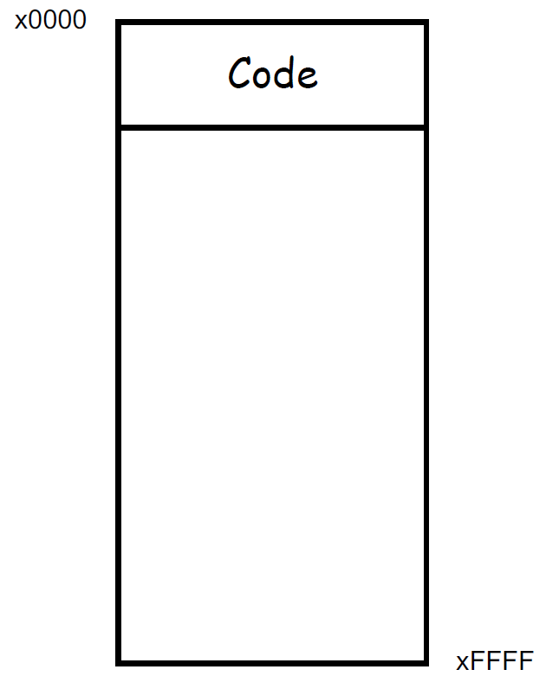
Typical Arrangement
Normally the actual program code (executable instructions) is placed in low memory
Operating System and boot code usually in lowest mem area

Slide 36
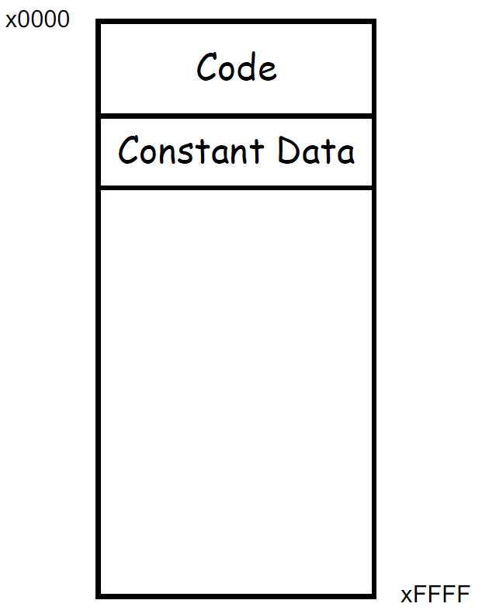
Typical Arrangement
Next we have an area for storage of constant data

Slide 37
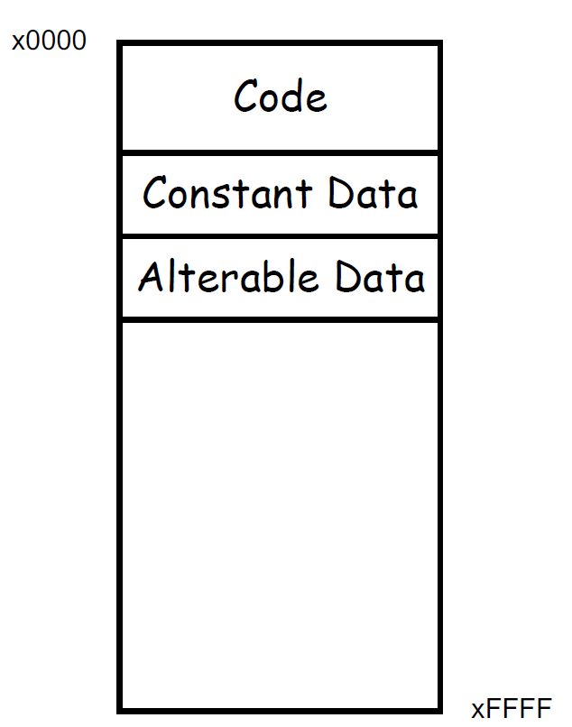
Typical Arrangement
Data that may be changed follows

Slide 38
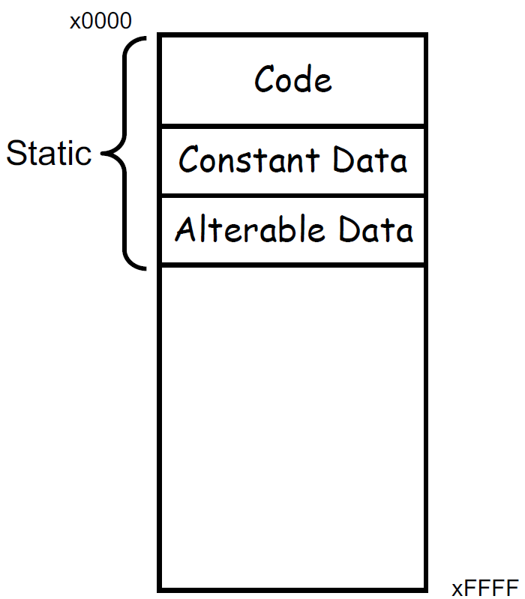
Typical Arrangement
These three items comprise what is considered the static area of memory.
The static area details (size, what is where, etc.) are known at translation or compile time.

Slide 39
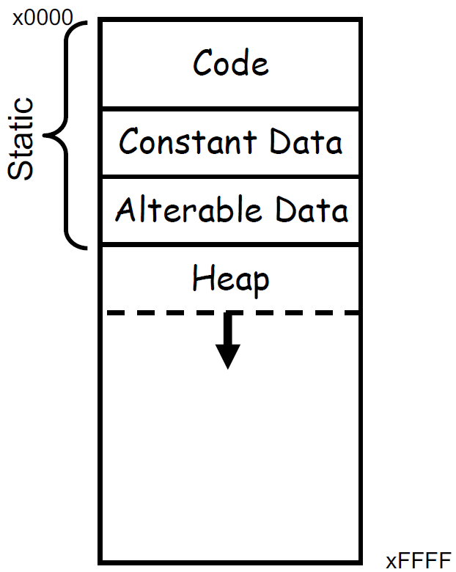
Typical Arrangement: Heap
Immediately above the static area the heap is located.
The heap can expand upward as the program dynamically requests additional storage space
malloc()
In most cases, the runtime environment manages the heap for the user

Slide 40
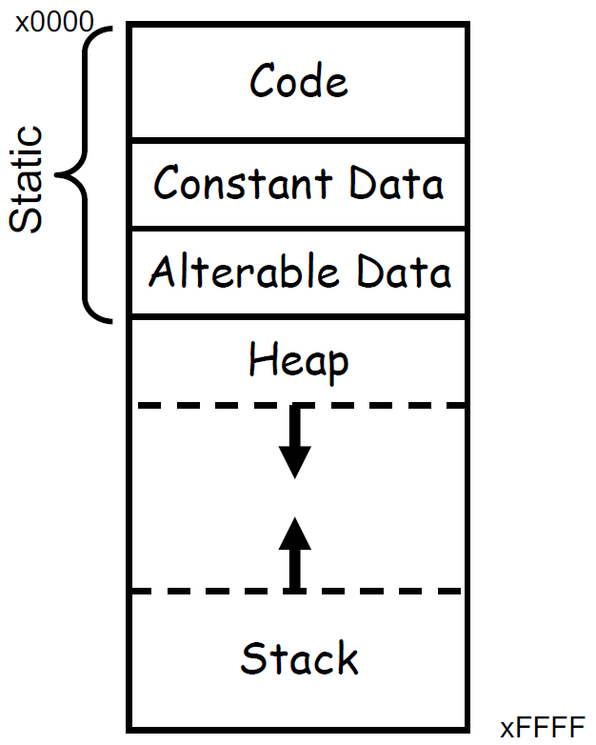
Typical Arrangement: stack for local variables
Finally, the activation stack starts in high memory and can grow down as space is needed.
Items maintained in the stack include
Local variables
Function parameters
Return values

Slide 41
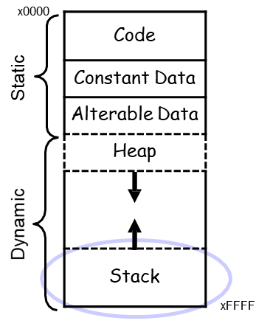
auto variables
auto, short for automatic variables are those that exist on the stack. The auto keyword is not normally used.
Automatic means that space is allocated and deallocated on the stack automatically without the programmer having to do any special operations.

Slide 42
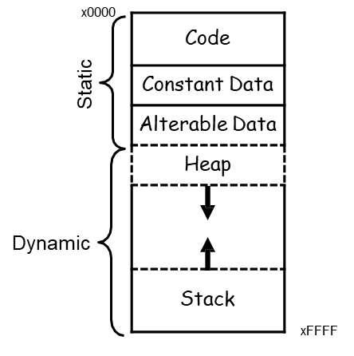
Summary of Typical Arrangement
These items in the upper portion of the memory change* during execution of the program.
Thus they are called dynamic
*Not just their value

Slide 43
Compiler Magic
The compiler has the job of converting your C program into assembly code
Thus it must convert the symbolic variable names into addresses
How does it keep track of what is where?
Keep track of scope
Storage class
Symbol table provides much of this information

Slide 44
Activation Records!!!
Two main areas (for now) in memory:
Global data section
Run-time stack
Local variables exist only during lifetime of function
De-allocated after function completes
How to define area of memory for a code block/function ?
......Activation Record
Also called Stack Frame
Local variables allocated in the activation record
Activation record is portion of run-time stack
Function can only access a valid portion of the stack
Should not access another functions activation records!
When function returns…POP the record
The local variables can no longer be accessed!

Slide 45
Symbol Table
For each variable keeps track of
Type
Scope
Location (as an offset)
Either in global area or local area
If in local area, then based on activation record
Other info (const, etc.)

Slide 46
Symbol Table
Like assembler, compiler needs to know information associated with identifiers
in assembler, all identifiers were labels and information is address
Symbol table kept track of the addresses of the labels
Compiler keeps more information
Name (identifier)
Type
Location in memory
Scope
_{Name} | _{Type} | _{Offset} | _{Scope}
_{scale} | _{int} | ₀ | _{global}
_{number} | _{int} | ₀ | _{main}
_{value} | _{int} | ₋₁ | _{main}
_{temp} | _{int} | ₋₂ | _{main}
_{x} | _{int} | ₀ | _{square}
_{y} | _{int} | ₋₁ | _{square}

Slide 47
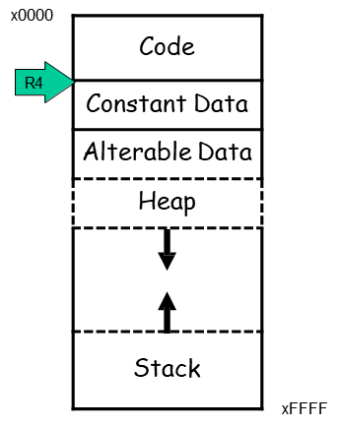
Offset?
Assembly code written by a compiler usually looks a little different from assembly code written by hand
Registers are dedicated to point to key areas of memory
R4 is the Global Pointer
Points to start of global static area

Slide 48
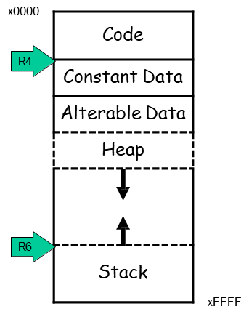
Keeping Track of auto variables
Stack pointer is obvious but the compiler writer needs more info...
Where is the activation stack frame?
R6 is Top of Stack (TOS) pointer

Slide 49
Why do we care?
We would like to know where a variable is throughout the execution of a function
We can just reference the variable from the stack pointer

Slide 50
Can we use TOS
int f(int a, int b) {
int c;
c = a + b;
return c;
}
int main() {
int x;
int y = 4;
x = f(7, y);
printf("%d\n", x);
return 0;
}
What do we need to keep track of?

Slide 51
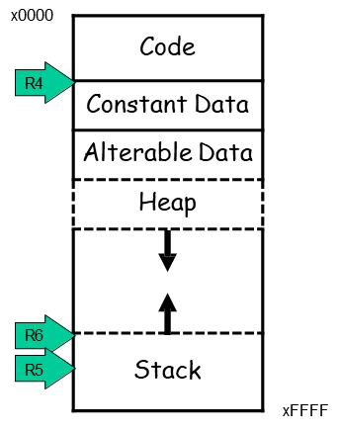
Frame Pointer
The Frame Pointer designates a fixed spot in the activation stack which can be used as a reference throughout execution of the function.
Note: Frame pointer also called dynamic link
Store Frame pointer in register….R5
Points to ‘start’ of set of local variables

Slide 52
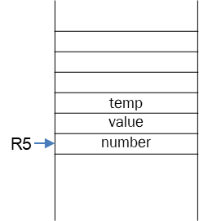
LC3: Local Variable Storage
Local variables are stored in an activation record, for each code block also known as a stack frame.
Cannot afford to forget about the Stack
Symbol table "offset” gives the distance from the base of the frame.
R5 is the frame pointer – holds address of the base of the current frame.
A new frame is pushed on the run-time stack each time a block is entered.
Because stack grows downward, base is the highest address of the frame, and variable offsets are <= 0.

Slide 53
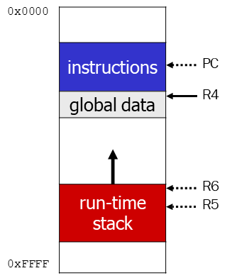
Summary: LC3 Allocation for Variables
Global data section
All global variables stored here (actually all static variables)
R4 points to beginning
Run-time stack
Used for local variables
R6 points to top of stack
R5 points to top frame on stack
New frame for each block (goes away when block exited)
Offset = distance from beginning of storage area
Global: LDR R1, R4, #4
Local: LDR R2, R5, #-3

Slide 54
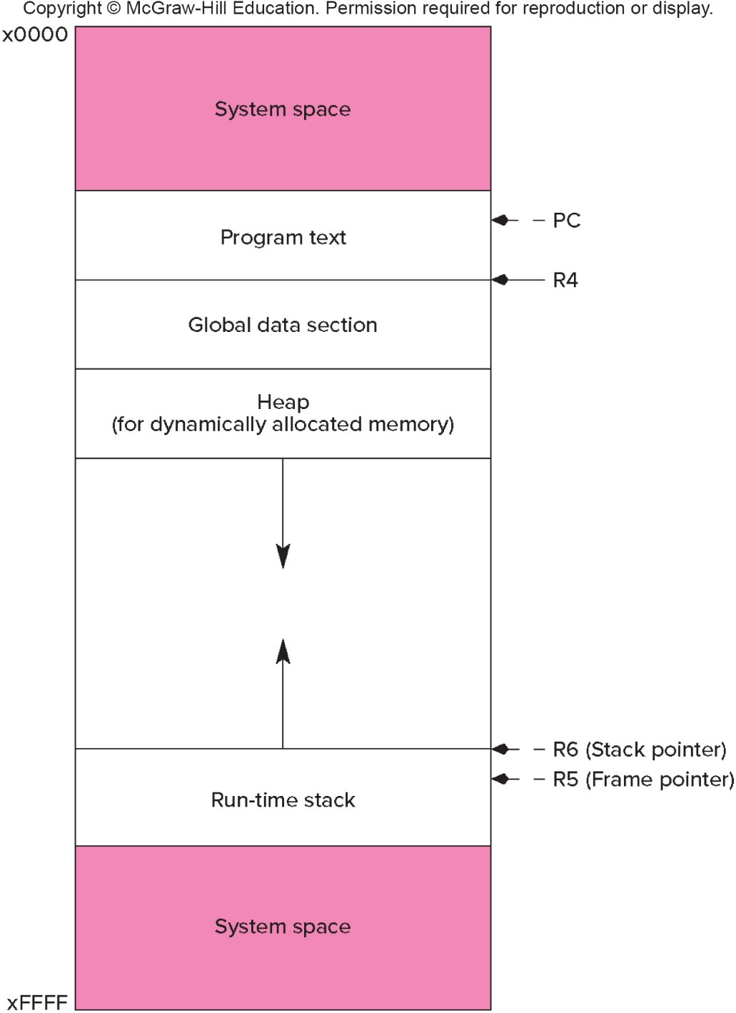
LC-3 Memory Map – The Complete Picture
The LC-3 operating system reserves some of the memory address space for trap vectors, service routine code, and memory-mapped I/O.
Program instructions will be placed in the "program text" section.
Global variables are allocated next. R4 is set to the first allocated address for globals.
Local variables are stored on the run-time stack. R5 points to the local variables of the currently- executing function.

Slide 55
Variables and Memory Locations
In our examples, a variable is always stored in memory.
When assigning to a variable, must store to memory location.
A real compiler would perform code optimizations that try to keep variables allocated in registers.
Why?

Slide 56
Example: Compiling to LC-3
#include <stdio.h>
int inGlobal;
main() {
int inLocal; /* local to main */
int LocalA, LocalB;
/* initialize */
inLocal = 5;
inGlobal = 3;
/* perform calculations */
LocalA = inLocal++;
LocalB = inLocal & ~inGlobal ;
/* print results */
printf("The results are: LocalA = %d,
LocalB =%d\n", LocalA, LocalB);
}

Slide 57
Example: Symbol Table

Slide 58
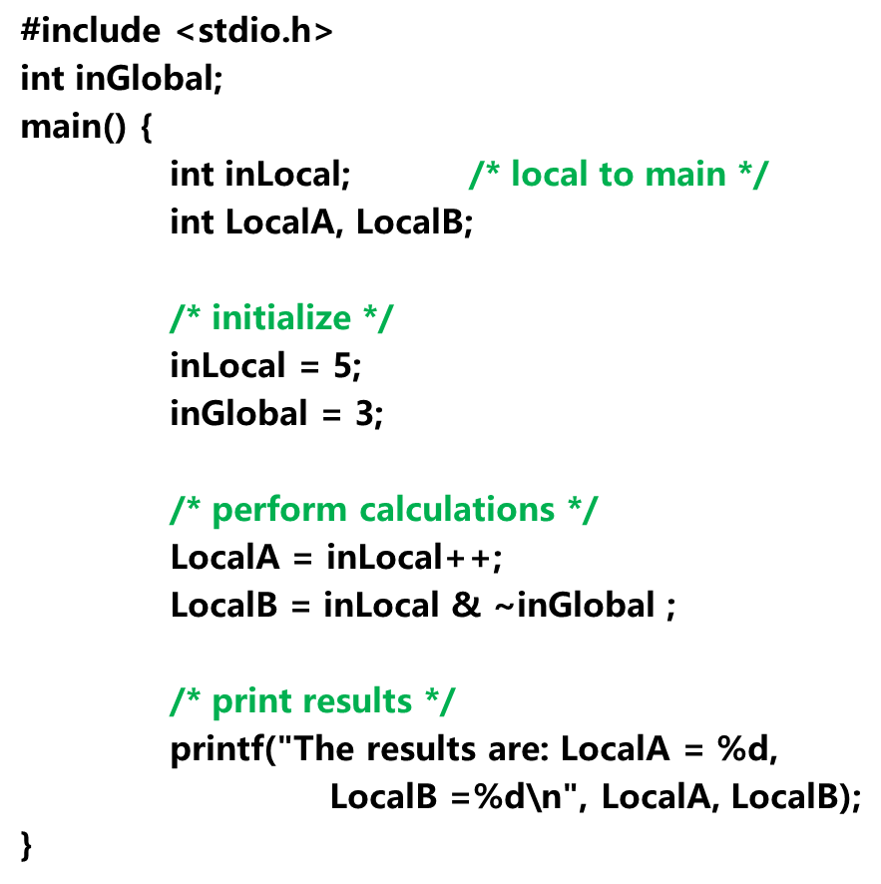
Example: Code Generation
; main
; initialize variables
AND R0, R0, #0
ADD R0, R0, #5 ; inLocal = 5
STR R0, R5, #0 ; (offset = 0)
AND R0, R0, #0
ADD R0, R0, #3 ; inGlobal = 3
STR R0, R4, #0 ; (offset = 0)

Slide 59
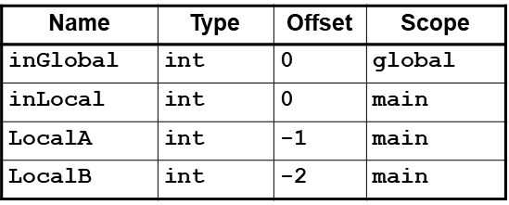
Example (continued)
; first statement:
; LocalA = inLocal++;
;address of inLocal = R5 + #0
Address of localA = R5 + # -1
LDR R0, R5, #0 ; get inLocal
ADD R1, R0, #1 ; increment
STR R1, R5, # -1 ; store localA

Slide 60
Example (continued)
; second statement:
; LocalB = inLocal & ~inGlobal;
address of inGlobal= R4+ #0
; previous code segment left
; inLocal value in R0
LDR R1, R4, #0 ; get inGlobal
NOT R1, R1 ; Not inGlobal
AND R2, R0, R1 ; inLocal & ~inGlobal
STR R2, R5, #-2 ; store in LocalB (offset = -2)

Slide 61
Exercise: C to LC3 Translation
What is the C code corresponding to these LC3 code segments
Y= A+X;
First identify accesses/addresses for variables A, X, Y:
A: R4, #0 X: R5, #0 Y: R5, # -1
Symbol Table:
Identifier | Type | Offset | Scope
A | int | 0 | Global
B | int | 2 | Global
X | int | 0 | main
Y | int | -1 | main
Z | int | -2 | main

