Slide 1
Chapter 5-1
The LC-3 Operate Instructions
计算机系统概论
Introduction to Computing Systems
（ CS1002A.01）
计算机科学与技术学院
School of Computer Science and Technology

Slide 2
Outline
1
1
Review
Review
2
2
From ENIAC to the Stored Program Computer
LC-3 ISA Overview
3
3
A Machine Structure：von Neumann Model
LC-3 Operate Instructions and Data Path
4
4
Summary
Summary

Slide 3
Outline
1
1
Review
Review
2
2
From ENIAC to the Stored Program Computer
LC-3 ISA Overview
3
3
A Machine Structure：von Neumann Model
LC-3 Operate Instructions and Data Path
4
4
Summary
Summary

Slide 4
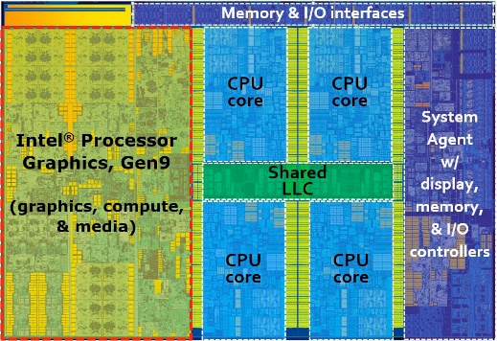

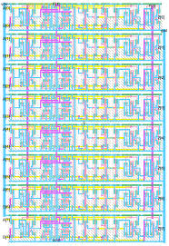
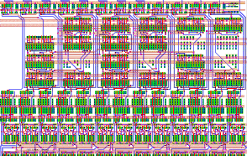
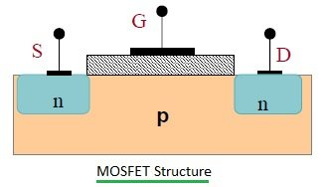
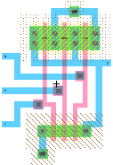
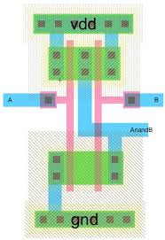
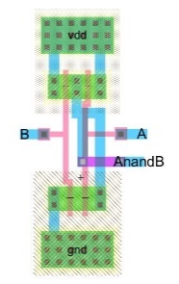
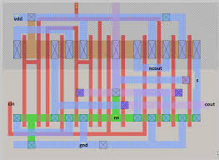
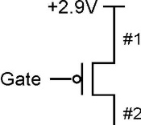
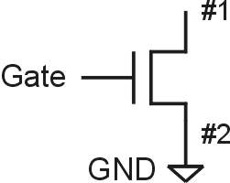
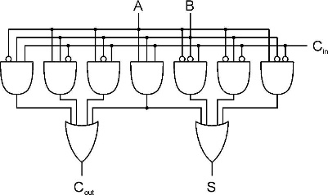
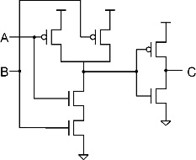
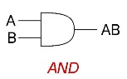

Approach: Bottom Up
ALU
Full Adder
Integrated Circuit Design
100 Modules/ IC
0.25M~20G Devices
Register Transfer Level (RTL) Design
1K~10K Cells/Module
(100K Devices)
A
B
Cin
Gate Level Design
Transistor Physical Layout
+
Clk
Register
Cout
S
Scheme for
Representing Information
Circuit Level Design
（Transistor Level Design）
(2~8 Devices/Gate)
Register Transfer Level (RTL) Design
2~16 Gates/Cell
(16~64 Devices)

Slide 5

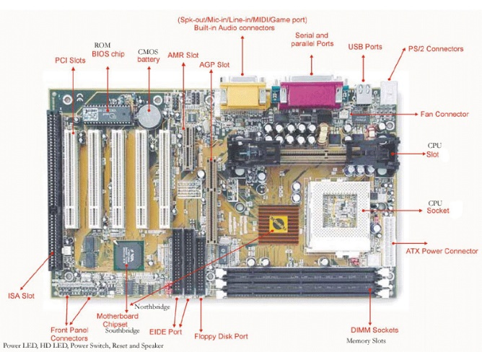

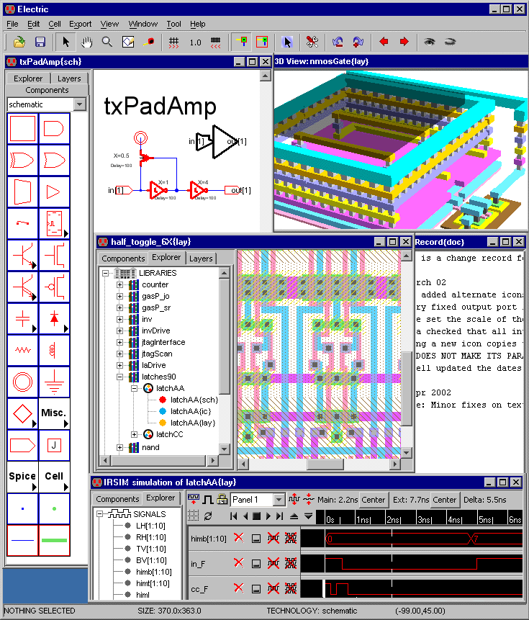
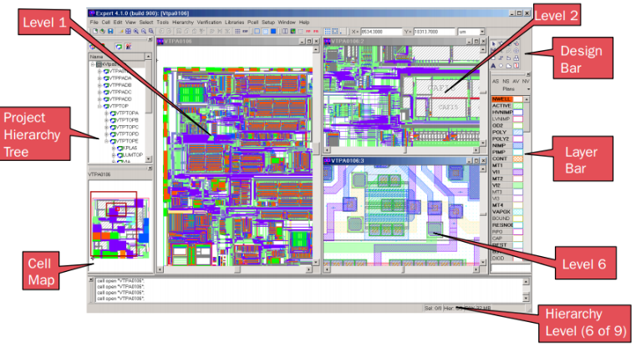
Approach: Bottom Up
Now, You are Here.
Personal Computer:
Hardware & Software Design
1~10PCBs/System
Motherboard Circuit Design
10 ICs/ PCB
1~50G Devices
Integrated Circuit Design
100 Modules/ IC
0.25M~20G Devices
Electronic System Level (ESL)Design

Slide 6
Great Idea #2 Von Neumann Structure
（Architecture Model）

Slide 7
Great Idea #1 Turing Machine
（Computational Model)
_{PC}

Slide 8
Great Idea #1 Turing Machine
（Computataional Model)
Fetch instruction from memory
Decode instruction
Tadd, Tmul
U
Evaluate address
a,b,c
c(a+b)
Fetch operands from memory
Universal Turing Machine
Execute operation
Store result

Slide 9
Instruction Processing: State Transition
_{PC}
F
F
F
F
F
F
F
IR
Fetch instruction from memory
D
D
D
D
D
D
D
Decode instruction
EA
EA
EA
EA
EA
EA
EA
Evaluate address
OP
OP
OP
OP
OP
OP
OP
Fetch operands from memory
EX
EX
EX
EX
EX
EX
EX
Execute operation
S
S
S
S
S
S
S
Store result
Notes:
9

Slide 10
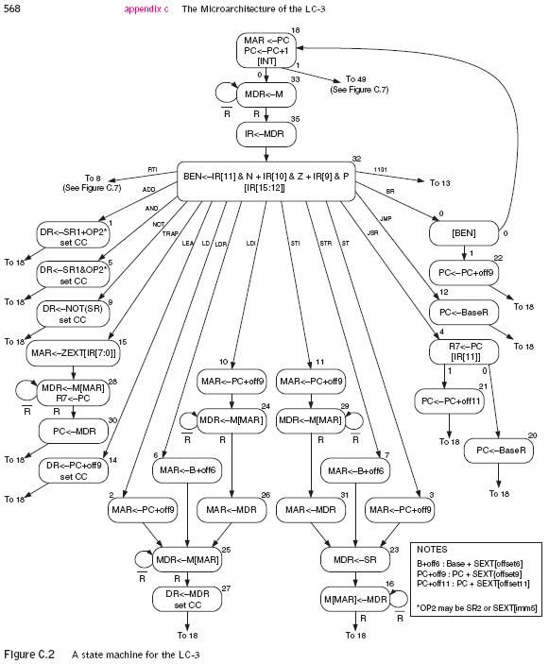
Instruction Processing: Finite State Automata
F
F
D
D
EA
EA
OP
OP
EX
EX
S
S
Notes:
10

Slide 11
Today
F
D
EA
OP
We are going to learn how to:
  compute with values in registers
  load data from memory to registers
  store data from registers to memory
EX
S

Slide 12


How do we get the electrons to do the work?
High Level Language
Program (e.g., C)
temp = v[k];
v[k] = v[k+1];
v[k+1] = temp;
Now, You are Here.
Compiler
lw $t0, 0($2)
lw $t1, 4($2)
sw $t1, 0($2)
sw $t0, 4($2)
Assembly Language Program (e.g., MIPS)
Anything can be represented
as a number,
i.e., data or instructions
Assembler
Machine Language Program (MIPS)
0000 1001 1100 0110 1010 1111 0101 1000
1010 1111 0101 1000 0000 1001 1100 0110
1100 0110 1010 1111 0101 1000 0000 1001
0101 1000 0000 1001 1100 0110 1010 1111
Machine Interpretation
Hardware Architecture Description
(e.g., block diagrams)
Architecture Implementation
ALUOP[0:3] <= InstReg[9:11] & MASK
Logic Circuit Description
(Circuit Schematic Diagrams)

Slide 13
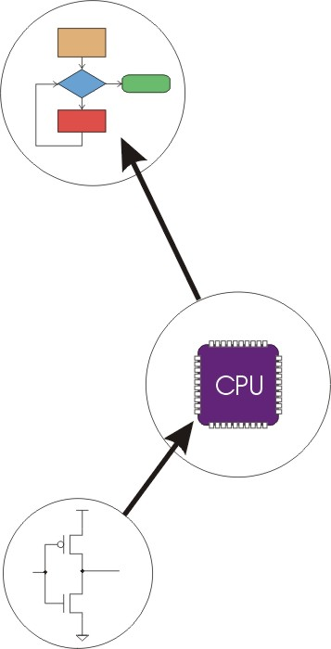
Great Idea #4: Software and Hardware Co-design
Application
Algorithm & Data Structure
Language
Software
Machine Architecture, ISA
Hardware
Microarchitecture
Logic and IC
Now, You are Here.
Device
Computer System: Layers of Abstraction
Notes:
13

Slide 14
Great Idea #3: Abstraction Helps Us Manage Complexity
Application
Solve a system of equations
Algorithm and Data Structure
Gaussian
elimination
Jacobi
iteration
Programming Language/Compiler
Red-black SOR
Multigrid
Operating System/Virtual Machines
Instruction Set Architecture (ISA)
FORTRAN
C
C++
Java
Microarchitecture
Sun SPARC
Intel x86
IBM PowerPC
Gates/Register-Transfer Level (RTL)
Pentium 4
Core 2 Duo
AMD Athlon X2
Analog/Digital Circuits
Electronic Devices
Ripple-carry adder
Carry-lookahead adder
Physics
Static CMOS
Dynamic CMOS
Nanomechanical

Slide 15
Outline
1
1
Review
Review
2
2
From ENIAC to the Stored Program Computer
LC-3 ISA Overview
3
3
A Machine Structure：von Neumann Model
LC-3 Operate Instructions and Data Path
4
4
Summary
Summary

Slide 16
Instruction Set Architecture
ISA = All of the programmer-visible components
and operations of the computer
  memory organization
    address space -- how may locations can be addressed?
    addressability -- how many bits per location?
  register set
    how many? what size? how are they used?
  instruction set
    opcodes
    data types
    addressing modes
ISA provides all information needed for someone that wants to write a program in machine language (or translate from a high-level language to machine language).
Notes:
16

Slide 17
LC-3 Overview: Memory and Registers
Memory
  address space: 2¹⁶ locations(16-bit addresses)
  addressability: 16 bits
Registers
  temporary storage, accessed in a single machine cycle
    accessing memory generally takes longer than a single cycle
  eight general-purpose registers: R0 - R7
    each 16 bits wide
    how many bits to uniquely identify a register?
  other registers
    not directly addressable, but used by (and affected by) instructions
    PC (program counter), condition codes
Notes:
17

Slide 18
LC-3 Overview: Memory Map
0x0000
Trap Vector Table
0x00FF
0x0100
Interrupt Vector Table
0x01FF
0x0200
Operating System
and Supervisor Stack
0x2FFF
0x3000
Program Text
PC
Global data section
R4(Global pointer)
Function1
R6
Heap (for dynamically
allocated memory)
R5
Function2
R6
R5
Run-time stack
R6 (stack pointer)
0xFDFF
R5 (frame pointer)
Function3
R6
0xFE00
Device Register
Addresses
0xFFFF
R5

Slide 19
LC-3 Overview: Instruction Set
Opcodes
  15 opcodes
  Operate instructions: ADD, AND, NOT
  Data movement instructions: LD, LDI, LDR, LEA, ST, STR, STI
  Control instructions: BR, JSR/JSRR, JMP(RET), RTI, TRAP
  some opcodes(ADD, AND, NOT; LD, LDI, LDR, LEA) set/clear condition codes, based on result:
    N = negative, Z = zero, P = positive (> 0)
Data Types
  16-bit 2’s complement integer
Addressing Modes 寻址模式
  How is the location of an operand specified?
  non-memory addresses: immediate, register
  memory addresses: PC-relative, indirect, base + offset
Notes:
19

Slide 20
LC-3 ISA Overview
_{运算指令(Operate Instructions)}
₁₅
₁₄
₁₃
₁₂
₁₁
₁₀
₉
₈
₇
₆
₅
₄
₃
₂
₁
₀
_{数据移动指令}
_{(Data Movement Instructions)}
_{ADD}
₀
₀
₀
₁
_{DR}
_{SR1}
₀
₀
₀
_{SR2}
_{ADD}
₀
₀
₀
₁
_{DR}
_{SR1}
₁
_{Imm5}
_{取数指令(Load)}
_{AND}
₀
₁
₀
₁
_{DR}
_{SR1}
₀
₀
₀
_{SR2}
_{AND}
₀
₁
₀
₁
_{DR}
_{SR1}
₁
_{Imm5}
₁₅
₁₄
₁₃
₁₂
₁₁
₁₀
₉
₈
₇
₆
₅
₄
₃
₂
₁
₀
_{LD}
₀
₀
₁
₀
_{DR}
_{PCoffset9}
_{NOT}
₁
₀
₀
₁
_{DR}
_{SR1}
₁
₁
₁
₁
₁
₁
_{LDR}
₀
₁
₁
₀
_{DR}
_{BaseR}
_{PCoffset6}
_{Reserved}
₁
₁
₀
₁
_{LDI}
₁
₀
₁
₀
_{DR}
_{PCoffset9}
_{控制指令(Control Instructions)}
_{LEA}
₁
₁
₁
₀
_{DR}
_{PCoffset9}
₁₅
₁₄
₁₃
₁₂
₁₁
₁₀
₉
₈
₇
₆
₅
₄
₃
₂
₁
₀
_{存数指令(Store)}
_{BR}
₀
₀
₀
₀
_{n}
_{z}
_{p}
_{PCoffset9}
_{JSR}
₀
₁
₀
₀
₁
_{PCoffset11}
₁₅
₁₄
₁₃
₁₂
₁₁
₁₀
₉
₈
₇
₆
₅
₄
₃
₂
₁
₀
_{JSRR}
₀
₁
₀
₀
₀
₀
₀
_{BaseR}
₀
₀
₀
₀
₀
₀
_{ST}
₀
₀
₁
₁
_{SR}
_{PCoffset9}
_{RTI}
₁
₀
₀
₀
₀
₀
₀
₀
₀
₀
₀
₀
₀
₀
₀
₀
_{STR}
₀
₁
₁
₁
_{SR}
_{BaseR}
_{PCoffset6}
_{JMP}
₁
₁
₀
₀
₀
₀
₀
_{BaseR}
₀
₀
₀
₀
₀
₀
_{STI}
₁
₀
₁
₁
_{SR}
_{PCoffset9}
_{RET}
₁
₁
₀
₀
₀
₀
₀
₁
₁
₁
₀
₀
₀
₀
₀
₀
_{TRAP}
₁
₁
₁
₁
₀
₀
₀
₀
_{TrapVector8}

Slide 21
Outline
1
1
Review
Review
2
2
From ENIAC to the Stored Program Computer
LC-3 ISA Overview
3
3
A Machine Structure：von Neumann Model
LC-3 Operate Instructions and Data Path
4
4
Summary
Summary

Slide 22
Operate Instructions
Only three operations: ADD, AND, NOT
Source and destination operands are registers
  These instructions do not reference memory.
  ADD and AND can use “immediate” mode,
  where one operand is hard-wired into the instruction.
Will show dataflow diagram with each instruction.
  illustrates when and where data moves to accomplish the desired operation
Notes:
22

Slide 23
LC-3 ISA Operate Instructions
_{运算指令}
₁₅
₁₄
₁₃
₁₂
₁₁
₁₀
₉
₈
₇
₆
₅
₄
₃
₂
₁
₀
_{ADD}
₀
₀
₀
₁
_{DR}
_{SR1}
₀
₀
₀
_{SR2}
_{移动数据指令}
_{ADD}
₀
₀
₀
₁
_{DR}
_{SR1}
₁
_{Imm5}
_{取数指令}
_{AND}
₀
₁
₀
₁
_{DR}
_{SR1}
₀
₀
₀
_{SR2}
_{AND}
₀
₁
₀
₁
_{DR}
_{SR1}
₁
_{Imm5}
₁₅
₁₄
₁₃
₁₂
₁₁
₁₀
₉
₈
₇
₆
₅
₄
₃
₂
₁
₀
_{LD}
₀
₀
₁
₀
_{DR}
_{PCoffset9}
_{NOT}
₁
₀
₀
₁
_{DR}
_{SR1}
₁
₁
₁
₁
₁
₁
_{LDR}
₀
₁
₁
₀
_{DR}
_{BaseR}
_{PCoffset6}
_{Reserved}
₁
₁
₀
₁
_{LDI}
₁
₀
₁
₀
_{DR}
_{PCoffset9}
_{控制指令}
_{LEA}
₁
₁
₁
₀
_{DR}
_{PCoffset9}
₁₅
₁₄
₁₃
₁₂
₁₁
₁₀
₉
₈
₇
₆
₅
₄
₃
₂
₁
₀
_{BR}
₀
₀
₀
₀
_{n}
_{z}
_{p}
_{PCoffset9}
_{存数指令}
_{JSR}
₀
₁
₀
₀
₁
_{PCoffset11}
₁₅
₁₄
₁₃
₁₂
₁₁
₁₀
₉
₈
₇
₆
₅
₄
₃
₂
₁
₀
_{JSRR}
₀
₁
₀
₀
₀
₀
₀
_{BaseR}
₀
₀
₀
₀
₀
₀
_{ST}
₀
₀
₁
₁
_{SR}
_{PCoffset9}
_{RTI}
₁
₀
₀
₀
₀
₀
₀
₀
₀
₀
₀
₀
₀
₀
₀
₀
_{STR}
₀
₁
₁
₁
_{SR}
_{BaseR}
_{PCoffset6}
_{JMP}
₁
₁
₀
₀
₀
₀
₀
_{BaseR}
₀
₀
₀
₀
₀
₀
_{STI}
₁
₀
₁
₁
_{SR}
_{PCoffset9}
_{RET}
₁
₁
₀
₀
₀
₀
₀
₁
₁
₁
₀
₀
₀
₀
₀
₀
_{TRAP}
₁
₁
₁
₁
₀
₀
₀
₀
_{TrapVector8}

Slide 24
Operate Instructions Overview
15
14
13
12
11
10
9
8
7
6
5
4
3
2
1
0
ADD
0
0
0
1
DR
SR1
0
0
0
SR2
ADD
0
0
0
1
DR
SR1
1
Imm5
AND
0
1
0
1
DR
SR1
0
0
0
SR2
AND
0
1
0
1
DR
SR1
1
Imm5
NOT
1
0
0
1
DR
SR1
1
1
1
1
1
1
Reserved
1
1
0
1

Slide 25
F
D
EA
LC-3 Data Path
OP
₁₆
GatePC
₁₆
GateMARMUX
EX
LD.PC
PC
DR
₃
MARMUX
+1
REG FILE
₁₆
₂
PCMUX
₁₆
₁₆
₁₆
₁₆
₁₆
LD.REG
Control Unit
S
[7:0]
SR2
OUT
SR1
OUT
Processing Unit
SEXT
₊
SR2
₃
₃
SR1
ADDR2MUX
MUX
MUX
ADDR1MUX
₁₆
₁₆
[10:0]
₁₆
₁₆
₁₆
₁₆
₁₆
SEXT
[8:0]
LD.CC
₁₆
SEXT
FINITE STATE MACHINE
SR2MUX
[5:0]
SEXT
₁₆
N
Z
P
ALUK
_{A}
_{B}
[4:0]
SEXT
₂
ALU
LD.IR
IR
LOGIC
…
₁₆
₁₆
₁₆
RUN
GateALU
₁₆
GateMDR
₁₆
Memory Unit
LD.MDR
MDR
MEMORY
MAR
LD.MAR
₁₆
INPUT
OUTPUT
MIO.EN
MUX
₁₆
MEM.EN,R,W

Slide 26
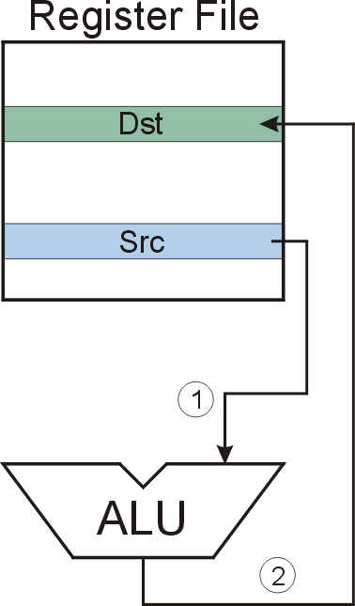
NOT (Register)
NOT
Note: Src and Dst
could be the same register.
Notes:
26

Slide 27
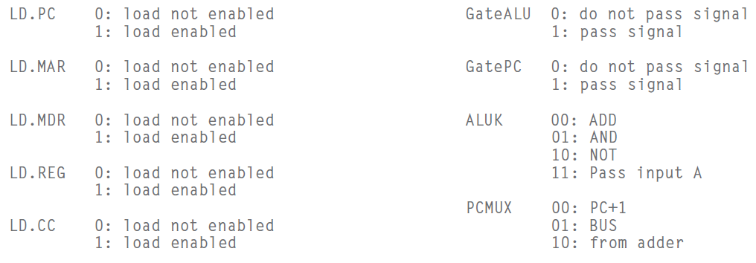
Signals
Notes:
27

Slide 28
F
D
EA
NOT (Register):
OP
₁₆
GatePC
₁₆
GateMARMUX
EX
LD.PC
PC
DR
₃
MARMUX
+1
REG FILE
₁₆
₂
PCMUX
₁₆
₁₆
₁₆
₁₆
₁₆
LD.REG
S
[7:0]
SR2
SR2
OUT
SR1
OUT
SR1
SEXT
₊
₃
₃
ADDR2MUX
MUX
MUX
ADDR1MUX
₁₆
₁₆
[10:0]
₁₆
₁₆
₁₆
₁₆
₁₆
SEXT
[8:0]
LD.CC
₁₆
SEXT
FINITE STATE MACHINE
SR2MUX
[5:0]
SEXT
₁₆
N
Z
P
ALUK
_{A}
_{B}
[4:0]
SEXT
₂
ALU
LD.IR
IR
LOGIC
…
₁₆
₁₆
₁₆
RUN
GateALU
₁₆
GateMDR
₁₆
LD.MDR
MDR
MEMORY
MAR
LD.MAR
₁₆
INPUT
OUTPUT
MIO.EN
MUX
₁₆
MEM.EN,R,W

Slide 29
F
D
EA
NOT (Register):
OP
₁₆
GatePC
₁₆
GateMARMUX
EX
LD.PC
PC
DR
₃
MARMUX
+1
REG FILE
₁₆
₂
PCMUX
₁₆
₁₆
₁₆
₁₆
₁₆
LD.REG
S
[7:0]
SR2
SR2
OUT
SR1
OUT
SR1
SEXT
₊
₃
₃
ADDR2MUX
MUX
MUX
ADDR1MUX
₁₆
₁₆
[10:0]
₁₆
₁₆
₁₆
₁₆
₁₆
SEXT
[8:0]
LD.CC
₁₆
SEXT
FINITE STATE MACHINE
SR2MUX
[5:0]
SEXT
₁₆
N
Z
P
ALUK
_{A}
_{B}
[4:0]
SEXT
₂
ALU
LD.IR
IR
LOGIC
…
₁₆
₁₆
₁₆
RUN
GateALU
₁₆
GateMDR
₁₆
LD.MDR
MDR
MEMORY
MAR
LD.MAR
₁₆
INPUT
OUTPUT
MIO.EN
MUX
₁₆
MEM.EN,R,W

Slide 30
F
D
EA
NOT (Register):
OP
₁₆
GatePC
₁₆
GateMARMUX
EX
LD.PC
PC
DR
₃
MARMUX
+1
REG FILE
₁₆
₂
PCMUX
₁₆
₁₆
₁₆
₁₆
₁₆
LD.REG
S
[7:0]
SR2
SR2
OUT
SR1
OUT
SR1
SEXT
₊
₃
₃
ADDR2MUX
MUX
MUX
ADDR1MUX
₁₆
₁₆
[10:0]
₁₆
₁₆
₁₆
₁₆
₁₆
SEXT
[8:0]
LD.CC
₁₆
SEXT
FINITE STATE MACHINE
SR2MUX
[5:0]
SEXT
₁₆
N
Z
P
ALUK
_{A}
_{B}
[4:0]
SEXT
₂
ALU
LD.IR
IR
LOGIC
…
₁₆
₁₆
₁₆
RUN
GateALU
₁₆
GateMDR
₁₆
LD.MDR
MDR
MEMORY
MAR
LD.MAR
₁₆
INPUT
OUTPUT
MIO.EN
MUX
₁₆
MEM.EN,R,W

Slide 31
NOT (Register):
F
D
EA
OP
EX
S
₁₆
GatePC
₁₆
GateMARMUX
LD.PC
PC
DR
₃
MARMUX
+1
REG FILE
₁₆
₂
PCMUX
₁₆
₁₆
₁₆
₁₆
₁₆
LD.REG
[7:0]
SR2
SR2
OUT
SR1
OUT
SR1
SEXT
₊
₃
₃
ADDR2MUX
MUX
MUX
ADDR1MUX
₁₆
₁₆
[10:0]
₁₆
₁₆
₁₆
₁₆
₁₆
SEXT
[8:0]
LD.CC
₁₆
SEXT
FINITE STATE MACHINE
SR2MUX
[5:0]
SEXT
₁₆
N
Z
P
NOT
_{A}
_{B}
[4:0]
SEXT
₂
ALU
LD.IR
IR
LOGIC
…
₁₆
₁₆
₁₆
RUN
GateALU
₁₆
GateMDR
₁₆
LD.MDR
MDR
MEMORY
MAR
LD.MAR
₁₆
INPUT
OUTPUT
MIO.EN
MUX
₁₆
MEM.EN,R,W

Slide 32
NOT (Register):
F
D
EA
OP
EX
S
₁₆
GatePC
₁₆
GateMARMUX
LD.PC
PC
DR
₃
MARMUX
+1
REG FILE
₁₆
₂
PCMUX
₁₆
₁₆
₁₆
₁₆
₁₆
LD.REG
[7:0]
SR2
SR2
OUT
SR1
OUT
SR1
SEXT
₊
₃
₃
ADDR2MUX
MUX
MUX
ADDR1MUX
₁₆
₁₆
[10:0]
₁₆
₁₆
₁₆
₁₆
₁₆
SEXT
[8:0]
LD.CC
₁₆
SEXT
FINITE STATE MACHINE
SR2MUX
[5:0]
SEXT
₁₆
N
Z
P
NOT
_{A}
_{B}
[4:0]
SEXT
₂
ALU
LD.IR
IR
LOGIC
…
₁₆
₁₆
₁₆
RUN
GateALU
₁₆
GateMDR
₁₆
LD.MDR
MDR
MEMORY
MAR
LD.MAR
₁₆
INPUT
OUTPUT
MIO.EN
MUX
₁₆
MEM.EN,R,W

Slide 33
NOT (Register):
F
D
EA
OP
EX
S
₁₆
GatePC
₁₆
GateMARMUX
LD.PC
PC
DR
₃
MARMUX
+1
REG FILE
₁₆
₂
PCMUX
₁₆
₁₆
₁₆
₁₆
₁₆
LD.REG
[7:0]
SR2
SR2
OUT
SR1
OUT
SR1
SEXT
₊
₃
₃
ADDR2MUX
MUX
MUX
ADDR1MUX
₁₆
₁₆
[10:0]
₁₆
₁₆
₁₆
₁₆
₁₆
SEXT
[8:0]
LD.CC
₁₆
SEXT
FINITE STATE MACHINE
SR2MUX
[5:0]
SEXT
₁₆
N
Z
P
NOT
_{A}
_{B}
[4:0]
SEXT
₂
ALU
LD.IR
IR
LOGIC
…
₁₆
₁₆
₁₆
RUN
GateALU
₁₆
GateMDR
₁₆
LD.MDR
MDR
MEMORY
MAR
LD.MAR
₁₆
INPUT
OUTPUT
MIO.EN
MUX
₁₆
MEM.EN,R,W

Slide 34
NOT (Register):
F
D
EA
OP
EX
S
₁₆
GatePC
₁₆
GateMARMUX
LD.PC
PC
DR
₃
MARMUX
+1
REG FILE
₁₆
₂
PCMUX
₁₆
₁₆
₁₆
₁₆
₁₆
LD.REG
[7:0]
SR2
SR2
OUT
SR1
OUT
SR1
SEXT
₊
₃
₃
ADDR2MUX
MUX
MUX
ADDR1MUX
₁₆
₁₆
[10:0]
₁₆
₁₆
₁₆
₁₆
₁₆
SEXT
[8:0]
LD.CC
₁₆
SEXT
FINITE STATE MACHINE
SR2MUX
[5:0]
SEXT
₁₆
N
Z
P
NOT
_{A}
_{B}
[4:0]
SEXT
₂
ALU
LD.IR
IR
LOGIC
…
₁₆
₁₆
₁₆
RUN
GateALU
₁₆
GateMDR
₁₆
LD.MDR
MDR
MEMORY
MAR
LD.MAR
₁₆
INPUT
OUTPUT
MIO.EN
MUX
₁₆
MEM.EN,R,W

Slide 35
NOT (Register): NOT R3, R5
Register File
R0
R1
R2
R3
0
1
0
1
0
0
0
0
1
1
1
1
0
0
0
0
R4
R5
1
0
1
0
1
1
1
1
0
0
0
0
1
1
1
1
R6
R7
①
②
A
B
ALU
NOT
Notes:
35

Slide 36
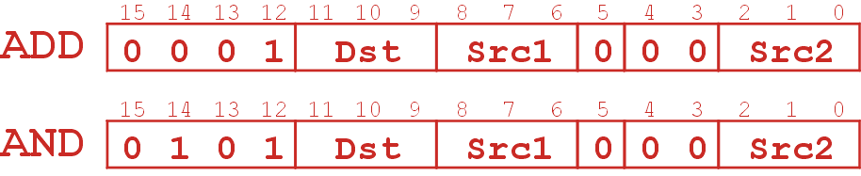
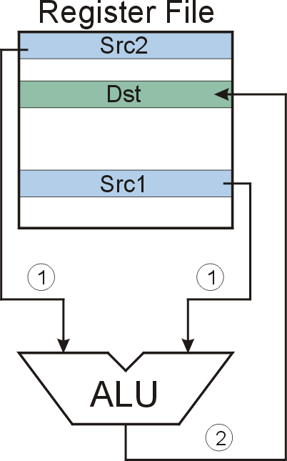
ADD/AND (Register)
this zero means “register mode”
ADD/AND
Notes:
36

Slide 37
F
D
EA
ADD/AND (Register)
OP
₁₆
GatePC
₁₆
GateMARMUX
EX
LD.PC
PC
DR
₃
MARMUX
+1
REG FILE
₁₆
₂
PCMUX
₁₆
₁₆
₁₆
₁₆
₁₆
LD.REG
S
[7:0]
SR2
SR2
OUT
SR1
OUT
SR1
SEXT
₊
₃
₃
ADDR2MUX
MUX
MUX
ADDR1MUX
₁₆
₁₆
[10:0]
₁₆
₁₆
₁₆
₁₆
₁₆
SEXT
[8:0]
LD.CC
₁₆
SEXT
FINITE STATE MACHINE
SR2MUX
[5:0]
SEXT
₁₆
N
Z
P
ALUK
_{A}
_{B}
[4:0]
SEXT
₂
ALU
LD.IR
IR
LOGIC
…
₁₆
₁₆
₁₆
RUN
GateALU
₁₆
GateMDR
₁₆
LD.MDR
MDR
MEMORY
MAR
LD.MAR
₁₆
INPUT
OUTPUT
MIO.EN
MUX
₁₆
MEM.EN,R,W

Slide 38
F
D
EA
ADD/AND (Register)
OP
₁₆
GatePC
₁₆
GateMARMUX
EX
LD.PC
PC
DR
₃
MARMUX
+1
REG FILE
₁₆
₂
PCMUX
₁₆
₁₆
₁₆
₁₆
₁₆
LD.REG
S
[7:0]
SR2
SR2
OUT
SR1
OUT
SR1
SEXT
₊
₃
₃
ADDR2MUX
MUX
MUX
ADDR1MUX
₁₆
₁₆
[10:0]
₁₆
₁₆
₁₆
₁₆
₁₆
SEXT
[8:0]
LD.CC
₁₆
SEXT
FINITE STATE MACHINE
SR2MUX
[5:0]
SEXT
₁₆
N
Z
P
ALUK
_{A}
_{B}
[4:0]
SEXT
₂
ALU
LD.IR
IR
LOGIC
…
₁₆
₁₆
₁₆
RUN
GateALU
₁₆
GateMDR
₁₆
LD.MDR
MDR
MEMORY
MAR
LD.MAR
₁₆
INPUT
OUTPUT
MIO.EN
MUX
₁₆
MEM.EN,R,W

Slide 39
F
D
EA
ADD/AND (Register)
OP
₁₆
GatePC
₁₆
GateMARMUX
EX
LD.PC
PC
DR
₃
MARMUX
+1
REG FILE
₁₆
₂
PCMUX
₁₆
₁₆
₁₆
₁₆
₁₆
LD.REG
S
[7:0]
SR2
SR2
OUT
SR1
OUT
SR1
SEXT
₊
₃
₃
ADDR2MUX
MUX
MUX
ADDR1MUX
₁₆
₁₆
[10:0]
₁₆
₁₆
₁₆
₁₆
₁₆
SEXT
[8:0]
LD.CC
₁₆
SEXT
FINITE STATE MACHINE
SR2MUX
[5:0]
SEXT
₁₆
N
Z
P
ALUK
_{A}
_{B}
[4:0]
SEXT
₂
ALU
LD.IR
IR
LOGIC
…
₁₆
₁₆
₁₆
RUN
GateALU
₁₆
GateMDR
₁₆
LD.MDR
MDR
MEMORY
MAR
LD.MAR
₁₆
INPUT
OUTPUT
MIO.EN
MUX
₁₆
MEM.EN,R,W

Slide 40
ADD/AND (Register)
F
D
EA
OP
EX
S
₁₆
GatePC
₁₆
GateMARMUX
LD.PC
PC
DR
₃
MARMUX
+1
REG FILE
₁₆
₂
PCMUX
₁₆
₁₆
₁₆
₁₆
₁₆
LD.REG
[7:0]
SR2
SR2
OUT
SR1
OUT
SR1
SEXT
₊
₃
₃
ADDR2MUX
MUX
MUX
ADDR1MUX
₁₆
₁₆
[10:0]
₁₆
₁₆
₁₆
₁₆
₁₆
SEXT
[8:0]
LD.CC
₁₆
SEXT
FINITE STATE MACHINE
SR2MUX
[5:0]
SEXT
₁₆
N
Z
P
ADD/AND
_{A}
_{B}
[4:0]
SEXT
₂
ALU
LD.IR
IR
LOGIC
…
₁₆
₁₆
₁₆
RUN
GateALU
₁₆
GateMDR
₁₆
LD.MDR
MDR
MEMORY
MAR
LD.MAR
₁₆
INPUT
OUTPUT
MIO.EN
MUX
₁₆
MEM.EN,R,W

Slide 41
AND (Register): AND R3, R5, R1
Register File
R0
R1
0
1
1
1
1
0
0
0
0
0
0
0
0
1
0
0
R2
IR
0
1
0
1
0
1
1
1
0
1
0
0
0
0
0
1
R3
0
0
1
0
1
0
0
0
0
0
0
0
0
1
0
0
R4
R5
1
0
1
0
1
1
1
1
0
0
0
0
1
1
1
1
R6
R7
①
①
②
Bit[5]= 0
1
0
A
B
ALU
AND
Notes:
41

Slide 42
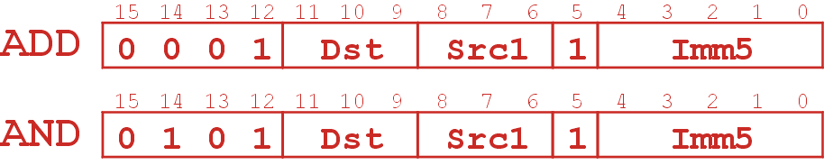
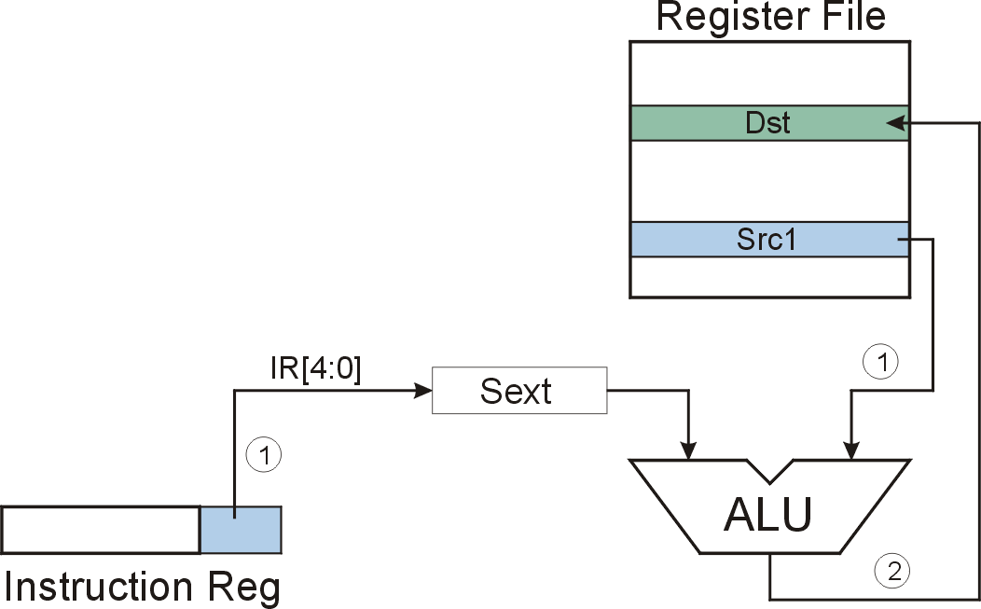
ADD/AND (Immediate)
this one means “immediate mode”
Note: Immediate field is
sign-extended.
ADD/AND
Notes:
42
.

Slide 43
F
D
EA
ADD/AND (Immediate)
OP
₁₆
GatePC
₁₆
GateMARMUX
EX
LD.PC
PC
DR
₃
MARMUX
+1
REG FILE
₁₆
₂
PCMUX
₁₆
₁₆
₁₆
₁₆
₁₆
LD.REG
S
[7:0]
SR2
SR2
OUT
SR1
OUT
SR1
SEXT
₊
₃
₃
ADDR2MUX
MUX
MUX
ADDR1MUX
₁₆
₁₆
[10:0]
₁₆
₁₆
₁₆
₁₆
₁₆
SEXT
[8:0]
LD.CC
₁₆
SEXT
FINITE STATE MACHINE
SR2MUX
[5:0]
SEXT
₁₆
N
Z
P
ALUK
_{A}
_{B}
[4:0]
SEXT
₂
ALU
LD.IR
IR
LOGIC
…
₁₆
₁₆
₁₆
RUN
GateALU
₁₆
GateMDR
₁₆
LD.MDR
MDR
MEMORY
MAR
LD.MAR
₁₆
INPUT
OUTPUT
MIO.EN
MUX
₁₆
MEM.EN,R,W

Slide 44
F
D
EA
ADD/AND (Immediate)
OP
₁₆
GatePC
₁₆
GateMARMUX
EX
LD.PC
PC
DR
₃
MARMUX
+1
REG FILE
₁₆
₂
PCMUX
₁₆
₁₆
₁₆
₁₆
₁₆
LD.REG
S
[7:0]
SR2
SR2
OUT
SR1
OUT
SR1
SEXT
₊
₃
₃
ADDR2MUX
MUX
MUX
ADDR1MUX
₁₆
₁₆
[10:0]
₁₆
₁₆
₁₆
₁₆
₁₆
SEXT
[8:0]
LD.CC
₁₆
SEXT
FINITE STATE MACHINE
SR2MUX
[5:0]
SEXT
₁₆
N
Z
P
ALUK
_{A}
_{B}
[4:0]
SEXT
₂
ALU
LD.IR
IR
LOGIC
…
₁₆
₁₆
₁₆
RUN
GateALU
₁₆
GateMDR
₁₆
LD.MDR
MDR
MEMORY
MAR
LD.MAR
₁₆
INPUT
OUTPUT
MIO.EN
MUX
₁₆
MEM.EN,R,W

Slide 45
F
D
EA
ADD/AND (Immediate)
OP
₁₆
GatePC
₁₆
GateMARMUX
EX
LD.PC
PC
DR
₃
MARMUX
+1
REG FILE
₁₆
₂
PCMUX
₁₆
₁₆
₁₆
₁₆
₁₆
LD.REG
S
[7:0]
SR2
SR2
OUT
SR1
OUT
SR1
SEXT
₊
₃
₃
ADDR2MUX
MUX
MUX
ADDR1MUX
₁₆
₁₆
[10:0]
₁₆
₁₆
₁₆
₁₆
₁₆
SEXT
[8:0]
LD.CC
₁₆
SEXT
FINITE STATE MACHINE
SR2MUX
[5:0]
SEXT
₁₆
N
Z
P
ALUK
_{A}
_{B}
[4:0]
SEXT
₂
ALU
LD.IR
IR
LOGIC
…
₁₆
₁₆
₁₆
RUN
GateALU
₁₆
GateMDR
₁₆
LD.MDR
MDR
MEMORY
MAR
LD.MAR
₁₆
INPUT
OUTPUT
MIO.EN
MUX
₁₆
MEM.EN,R,W

Slide 46
ADD/AND (Immediate)
F
D
EA
OP
EX
S
₁₆
GatePC
₁₆
GateMARMUX
LD.PC
PC
DR
₃
MARMUX
+1
REG FILE
₁₆
₂
PCMUX
₁₆
₁₆
₁₆
₁₆
₁₆
LD.REG
[7:0]
SR2
SR2
OUT
SR1
OUT
SR1
SEXT
₊
₃
₃
ADDR2MUX
MUX
MUX
ADDR1MUX
₁₆
₁₆
[10:0]
₁₆
₁₆
₁₆
₁₆
₁₆
SEXT
[8:0]
LD.CC
₁₆
SEXT
FINITE STATE MACHINE
SR2MUX
[5:0]
SEXT
₁₆
N
Z
P
ADD/AND
_{A}
_{B}
[4:0]
SEXT
₂
ALU
LD.IR
IR
LOGIC
…
₁₆
₁₆
₁₆
RUN
GateALU
₁₆
GateMDR
₁₆
LD.MDR
MDR
MEMORY
MAR
LD.MAR
₁₆
INPUT
OUTPUT
MIO.EN
MUX
₁₆
MEM.EN,R,W

Slide 47
ADD (Immediate) ADD R1, R5, #-2
Register File
R0
R1
0
0
0
0
0
0
0
0
0
0
0
0
0
1
0
0
R2
IR
0
0
0
1
0
0
1
1
0
1
1
1
1
1
1
0
R3
R4
IR[4:0]=11110
R5
0
0
0
0
0
0
0
0
0
0
0
0
0
1
1
0
R6
SEXT
R7
1111111111111110
①
①
②
1
0
Bit[5]=1
A
B
IR[4:0] = # -2
R5 = # 6
R1 = # 4
ALU
ADD
Notes:
47

Slide 48
Using Operate Instructions
With only ADD, AND, NOT…
  How do we subtract?
  How do we OR?
  How do we copy from one register to another?
  How do we initialize a register to zero?
Notes:
48
Subtract: R3 = R1 - R2
Take 2’s complement of R2, then add to R1.
(1) R2 = NOT(R2)
(2) R2 = R2 + 1
(3) R3 = R1 + R2
Register-to-register copy: R3 = R2
R3 = R2 + 0 (Add-immediate)
Initialize to zero: R1 = 0
R1 = R1 AND 0 (And-immediate)

Slide 49
Outline
1
1
Review
Review
2
2
From ENIAC to the Stored Program Computer
LC-3 ISA Overview
3
3
A Machine Structure：von Neumann Model
LC-3 Operate Instructions and Data Path
4
4
Summary
Summary

Slide 50
Great Idea #4: Software and Hardware Co-design
Application
Algorithm & Data Structure
Language
Software
指令集体系结构 (Machine Architecture, ISA)
Hardware
Microarchitecture
Now, You are Here.
Logic and IC
Device
How do we get the electrons to do the work?
Notes:
50

Slide 51
How do we get the electrons to do the work?
High Level Language
Program (e.g., C)
temp = v[k];
v[k] = v[k+1];
v[k+1] = temp;
Now, You are Here.
Compiler
lw $t0, 0($2)
lw $t1, 4($2)
sw $t1, 0($2)
sw $t0, 4($2)
Assembly Language Program (e.g., MIPS)
Anything can be represented
as a number,
i.e., data or instructions
Assembler
Machine Language Program (MIPS)
0000 1001 1100 0110 1010 1111 0101 1000
1010 1111 0101 1000 0000 1001 1100 0110
1100 0110 1010 1111 0101 1000 0000 1001
0101 1000 0000 1001 1100 0110 1010 1111
Machine Interpretation
Hardware Architecture Description
(e.g., block diagrams)
Architecture Implementation
ALUOP[0:3] <= InstReg[9:11] & MASK
Logic Circuit Description
(Circuit Schematic Diagrams)

Slide 52
Operate Instructions
15
14
13
12
11
10
9
8
7
6
5
4
3
2
1
0
ADD
0
0
0
1
DR
SR1
0
0
0
SR2
ADD
0
0
0
1
DR
SR1
1
Imm5
AND
0
1
0
1
DR
SR1
0
0
0
SR2
AND
0
1
0
1
DR
SR1
1
Imm5
NOT
1
0
0
1
DR
SR1
1
1
1
1
1
1
Reserved
1
1
0
1

Slide 53
F
D
EA
LC-3 Data Path
OP
₁₆
GatePC
₁₆
GateMARMUX
EX
LD.PC
PC
DR
₃
MARMUX
+1
REG FILE
₁₆
₂
PCMUX
₁₆
₁₆
₁₆
₁₆
₁₆
LD.REG
Control Unit
S
[7:0]
SR2
OUT
SR1
OUT
Processing Unit
SEXT
₊
SR2
₃
₃
SR1
ADDR2MUX
MUX
MUX
ADDR1MUX
₁₆
₁₆
[10:0]
₁₆
₁₆
₁₆
₁₆
₁₆
SEXT
[8:0]
LD.CC
₁₆
SEXT
FINITE STATE MACHINE
SR2MUX
[5:0]
SEXT
₁₆
N
Z
P
ALUK
_{A}
_{B}
[4:0]
SEXT
₂
ALU
LD.IR
IR
LOGIC
…
₁₆
₁₆
₁₆
RUN
GateALU
₁₆
GateMDR
₁₆
Memory Unit
LD.MDR
MDR
MEMORY
MAR
LD.MAR
₁₆
INPUT
OUTPUT
MIO.EN
MUX
₁₆
MEM.EN,R,W

Slide 54
LC-3 Data Path After Operate Instruction
₁₆
GatePC
₁₆
GateMARMUX
LD.PC
PC
DR
₃
MARMUX
+1
REG FILE
₁₆
₂
PCMUX
₁₆
₁₆
₁₆
₁₆
₁₆
LD.REG
[7:0]
SR2
SR2
OUT
SR1
OUT
SR1
SEXT
₊
₃
₃
ADDR2MUX
MUX
MUX
ADDR1MUX
₁₆
₁₆
[10:0]
₁₆
₁₆
₁₆
₁₆
₁₆
SEXT
[8:0]
LD.CC
₁₆
SEXT
FINITE STATE MACHINE
SR2MUX
[5:0]
SEXT
₁₆
N
Z
P
ALUK
_{A}
_{B}
[4:0]
SEXT
₂
ALU
LD.IR
IR
LOGIC
…
₁₆
₁₆
₁₆
RUN
GateALU
₁₆
GateMDR
₁₆
LD.MDR
MDR
MEMORY
MAR
LD.MAR
₁₆
INPUT
OUTPUT
MIO.EN
MUX
₁₆
MEM.EN,R,W

Slide 55
Next Lecture: Data Movement Instructions
取数指令
15
14
13
12
11
10
9
8
7
6
5
4
3
2
1
0
LD
0
0
1
0
DR
PCoffset9
LDR
0
1
1
0
DR
BaseR
PCoffset6
LDI
1
0
1
0
DR
PCoffset9
LEA
1
1
1
0
DR
PCoffset9
存数指令
15
14
13
12
11
10
9
8
7
6
5
4
3
2
1
0
ST
0
0
1
1
SR
PCoffset9
STR
0
1
1
1
SR
BaseR
PCoffset6
STI
1
0
1
1
SR
PCoffset9

Slide 56
Reading
5.3 Data Movement Instructions

