Slide 1
Chapter 5-2
The LC-3 Data Movement Instructions
计算机系统概论
Introduction to Computing Systems
（ CS1002A.01）
计算机科学与技术学院
School of Computer Science and Technology

Slide 2
Outline
1
Review
2
LC-3 PC-Relative Load/Store
3
LC-3 Indirect, Base+offset Load/Store
4
Summary

Slide 3
Outline
1
Review
2
LC-3 PC-Relative Load/Store
3
LC-3 Indirect, Base+offset Load/Store
4
Summary

Slide 4
Great Idea #3 ：Abstraction
Application
Solve a system of equations
Algorithm and Data Structure
Gaussian
elimination
Jacobi
iteration
Programming Language/Compiler
Red-black SOR
Multigrid
Operating System/Virtual Machines
Instruction Set Architecture (ISA)
FORTRAN
C
C++
Java
Microarchitecture
Sun SPARC
Intel x86
IBM PowerPC
Gates/Register-Transfer Level (RTL)
Pentium 4
Core 2 Duo
AMD Athlon X2
Analog/Digital Circuits
Electronic Devices
Ripple-carry adder
Carry-lookahead adder
Physics
Static CMOS
Dynamic CMOS
Nanomechanical

Slide 5
LC-3 ISA Operate Instructions
_{运算指令}
₁₅
₁₄
₁₃
₁₂
₁₁
₁₀
₉
₈
₇
₆
₅
₄
₃
₂
₁
₀
_{ADD}
₀
₀
₀
₁
_{DR}
_{SR1}
₀
₀
₀
_{SR2}
_{移动数据指令}
_{ADD}
₀
₀
₀
₁
_{DR}
_{SR1}
₁
_{Imm5}
_{取数指令}
_{AND}
₀
₁
₀
₁
_{DR}
_{SR1}
₀
₀
₀
_{SR2}
_{AND}
₀
₁
₀
₁
_{DR}
_{SR1}
₁
_{Imm5}
₁₅
₁₄
₁₃
₁₂
₁₁
₁₀
₉
₈
₇
₆
₅
₄
₃
₂
₁
₀
_{LD}
₀
₀
₁
₀
_{DR}
_{PCoffset9}
_{NOT}
₁
₀
₀
₁
_{DR}
_{SR1}
₁
₁
₁
₁
₁
₁
_{LDR}
₀
₁
₁
₀
_{DR}
_{BaseR}
_{PCoffset6}
_{Reserved}
₁
₁
₀
₁
_{LDI}
₁
₀
₁
₀
_{DR}
_{PCoffset9}
_{控制指令}
_{LEA}
₁
₁
₁
₀
_{DR}
_{PCoffset9}
₁₅
₁₄
₁₃
₁₂
₁₁
₁₀
₉
₈
₇
₆
₅
₄
₃
₂
₁
₀
_{BR}
₀
₀
₀
₀
_{n}
_{z}
_{p}
_{PCoffset9}
_{存数指令}
_{JSR}
₀
₁
₀
₀
₁
_{PCoffset11}
₁₅
₁₄
₁₃
₁₂
₁₁
₁₀
₉
₈
₇
₆
₅
₄
₃
₂
₁
₀
_{JSRR}
₀
₁
₀
₀
₀
₀
₀
_{BaseR}
₀
₀
₀
₀
₀
₀
_{ST}
₀
₀
₁
₁
_{SR}
_{PCoffset9}
_{RTI}
₁
₀
₀
₀
₀
₀
₀
₀
₀
₀
₀
₀
₀
₀
₀
₀
_{STR}
₀
₁
₁
₁
_{SR}
_{BaseR}
_{PCoffset6}
_{JMP}
₁
₁
₀
₀
₀
₀
₀
_{BaseR}
₀
₀
₀
₀
₀
₀
_{STI}
₁
₀
₁
₁
_{SR}
_{PCoffset9}
_{RET}
₁
₁
₀
₀
₀
₀
₀
₁
₁
₁
₀
₀
₀
₀
₀
₀
_{TRAP}
₁
₁
₁
₁
₀
₀
₀
₀
_{TrapVector8}

Slide 6
LC-3 Data Path After Operate Instruction
16
GatePC
16
GateMARMUX
LD.PC
PC
DR
3
MARMUX
+1
REG FILE
16
2
PCMUX
16
16
16
16
16
LD.REG
[7:0]
SR2
SR2
OUT
SR1
OUT
SR1
SEXT
+
3
3
ADDR2MUX
MUX
MUX
ADDR1MUX
16
16
[10:0]
16
16
16
16
16
SEXT
[8:0]
LD.CC
16
SEXT
FINITE STATE MACHINE
SR2MUX
[5:0]
SEXT
16
N
Z
P
ADD/AND
A
B
[4:0]
SEXT
2
ALU
LD.IR
IR
LOGIC
…
16
16
16
RUN
GateALU
16
GateMDR
16
LD.MDR
MDR
MEMORY
MAR
LD.MAR
16
INPUT
OUTPUT
MIO.EN
MUX
16
MEM.EN,R,W

Slide 7
Today
F
D
EA
OP
We are going to learn how to:
  load data from memory to registers
  store data from registers to memory
EX
S

Slide 8
Outline
1
Review
2
LC-3 PC-Relative Load/Store
3
LC-3 Indirect, Base+offset Load/Store
4
Summary

Slide 9
Today
F
D
EA
OP
We are going to learn how to:
  compute with values in registers
  load data from memory to registers
  store data from registers to memory
EX
S

Slide 10
LC-3 Overview: Memory Map
0x0000
Trap Vector Table
0x00FF
0x0100
Interrupt Vector Table
0x01FF
0x0200
Operating System
and Supervisor Stack
0x2FFF
0x3000
Program Text
PC
Global data section
R4(Global pointer)
Function1
R6
Heap (for dynamically
allocated memory)
R5
Function2
R6
R5
Run-time stack
R6 (stack pointer)
0xFDFF
R5 (frame pointer)
Function3
R6
0xFE00
Device Register
Addresses
0xFFFF
R5

Slide 11
Data Movement Instructions
取数指令
15
14
13
12
11
10
9
8
7
6
5
4
3
2
1
0
LD
0
0
1
0
DR
PCoffset9
LDR
0
1
1
0
DR
BaseR
PCoffset6
LDI
1
0
1
0
DR
PCoffset9
LEA
1
1
1
0
DR
PCoffset9
存数指令
15
14
13
12
11
10
9
8
7
6
5
4
3
2
1
0
ST
0
0
1
1
SR
PCoffset9
STR
0
1
1
1
SR
BaseR
PCoffset6
STI
1
0
1
1
SR
PCoffset9

Slide 12
Data Movement Instructions
Load -- read data from memory to register
  LD: PC-relative mode
  LDR: base+offset mode
  LDI: indirect mode
Store -- write data from register to memory
  ST: PC-relative mode
  STR: base+offset mode
  STI: indirect mode
Load effective address -- compute address,
save in register
  LEA: immediate mode
  does not access memory
Notes:
12

Slide 13
PC-Relative Addressing Mode
Want to specify address directly in the instruction
  But an address is 16 bits, and so is an instruction!
  After subtracting 4 bits for opcode and 3 bits for register, we have 9 bits available for address.
Solution:
  Use the 9 bits as a signed offset from the current PC.
9 bits:
Can form any address X, such that:
Remember that PC is incremented as part of the FETCH phase;
This is done before the EVALUATE ADDRESS stage.

Slide 14
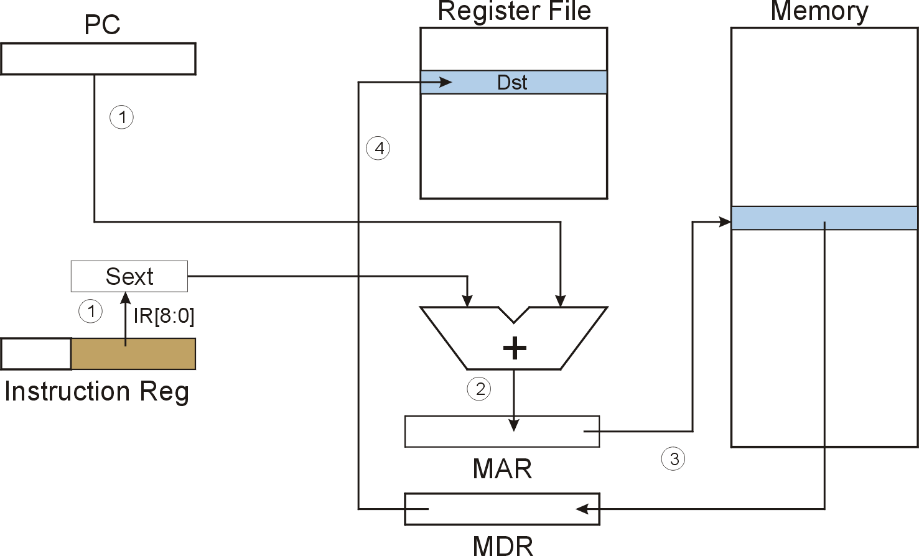
LD (PC-Relative) LD DR, PCoffset9
LD
Notes:
14

Slide 15
LD (PC-Relative) : LD R1, x1AF
Register File
Memory
PC
0
1
0
0
0
0
0
0
0
0
0
1
1
0
0
1
R0
R1
0
0
0
0
0
0
0
0
0
0
0
0
0
1
0
1
R2
IR
0
0
1
0
0
0
1
1
1
0
1
0
1
1
1
1
R3
①
①
R4
IR[8:0]=110101111
R5
SEXT
R6
x3FC8
R7
0
0
0
0
0
0
0
0
0
0
0
0
0
1
0
1
1111111110101111 = xFFAF
x4019
A
B
+
PC = x4018
PC+1 = x4019
X4019 + xFFAF = x3FC8
②
④
③
x3FC8
x3FC8
MAR
③
# 5
MDR
Notes:
15

Slide 16
F
D
EA
LD (PC-Relative)
OP
16
GatePC
16
GateMARMUX
EX
LD.PC
PC
DR
3
MARMUX
+1
REG FILE
16
2
PCMUX
16
16
16
16
16
LD.REG
S
[7:0]
SR2
SR2
OUT
SR1
OUT
SR1
SEXT
+
3
3
ADDR2MUX
MUX
MUX
ADDR1MUX
16
16
[10:0]
16
16
16
16
16
SEXT
[8:0]
LD.CC
16
SEXT
FINITE STATE MACHINE
SR2MUX
[5:0]
SEXT
16
N
Z
P
ALUK
A
B
[4:0]
SEXT
2
ALU
LD.IR
IR
LOGIC
…
16
16
16
RUN
GateALU
16
GateMDR
16
LD.MDR
MDR
MEMORY
MAR
LD.MAR
16
INPUT
OUTPUT
MIO.EN
MUX
16
MEM.EN,R,W

Slide 17
F
D
EA
LD (PC-Relative)
OP
16
GatePC
16
GateMARMUX
EX
LD.PC
PC
DR
3
MARMUX
+1
REG FILE
16
2
PCMUX
16
16
16
16
16
LD.REG
S
[7:0]
SR2
SR2
OUT
SR1
OUT
SR1
SEXT
+
3
3
ADDR2MUX
MUX
MUX
ADDR1MUX
16
16
[10:0]
16
16
16
16
16
SEXT
[8:0]
LD.CC
16
SEXT
FINITE STATE MACHINE
SR2MUX
[5:0]
SEXT
16
N
Z
P
ALUK
A
B
[4:0]
SEXT
2
ALU
LD.IR
IR
LOGIC
…
16
16
16
RUN
GateALU
16
GateMDR
16
LD.MDR
MDR
MEMORY
MAR
LD.MAR
16
INPUT
OUTPUT
MIO.EN
MUX
16
MEM.EN,R,W

Slide 18
F
D
EA
LD (PC-Relative)
OP
16
GatePC
16
GateMARMUX
EX
LD.PC
PC
DR
3
MARMUX
+1
REG FILE
16
2
PCMUX
16
16
16
16
16
LD.REG
S
[7:0]
SR2
SR2
OUT
SR1
OUT
SR1
SEXT
+
3
3
ADDR2MUX
MUX
MUX
ADDR1MUX
16
16
[10:0]
16
16
16
16
16
SEXT
[8:0]
LD.CC
16
SEXT
FINITE STATE MACHINE
SR2MUX
[5:0]
SEXT
16
N
Z
P
ALUK
A
B
[4:0]
SEXT
2
ALU
LD.IR
IR
LOGIC
…
16
16
16
RUN
GateALU
16
GateMDR
16
LD.MDR
MDR
MEMORY
MAR
LD.MAR
16
INPUT
OUTPUT
MIO.EN
MUX
16
MEM.EN,R,W

Slide 19
LD (PC-Relative)
F
D
EA
OP
EX
S
16
GatePC
16
GateMARMUX
LD.PC
PC
DR
3
MARMUX
+1
REG FILE
16
2
PCMUX
16
16
16
16
16
LD.REG
[7:0]
SR2
SR2
OUT
SR1
OUT
SR1
SEXT
+
3
3
ADDR2MUX
MUX
MUX
ADDR1MUX
16
16
[10:0]
16
16
16
16
16
SEXT
[8:0]
LD.CC
16
SEXT
FINITE STATE MACHINE
SR2MUX
[5:0]
SEXT
16
N
Z
P
ALUK
A
B
[4:0]
SEXT
2
ALU
LD.IR
IR
LOGIC
…
16
16
16
RUN
GateALU
16
GateMDR
16
LD.MDR
MDR
MEMORY
MAR
LD.MAR
16
INPUT
OUTPUT
MIO.EN
MUX
16
MEM.EN,R,W

Slide 20
D
EA
LD (PC-Relative)
F
OP
16
GatePC
16
GateMARMUX
EX
LD.PC
PC
DR
3
MARMUX
+1
REG FILE
16
2
PCMUX
16
16
16
16
16
LD.REG
S
[7:0]
SR2
SR2
OUT
SR1
OUT
SR1
SEXT
+
3
3
ADDR2MUX
MUX
MUX
ADDR1MUX
16
16
[10:0]
16
16
16
16
16
SEXT
[8:0]
LD.CC
16
SEXT
FINITE STATE MACHINE
SR2MUX
[5:0]
SEXT
16
N
Z
P
ALUK
A
B
[4:0]
SEXT
2
ALU
LD.IR
IR
LOGIC
…
16
16
16
RUN
GateALU
16
GateMDR
16
LD.MDR
MDR
MEMORY
MAR
LD.MAR
16
INPUT
OUTPUT
MIO.EN
MUX
16
MEM.EN,R,W

Slide 21
D
EA
LD (PC-Relative)
F
EX
OP
16
GatePC
16
GateMARMUX
LD.PC
PC
DR
3
MARMUX
+1
REG FILE
16
2
PCMUX
16
16
16
16
16
LD.REG
S
[7:0]
SR2
SR2
OUT
SR1
OUT
SR1
SEXT
+
3
3
ADDR2MUX
MUX
MUX
ADDR1MUX
16
16
[10:0]
16
16
16
16
16
SEXT
[8:0]
LD.CC
16
SEXT
FINITE STATE MACHINE
SR2MUX
[5:0]
SEXT
16
N
Z
P
ALUK
A
B
[4:0]
SEXT
2
ALU
LD.IR
IR
LOGIC
…
16
16
16
GateALU
RUN
16
GateMDR
16
LD.MDR
MDR
MEMORY
MAR
LD.MAR
16
INPUT
OUTPUT
MIO.EN
MUX
16
MEM.EN,R,W

Slide 22
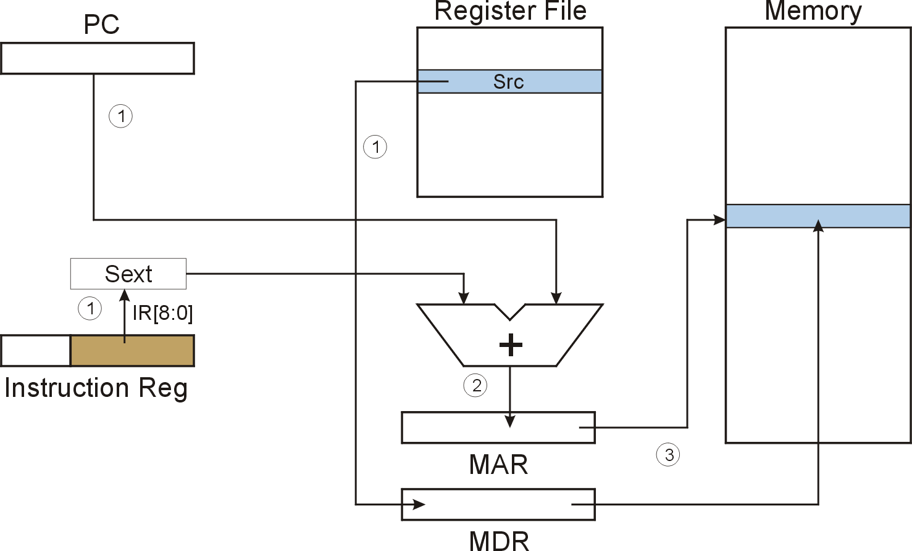
ST (PC-Relative) ST SR, PCoffset9
4
ST
Notes:
22

Slide 23
F
D
EA
ST (PC-Relative)
OP
16
GatePC
16
GateMARMUX
EX
LD.PC
PC
DR
3
MARMUX
+1
REG FILE
16
2
PCMUX
16
16
16
16
16
LD.REG
S
[7:0]
SR2
SR2
OUT
SR1
OUT
SR1
SEXT
+
3
3
ADDR2MUX
MUX
MUX
ADDR1MUX
16
16
[10:0]
16
16
16
16
16
SEXT
[8:0]
LD.CC
16
SEXT
FINITE STATE MACHINE
SR2MUX
[5:0]
SEXT
16
N
Z
P
ALUK
A
B
[4:0]
SEXT
2
ALU
LD.IR
IR
LOGIC
…
16
16
16
RUN
GateALU
16
GateMDR
16
LD.MDR
MDR
MEMORY
MAR
LD.MAR
16
INPUT
OUTPUT
MIO.EN
MUX
16
MEM.EN,R,W

Slide 24
F
D
EA
ST (PC-Relative)
OP
16
GatePC
16
GateMARMUX
EX
LD.PC
PC
DR
3
MARMUX
+1
REG FILE
16
2
PCMUX
16
16
16
16
16
LD.REG
S
[7:0]
SR2
SR2
OUT
SR1
OUT
SR1
SEXT
+
3
3
ADDR2MUX
MUX
MUX
ADDR1MUX
16
16
[10:0]
16
16
16
16
16
SEXT
[8:0]
LD.CC
16
SEXT
FINITE STATE MACHINE
SR2MUX
[5:0]
SEXT
16
N
Z
P
ALUK
A
B
[4:0]
SEXT
2
ALU
LD.IR
IR
LOGIC
…
16
16
16
RUN
GateALU
16
GateMDR
16
LD.MDR
MDR
MEMORY
MAR
LD.MAR
16
INPUT
OUTPUT
MIO.EN
MUX
16
MEM.EN,R,W

Slide 25
F
D
EA
ST (PC-Relative)
OP
16
GatePC
16
GateMARMUX
EX
LD.PC
PC
DR
3
MARMUX
+1
REG FILE
16
2
PCMUX
16
16
16
16
16
LD.REG
S
[7:0]
SR2
SR2
OUT
SR1
OUT
SR1
SEXT
+
3
3
ADDR2MUX
MUX
MUX
ADDR1MUX
16
16
[10:0]
16
16
16
16
16
SEXT
[8:0]
LD.CC
16
SEXT
FINITE STATE MACHINE
SR2MUX
[5:0]
SEXT
16
N
Z
P
ALUK
A
B
[4:0]
SEXT
2
ALU
LD.IR
IR
LOGIC
…
16
16
16
RUN
GateALU
16
GateMDR
16
LD.MDR
MDR
MEMORY
MAR
LD.MAR
16
INPUT
OUTPUT
MIO.EN
MUX
16
MEM.EN,R,W

Slide 26
ST (PC-Relative)
F
D
EA
OP
EX
S
16
GatePC
16
GateMARMUX
LD.PC
PC
DR
3
MARMUX
+1
REG FILE
16
2
PCMUX
16
16
16
16
16
LD.REG
[7:0]
SR2
SR2
OUT
SR1
OUT
SR1
SEXT
+
3
3
ADDR2MUX
MUX
MUX
ADDR1MUX
16
16
[10:0]
16
16
16
16
16
SEXT
[8:0]
LD.CC
16
SEXT
FINITE STATE MACHINE
SR2MUX
[5:0]
SEXT
16
N
Z
P
ALUK
A
B
[4:0]
SEXT
2
ALU
LD.IR
IR
LOGIC
…
16
16
16
RUN
GateALU
16
GateMDR
16
LD.MDR
MDR
MEMORY
MAR
LD.MAR
16
INPUT
OUTPUT
MIO.EN
MUX
16
MEM.EN,R,W

Slide 27
D
EA
ST (PC-Relative)
F
EX
S
OP
16
GatePC
16
GateMARMUX
LD.PC
PC
DR
3
MARMUX
+1
REG FILE
16
2
PCMUX
16
16
16
16
16
LD.REG
[7:0]
SR2
SR2
OUT
SR1
OUT
SR1
SEXT
+
3
3
ADDR2MUX
MUX
MUX
ADDR1MUX
16
16
[10:0]
16
16
16
16
16
SEXT
[8:0]
LD.CC
16
SEXT
FINITE STATE MACHINE
SR2MUX
[5:0]
SEXT
16
N
Z
P
ALUK
A
B
[4:0]
SEXT
2
ALU
LD.IR
IR
LOGIC
…
16
16
16
GateALU
RUN
16
GateMDR
16
LD.MDR
MDR
MEMORY
MAR
LD.MAR
16
INPUT
OUTPUT
MIO.EN
MUX
16
MEM.EN,R,W

Slide 28
D
EA
ST (PC-Relative)
F
EX
OP
16
GatePC
16
GateMARMUX
LD.PC
PC
DR
3
MARMUX
+1
REG FILE
16
2
PCMUX
16
16
16
16
16
LD.REG
S
[7:0]
SR2
SR2
OUT
SR1
OUT
SR1
SEXT
+
3
3
ADDR2MUX
MUX
MUX
ADDR1MUX
16
16
[10:0]
16
16
16
16
16
SEXT
[8:0]
LD.CC
16
SEXT
FINITE STATE MACHINE
SR2MUX
[5:0]
SEXT
16
N
Z
P
ALUK
A
B
[4:0]
SEXT
2
ALU
LD.IR
IR
LOGIC
…
16
16
16
RUN
GateALU
16
GateMDR
16
LD.MDR
MDR
MEMORY
MAR
LD.MAR
16
INPUT
OUTPUT
MIO.EN
MUX
16
MEM.EN,R,W

Slide 29
Outline
1
Review
2
LC-3 PC-Relative Load/Store
3
LC-3 Indirect, Base+offset Load/Store
4
Summary

Slide 30
Indirect Addressing Mode
With PC-relative mode, can only address data
within 256 words of the instruction.
  What about the rest of memory?
Solution #1:
  Read address from memory location,
  then load/store to that address.
First address is generated from PC and IR
(just like PC-relative addressing), then
content of that address is used as target for load/store.

Slide 31
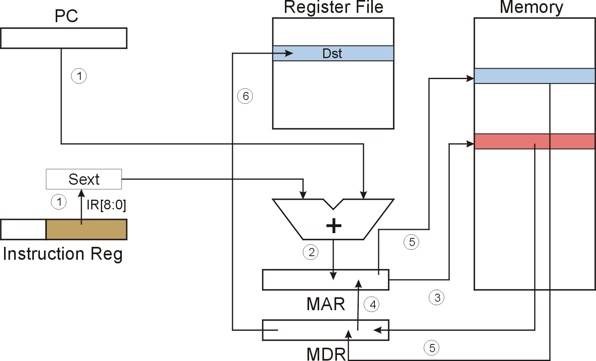
LDI (Indirect) LDI DR, PCoffset9
LDI
Notes:
31

Slide 32
LDI (Indirect) : LDI R1, x1AF
Register File
Memory
PC
0
1
0
0
0
0
0
0
0
0
0
1
1
0
0
1
R0
R1
1
1
1
1
1
1
1
1
1
1
1
1
1
1
1
1
R2
IR
1
0
1
0
0
0
1
1
1
0
1
0
1
1
1
1
R3
x2100
1
1
1
1
1
1
1
1
1
1
1
1
1
1
1
1
①
①
R4
IR[8:0]=110101111
R5
SEXT
R6
x3FC8
R7
0
0
1
0
0
0
0
1
0
0
0
0
0
0
0
0
1111111110101111 = xFFAF
x4019
A
B
+
PC = x4018
PC+1 = x4019
X4019 + xFFAF = x3FC8
②
④
③
x3FC8
x3FC8/ x2100
MAR
③
x2100/ # -1
MDR
Notes:
32

Slide 33
F
D
EA
LDI (Indirect)
OP
16
GatePC
16
GateMARMUX
EX
LD.PC
PC
DR
3
MARMUX
+1
REG FILE
16
2
PCMUX
16
16
16
16
16
LD.REG
S
[7:0]
SR2
SR2
OUT
SR1
OUT
SR1
SEXT
+
3
3
ADDR2MUX
MUX
MUX
ADDR1MUX
16
16
[10:0]
16
16
16
16
16
SEXT
[8:0]
LD.CC
16
SEXT
FINITE STATE MACHINE
SR2MUX
[5:0]
SEXT
16
N
Z
P
ALUK
A
B
[4:0]
SEXT
2
ALU
LD.IR
IR
LOGIC
…
16
16
16
RUN
GateALU
16
GateMDR
16
LD.MDR
MDR
MEMORY
MAR
LD.MAR
16
INPUT
OUTPUT
MIO.EN
MUX
16
MEM.EN,R,W

Slide 34
F
D
EA
LDI (Indirect)
OP
16
GatePC
16
GateMARMUX
EX
LD.PC
PC
DR
3
MARMUX
+1
REG FILE
16
2
PCMUX
16
16
16
16
16
LD.REG
S
[7:0]
SR2
SR2
OUT
SR1
OUT
SR1
SEXT
+
3
3
ADDR2MUX
MUX
MUX
ADDR1MUX
16
16
[10:0]
16
16
16
16
16
SEXT
[8:0]
LD.CC
16
SEXT
FINITE STATE MACHINE
SR2MUX
[5:0]
SEXT
16
N
Z
P
ALUK
A
B
[4:0]
SEXT
2
ALU
LD.IR
IR
LOGIC
…
16
16
16
RUN
GateALU
16
GateMDR
16
LD.MDR
MDR
MEMORY
MAR
LD.MAR
16
INPUT
OUTPUT
MIO.EN
MUX
16
MEM.EN,R,W

Slide 35
F
D
EA
LDI (Indirect)
OP
16
GatePC
16
GateMARMUX
EX
LD.PC
PC
DR
3
MARMUX
+1
REG FILE
16
2
PCMUX
16
16
16
16
16
LD.REG
S
[7:0]
SR2
SR2
OUT
SR1
OUT
SR1
SEXT
+
3
3
ADDR2MUX
MUX
MUX
ADDR1MUX
16
16
[10:0]
16
16
16
16
16
SEXT
[8:0]
LD.CC
16
SEXT
FINITE STATE MACHINE
SR2MUX
[5:0]
SEXT
16
N
Z
P
ALUK
A
B
[4:0]
SEXT
2
ALU
LD.IR
IR
LOGIC
…
16
16
16
RUN
GateALU
16
GateMDR
16
LD.MDR
MDR
MEMORY
MAR
LD.MAR
16
INPUT
OUTPUT
MIO.EN
MUX
16
MEM.EN,R,W

Slide 36
LDI (Indirect)
F
D
EA
OP
EX
S
16
GatePC
16
GateMARMUX
LD.PC
PC
DR
3
MARMUX
+1
REG FILE
16
2
PCMUX
16
16
16
16
16
LD.REG
[7:0]
SR2
SR2
OUT
SR1
OUT
SR1
SEXT
+
3
3
ADDR2MUX
MUX
MUX
ADDR1MUX
16
16
[10:0]
16
16
16
16
16
SEXT
[8:0]
LD.CC
16
SEXT
FINITE STATE MACHINE
SR2MUX
[5:0]
SEXT
16
N
Z
P
ALUK
A
B
[4:0]
SEXT
2
ALU
LD.IR
IR
LOGIC
…
16
16
16
RUN
GateALU
16
GateMDR
16
LD.MDR
MDR
MEMORY
MAR
LD.MAR
16
INPUT
OUTPUT
MIO.EN
MUX
16
MEM.EN,R,W

Slide 37
D
LDI (Indirect)
F
EA
OP
16
GatePC
16
GateMARMUX
EX
LD.PC
PC
DR
3
MARMUX
+1
REG FILE
16
2
PCMUX
16
16
16
16
16
LD.REG
S
[7:0]
SR2
SR2
OUT
SR1
OUT
SR1
SEXT
+
3
3
ADDR2MUX
MUX
MUX
ADDR1MUX
16
16
[10:0]
16
16
16
16
16
SEXT
[8:0]
LD.CC
16
SEXT
FINITE STATE MACHINE
SR2MUX
[5:0]
SEXT
16
N
Z
P
ALUK
A
B
[4:0]
SEXT
2
ALU
LD.IR
IR
LOGIC
…
16
16
16
RUN
GateALU
16
GateMDR
16
LD.MDR
MDR
MEMORY
MAR
LD.MAR
16
INPUT
OUTPUT
MIO.EN
MUX
16
MEM.EN,R,W

Slide 38
D
EA
LDI (Indirect)
F
OP
16
GatePC
16
GateMARMUX
EX
LD.PC
PC
DR
3
MARMUX
+1
REG FILE
16
2
PCMUX
16
16
16
16
16
LD.REG
S
[7:0]
SR2
SR2
OUT
SR1
OUT
SR1
SEXT
+
3
3
ADDR2MUX
MUX
MUX
ADDR1MUX
16
16
[10:0]
16
16
16
16
16
SEXT
[8:0]
LD.CC
16
SEXT
FINITE STATE MACHINE
SR2MUX
[5:0]
SEXT
16
N
Z
P
ALUK
A
B
[4:0]
SEXT
2
ALU
LD.IR
IR
LOGIC
…
16
16
16
RUN
GateALU
16
GateMDR
16
LD.MDR
MDR
MEMORY
MAR
LD.MAR
16
INPUT
OUTPUT
MIO.EN
MUX
16
MEM.EN,R,W

Slide 39
D
LDI (Indirect)
F
EA
OP
16
GatePC
16
GateMARMUX
EX
LD.PC
PC
DR
3
MARMUX
+1
REG FILE
16
2
PCMUX
16
16
16
16
16
LD.REG
S
[7:0]
SR2
SR2
OUT
SR1
OUT
SR1
SEXT
+
3
3
ADDR2MUX
MUX
MUX
ADDR1MUX
16
16
[10:0]
16
16
16
16
16
SEXT
[8:0]
LD.CC
16
SEXT
FINITE STATE MACHINE
SR2MUX
[5:0]
SEXT
16
N
Z
P
ALUK
A
B
[4:0]
SEXT
2
ALU
LD.IR
IR
LOGIC
…
16
16
16
RUN
GateALU
16
GateMDR
16
LD.MDR
MDR
MEMORY
MAR
LD.MAR
16
INPUT
OUTPUT
MIO.EN
MUX
16
MEM.EN,R,W

Slide 40
D
EA
LDI (Indirect)
F
EX
OP
16
GatePC
16
GateMARMUX
LD.PC
PC
DR
3
MARMUX
+1
REG FILE
16
2
PCMUX
16
16
16
16
16
LD.REG
S
[7:0]
SR2
SR2
OUT
SR1
OUT
SR1
SEXT
+
3
3
ADDR2MUX
MUX
MUX
ADDR1MUX
16
16
[10:0]
16
16
16
16
16
SEXT
[8:0]
LD.CC
16
SEXT
FINITE STATE MACHINE
SR2MUX
[5:0]
SEXT
16
N
Z
P
ALUK
A
B
[4:0]
SEXT
2
ALU
LD.IR
IR
LOGIC
…
16
16
16
GateALU
RUN
16
GateMDR
16
LD.MDR
MDR
MEMORY
MAR
LD.MAR
16
INPUT
OUTPUT
MIO.EN
MUX
16
MEM.EN,R,W

Slide 41
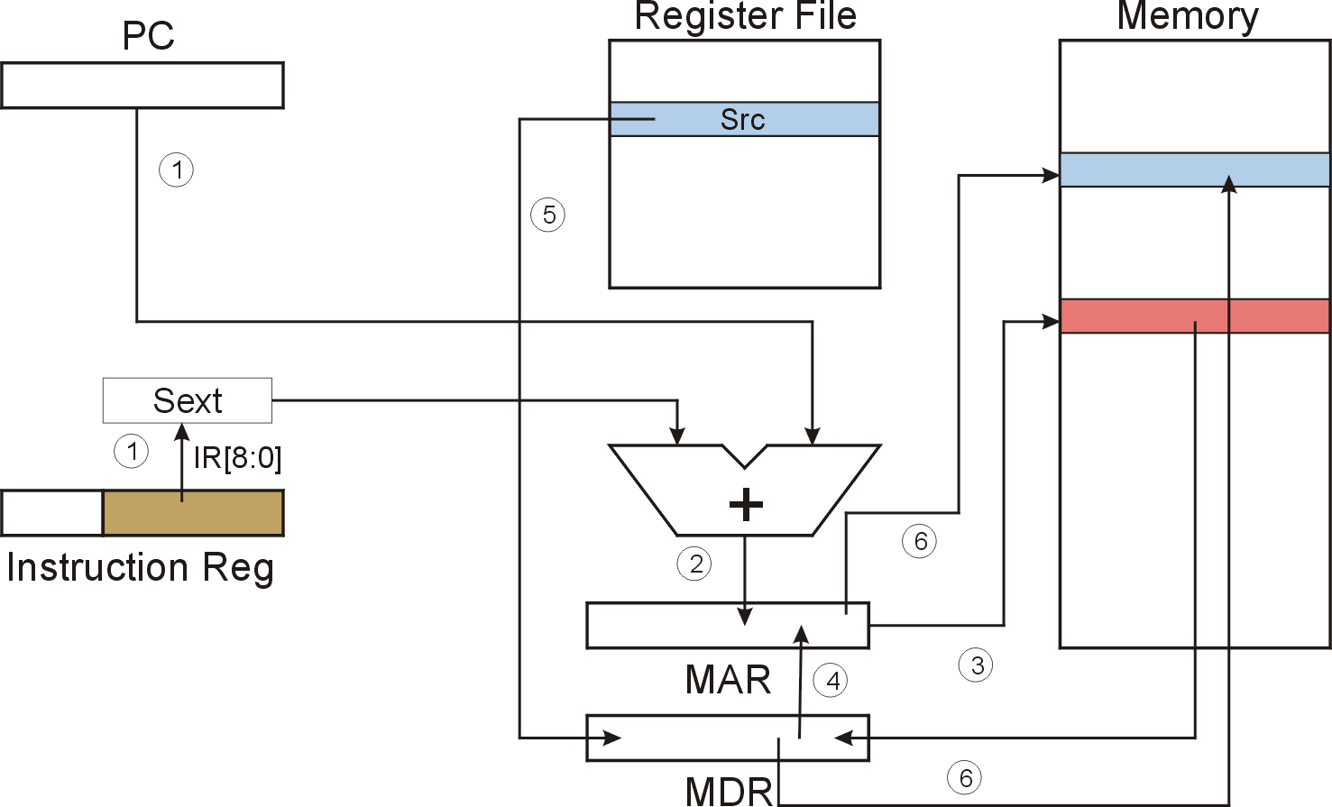
STI (Indirect) STI SR, PCoffset9
STI
Notes:
41

Slide 42
F
D
EA
STI (Indirect)
OP
16
GatePC
16
GateMARMUX
EX
LD.PC
PC
DR
3
MARMUX
+1
REG FILE
16
2
PCMUX
16
16
16
16
16
LD.REG
S
[7:0]
SR2
SR2
OUT
SR1
OUT
SR1
SEXT
+
3
3
ADDR2MUX
MUX
MUX
ADDR1MUX
16
16
[10:0]
16
16
16
16
16
SEXT
[8:0]
LD.CC
16
SEXT
FINITE STATE MACHINE
SR2MUX
[5:0]
SEXT
16
N
Z
P
ALUK
A
B
[4:0]
SEXT
2
ALU
LD.IR
IR
LOGIC
…
16
16
16
RUN
GateALU
16
GateMDR
16
LD.MDR
MDR
MEMORY
MAR
LD.MAR
16
INPUT
OUTPUT
MIO.EN
MUX
16
MEM.EN,R,W

Slide 43
F
D
EA
STI (Indirect)
OP
16
GatePC
16
GateMARMUX
EX
LD.PC
PC
DR
3
MARMUX
+1
REG FILE
16
2
PCMUX
16
16
16
16
16
LD.REG
S
[7:0]
SR2
SR2
OUT
SR1
OUT
SR1
SEXT
+
3
3
ADDR2MUX
MUX
MUX
ADDR1MUX
16
16
[10:0]
16
16
16
16
16
SEXT
[8:0]
LD.CC
16
SEXT
FINITE STATE MACHINE
SR2MUX
[5:0]
SEXT
16
N
Z
P
ALUK
A
B
[4:0]
SEXT
2
ALU
LD.IR
IR
LOGIC
…
16
16
16
RUN
GateALU
16
GateMDR
16
LD.MDR
MDR
MEMORY
MAR
LD.MAR
16
INPUT
OUTPUT
MIO.EN
MUX
16
MEM.EN,R,W

Slide 44
F
D
EA
STI (Indirect)
OP
16
GatePC
16
GateMARMUX
EX
LD.PC
PC
DR
3
MARMUX
+1
REG FILE
16
2
PCMUX
16
16
16
16
16
LD.REG
S
[7:0]
SR2
SR2
OUT
SR1
OUT
SR1
SEXT
+
3
3
ADDR2MUX
MUX
MUX
ADDR1MUX
16
16
[10:0]
16
16
16
16
16
SEXT
[8:0]
LD.CC
16
SEXT
FINITE STATE MACHINE
SR2MUX
[5:0]
SEXT
16
N
Z
P
ALUK
A
B
[4:0]
SEXT
2
ALU
LD.IR
IR
LOGIC
…
16
16
16
RUN
GateALU
16
GateMDR
16
LD.MDR
MDR
MEMORY
MAR
LD.MAR
16
INPUT
OUTPUT
MIO.EN
MUX
16
MEM.EN,R,W

Slide 45
STI (Indirect)
F
D
EA
OP
EX
S
16
GatePC
16
GateMARMUX
LD.PC
PC
DR
3
MARMUX
+1
REG FILE
16
2
PCMUX
16
16
16
16
16
LD.REG
[7:0]
SR2
SR2
OUT
SR1
OUT
SR1
SEXT
+
3
3
ADDR2MUX
MUX
MUX
ADDR1MUX
16
16
[10:0]
16
16
16
16
16
SEXT
[8:0]
LD.CC
16
SEXT
FINITE STATE MACHINE
SR2MUX
[5:0]
SEXT
16
N
Z
P
ALUK
A
B
[4:0]
SEXT
2
ALU
LD.IR
IR
LOGIC
…
16
16
16
RUN
GateALU
16
GateMDR
16
LD.MDR
MDR
MEMORY
MAR
LD.MAR
16
INPUT
OUTPUT
MIO.EN
MUX
16
MEM.EN,R,W

Slide 46
D
EA
STI (Indirect)
F
OP
16
GatePC
16
GateMARMUX
EX
LD.PC
PC
DR
3
MARMUX
+1
REG FILE
16
2
PCMUX
16
16
16
16
16
LD.REG
S
[7:0]
SR2
SR2
OUT
SR1
OUT
SR1
SEXT
+
3
3
ADDR2MUX
MUX
MUX
ADDR1MUX
16
16
[10:0]
16
16
16
16
16
SEXT
[8:0]
LD.CC
16
SEXT
FINITE STATE MACHINE
SR2MUX
[5:0]
SEXT
16
N
Z
P
ALUK
A
B
[4:0]
SEXT
2
ALU
LD.IR
IR
LOGIC
…
16
16
16
RUN
GateALU
16
GateMDR
16
LD.MDR
MDR
MEMORY
MAR
LD.MAR
16
INPUT
OUTPUT
MIO.EN
MUX
16
MEM.EN,R,W

Slide 47
D
EA
STI (Indirect)
F
OP
16
GatePC
16
GateMARMUX
EX
LD.PC
PC
DR
3
MARMUX
+1
REG FILE
16
2
PCMUX
16
16
16
16
16
LD.REG
S
[7:0]
SR2
SR2
OUT
SR1
OUT
SR1
SEXT
+
3
3
ADDR2MUX
MUX
MUX
ADDR1MUX
16
16
[10:0]
16
16
16
16
16
SEXT
[8:0]
LD.CC
16
SEXT
FINITE STATE MACHINE
SR2MUX
[5:0]
SEXT
16
N
Z
P
ALUK
A
B
[4:0]
SEXT
2
ALU
LD.IR
IR
LOGIC
…
16
16
16
RUN
GateALU
16
GateMDR
16
LD.MDR
MDR
MEMORY
MAR
LD.MAR
16
INPUT
OUTPUT
MIO.EN
MUX
16
MEM.EN,R,W

Slide 48
D
EA
STI (Indirect)
F
EX
OP
OP
16
GatePC
16
GateMARMUX
LD.PC
PC
DR
3
MARMUX
+1
REG FILE
16
2
PCMUX
16
16
16
16
16
LD.REG
[7:0]
SR2
SR2
OUT
SR1
OUT
SR1
SEXT
+
3
3
ADDR2MUX
MUX
MUX
ADDR1MUX
16
16
[10:0]
16
16
16
16
16
SEXT
[8:0]
LD.CC
16
SEXT
FINITE STATE MACHINE
SR2MUX
[5:0]
SEXT
16
N
Z
P
ALUK
A
B
[4:0]
SEXT
2
ALU
LD.IR
IR
LOGIC
…
16
16
16
GateALU
RUN
16
GateMDR
16
LD.MDR
MDR
MEMORY
MAR
LD.MAR
16
INPUT
OUTPUT
MIO.EN
MUX
16
MEM.EN,R,W

Slide 49
D
EA
STI (Indirect)
F
OP
EX
S
16
GatePC
16
GateMARMUX
LD.PC
PC
DR
3
MARMUX
+1
REG FILE
16
2
PCMUX
16
16
16
16
16
LD.REG
[7:0]
SR2
SR2
OUT
SR1
OUT
SR1
SEXT
+
3
3
ADDR2MUX
MUX
MUX
ADDR1MUX
16
16
[10:0]
16
16
16
16
16
SEXT
[8:0]
LD.CC
16
SEXT
FINITE STATE MACHINE
SR2MUX
[5:0]
SEXT
16
N
Z
P
ALUK
A
B
[4:0]
SEXT
2
ALU
LD.IR
IR
LOGIC
…
16
16
16
RUN
GateALU
16
GateMDR
16
LD.MDR
MDR
MEMORY
MAR
LD.MAR
16
INPUT
OUTPUT
MIO.EN
MUX
16
MEM.EN,R,W

Slide 50
Base + Offset Addressing Mode
With PC-relative mode, can only address data
within 256 words of the instruction.
  What about the rest of memory?
Solution #2:
  Use a register to generate a full 16-bit address.
4 bits for opcode, 3 for src/dest register,
3 bits for base register -- remaining 6 bits are used
as a signed offset.
  Offset is sign-extended before adding to base register.

Slide 51
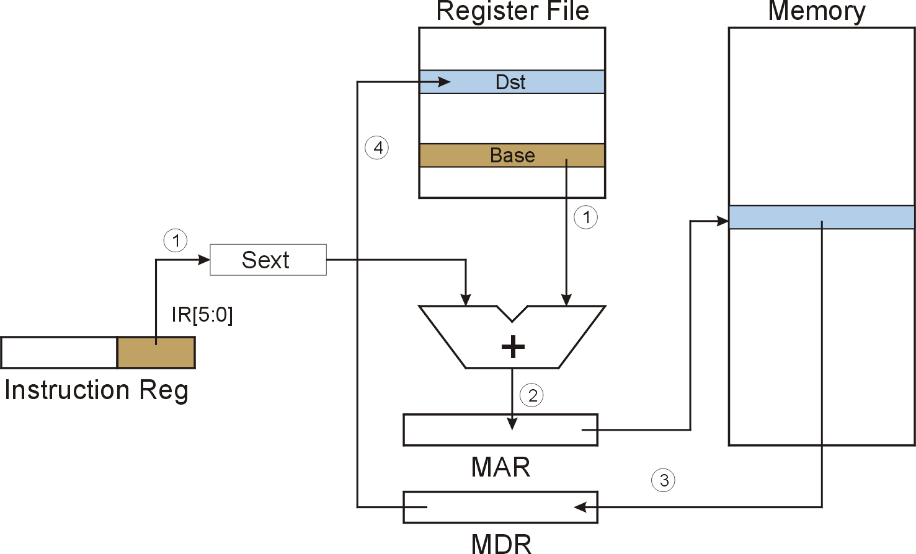
LDR (Base+Offset) LDR DR, BaseR, offset6
LDR
Notes:
51

Slide 52
LDR (Base+Offset) : LD R1, R3, x1D
Register File
Memory
R0
R1
0
0
0
0
0
0
0
0
0
0
0
0
0
1
0
1
R2
IR
0
1
1
0
0
0
1
0
1
1
0
1
1
1
0
1
R3
0
0
1
0
0
0
1
1
0
1
0
0
0
1
0
1
①
R4
IR[5:0]=011101
R5
SEXT
R6
x2362
R7
0
0
0
0
0
0
0
0
0
0
0
0
0
1
0
1
0000000000011101 = x1D
x2345
A
B
+
PC = x4018
PC+1 = x4019
x1D + x2345 = x2362
②
④
③
x2362
x2362
MAR
③
# 5
MDR
Notes:
52

Slide 53
F
D
EA
LDR (Base+Offset)
OP
16
GatePC
16
GateMARMUX
EX
LD.PC
PC
DR
3
MARMUX
+1
REG FILE
16
2
PCMUX
16
16
16
16
16
LD.REG
S
[7:0]
SR2
SR2
OUT
SR1
OUT
SR1
SEXT
+
3
3
ADDR2MUX
MUX
MUX
ADDR1MUX
16
16
[10:0]
16
16
16
16
16
SEXT
[8:0]
LD.CC
16
SEXT
FINITE STATE MACHINE
SR2MUX
[5:0]
SEXT
16
N
Z
P
ALUK
A
B
[4:0]
SEXT
2
ALU
LD.IR
IR
LOGIC
…
16
16
16
RUN
GateALU
16
GateMDR
16
LD.MDR
MDR
MEMORY
MAR
LD.MAR
16
INPUT
OUTPUT
MIO.EN
MUX
16
MEM.EN,R,W

Slide 54
F
D
EA
LDR (Base+Offset)
OP
16
GatePC
16
GateMARMUX
EX
LD.PC
PC
DR
3
MARMUX
+1
REG FILE
16
2
PCMUX
16
16
16
16
16
LD.REG
S
[7:0]
SR2
SR2
OUT
SR1
OUT
SR1
SEXT
+
3
3
ADDR2MUX
MUX
MUX
ADDR1MUX
16
16
[10:0]
16
16
16
16
16
SEXT
[8:0]
LD.CC
16
SEXT
FINITE STATE MACHINE
SR2MUX
[5:0]
SEXT
16
N
Z
P
ALUK
A
B
[4:0]
SEXT
2
ALU
LD.IR
IR
LOGIC
…
16
16
16
RUN
GateALU
16
GateMDR
16
LD.MDR
MDR
MEMORY
MAR
LD.MAR
16
INPUT
OUTPUT
MIO.EN
MUX
16
MEM.EN,R,W

Slide 55
F
D
EA
LDR (Base+Offset)
OP
16
GatePC
16
GateMARMUX
EX
LD.PC
PC
DR
3
MARMUX
+1
REG FILE
16
2
PCMUX
16
16
16
16
16
LD.REG
S
[7:0]
SR2
SR2
OUT
SR1
OUT
SR1
SEXT
+
3
3
ADDR2MUX
MUX
MUX
ADDR1MUX
16
16
[10:0]
16
16
16
16
16
SEXT
[8:0]
LD.CC
16
SEXT
FINITE STATE MACHINE
SR2MUX
[5:0]
SEXT
16
N
Z
P
ALUK
A
B
[4:0]
SEXT
2
ALU
LD.IR
IR
LOGIC
…
16
16
16
RUN
GateALU
16
GateMDR
16
LD.MDR
MDR
MEMORY
MAR
LD.MAR
16
INPUT
OUTPUT
MIO.EN
MUX
16
MEM.EN,R,W

Slide 56
LDR (Base+Offset)
F
D
EA
OP
EX
S
16
GatePC
16
GateMARMUX
LD.PC
PC
DR
3
MARMUX
+1
REG FILE
16
2
PCMUX
16
16
16
16
16
LD.REG
[7:0]
SR2
SR2
OUT
SR1
OUT
SR1
SEXT
+
3
3
ADDR2MUX
MUX
MUX
ADDR1MUX
16
16
[10:0]
16
16
16
16
16
SEXT
[8:0]
LD.CC
16
SEXT
FINITE STATE MACHINE
SR2MUX
[5:0]
SEXT
16
N
Z
P
ALUK
A
B
[4:0]
SEXT
2
ALU
LD.IR
IR
LOGIC
…
16
16
16
RUN
GateALU
16
GateMDR
16
LD.MDR
MDR
MEMORY
MAR
LD.MAR
16
INPUT
OUTPUT
MIO.EN
MUX
16
MEM.EN,R,W

Slide 57
D
EA
LDR (Base+Offset)
D
OP
16
GatePC
16
GateMARMUX
EX
LD.PC
PC
DR
3
MARMUX
+1
REG FILE
16
2
PCMUX
16
16
16
16
16
LD.REG
S
[7:0]
SR2
SR2
OUT
SR1
OUT
SR1
SEXT
+
3
3
ADDR2MUX
MUX
MUX
ADDR1MUX
16
16
[10:0]
16
16
16
16
16
SEXT
[8:0]
LD.CC
16
SEXT
FINITE STATE MACHINE
SR2MUX
[5:0]
SEXT
16
N
Z
P
ALUK
A
B
[4:0]
SEXT
2
ALU
LD.IR
IR
LOGIC
…
16
16
16
RUN
GateALU
16
GateMDR
16
LD.MDR
MDR
MEMORY
MAR
LD.MAR
16
INPUT
OUTPUT
MIO.EN
MUX
16
MEM.EN,R,W

Slide 58
D
EA
LDR (Base+Offset)
F
EX
OP
16
GatePC
16
GateMARMUX
LD.PC
PC
DR
3
MARMUX
+1
REG FILE
16
2
PCMUX
16
16
16
16
16
LD.REG
S
[7:0]
SR2
SR2
OUT
SR1
OUT
SR1
SEXT
+
3
3
ADDR2MUX
MUX
MUX
ADDR1MUX
16
16
[10:0]
16
16
16
16
16
SEXT
[8:0]
LD.CC
16
SEXT
FINITE STATE MACHINE
SR2MUX
[5:0]
SEXT
16
N
Z
P
ALUK
A
B
[4:0]
SEXT
2
ALU
LD.IR
IR
LOGIC
…
16
16
16
GateALU
RUN
16
GateMDR
16
LD.MDR
MDR
MEMORY
MAR
LD.MAR
16
INPUT
OUTPUT
MIO.EN
MUX
16
MEM.EN,R,W

Slide 59

STR (Base+Offset) STR SR, BaseR, offset6
STR
Notes:
59

Slide 60
F
D
EA
STR (Base+Offset)
OP
16
GatePC
16
GateMARMUX
EX
LD.PC
PC
DR
3
MARMUX
+1
REG FILE
16
2
PCMUX
16
16
16
16
16
LD.REG
S
[7:0]
SR2
SR2
OUT
SR1
OUT
SR1
SEXT
+
3
3
ADDR2MUX
MUX
MUX
ADDR1MUX
16
16
[10:0]
16
16
16
16
16
SEXT
[8:0]
LD.CC
16
SEXT
FINITE STATE MACHINE
SR2MUX
[5:0]
SEXT
16
N
Z
P
ALUK
A
B
[4:0]
SEXT
2
ALU
LD.IR
IR
LOGIC
…
16
16
16
RUN
GateALU
16
GateMDR
16
LD.MDR
MDR
MEMORY
MAR
LD.MAR
16
INPUT
OUTPUT
MIO.EN
MUX
16
MEM.EN,R,W

Slide 61
F
D
EA
STR (Base+Offset)
OP
16
GatePC
16
GateMARMUX
EX
LD.PC
PC
DR
3
MARMUX
+1
REG FILE
16
2
PCMUX
16
16
16
16
16
LD.REG
S
[7:0]
SR2
SR2
OUT
SR1
OUT
SR1
SEXT
+
3
3
ADDR2MUX
MUX
MUX
ADDR1MUX
16
16
[10:0]
16
16
16
16
16
SEXT
[8:0]
LD.CC
16
SEXT
FINITE STATE MACHINE
SR2MUX
[5:0]
SEXT
16
N
Z
P
ALUK
A
B
[4:0]
SEXT
2
ALU
LD.IR
IR
LOGIC
…
16
16
16
RUN
GateALU
16
GateMDR
16
LD.MDR
MDR
MEMORY
MAR
LD.MAR
16
INPUT
OUTPUT
MIO.EN
MUX
16
MEM.EN,R,W

Slide 62
F
D
EA
STR (Base+Offset)
OP
16
GatePC
16
GateMARMUX
EX
LD.PC
PC
DR
3
MARMUX
+1
REG FILE
16
2
PCMUX
16
16
16
16
16
LD.REG
S
[7:0]
SR2
SR2
OUT
SR1
OUT
SR1
SEXT
+
3
3
ADDR2MUX
MUX
MUX
ADDR1MUX
16
16
[10:0]
16
16
16
16
16
SEXT
[8:0]
LD.CC
16
SEXT
FINITE STATE MACHINE
SR2MUX
[5:0]
SEXT
16
N
Z
P
ALUK
A
B
[4:0]
SEXT
2
ALU
LD.IR
IR
LOGIC
…
16
16
16
RUN
GateALU
16
GateMDR
16
LD.MDR
MDR
MEMORY
MAR
LD.MAR
16
INPUT
OUTPUT
MIO.EN
MUX
16
MEM.EN,R,W

Slide 63
STR (Base+Offset)
F
D
EA
OP
EX
S
16
GatePC
16
GateMARMUX
LD.PC
PC
DR
3
MARMUX
+1
REG FILE
16
2
PCMUX
16
16
16
16
16
LD.REG
[7:0]
SR2
SR2
OUT
SR1
OUT
SR1
SEXT
+
3
3
ADDR2MUX
MUX
MUX
ADDR1MUX
16
16
[10:0]
16
16
16
16
16
SEXT
[8:0]
LD.CC
16
SEXT
FINITE STATE MACHINE
SR2MUX
[5:0]
SEXT
16
N
Z
P
ALUK
A
B
[4:0]
SEXT
2
ALU
LD.IR
IR
LOGIC
…
16
16
16
RUN
GateALU
16
GateMDR
16
LD.MDR
MDR
MEMORY
MAR
LD.MAR
16
INPUT
OUTPUT
MIO.EN
MUX
16
MEM.EN,R,W

Slide 64
D
EA
STR (Base+Offset)
F
EX
OP
OP
16
GatePC
16
GateMARMUX
LD.PC
PC
DR
3
MARMUX
+1
REG FILE
16
2
PCMUX
16
16
16
16
16
LD.REG
[7:0]
SR2
SR2
OUT
SR1
OUT
SR1
SEXT
+
3
3
ADDR2MUX
MUX
MUX
ADDR1MUX
16
16
[10:0]
16
16
16
16
16
SEXT
[8:0]
LD.CC
16
SEXT
FINITE STATE MACHINE
SR2MUX
[5:0]
SEXT
16
N
Z
P
ALUK
A
B
[4:0]
SEXT
2
ALU
LD.IR
IR
LOGIC
…
16
16
16
GateALU
RUN
16
GateMDR
16
LD.MDR
MDR
MEMORY
MAR
LD.MAR
16
INPUT
OUTPUT
MIO.EN
MUX
16
MEM.EN,R,W

Slide 65
D
EA
STR (Base+Offset)
F
OP
EX
S
16
GatePC
16
GateMARMUX
LD.PC
PC
DR
3
MARMUX
+1
REG FILE
16
2
PCMUX
16
16
16
16
16
LD.REG
[7:0]
SR2
SR2
OUT
SR1
OUT
SR1
SEXT
+
3
3
ADDR2MUX
MUX
MUX
ADDR1MUX
16
16
[10:0]
16
16
16
16
16
SEXT
[8:0]
LD.CC
16
SEXT
FINITE STATE MACHINE
SR2MUX
[5:0]
SEXT
16
N
Z
P
ALUK
A
B
[4:0]
SEXT
2
ALU
LD.IR
IR
LOGIC
…
16
16
16
RUN
GateALU
16
GateMDR
16
LD.MDR
MDR
MEMORY
MAR
LD.MAR
16
INPUT
OUTPUT
MIO.EN
MUX
16
MEM.EN,R,W

Slide 66
Load Effective Address
Computes address like PC-relative (PC plus signed offset) and stores the result into a register.
Note: The address is stored in the register,
not the contents of the memory location.

Slide 67
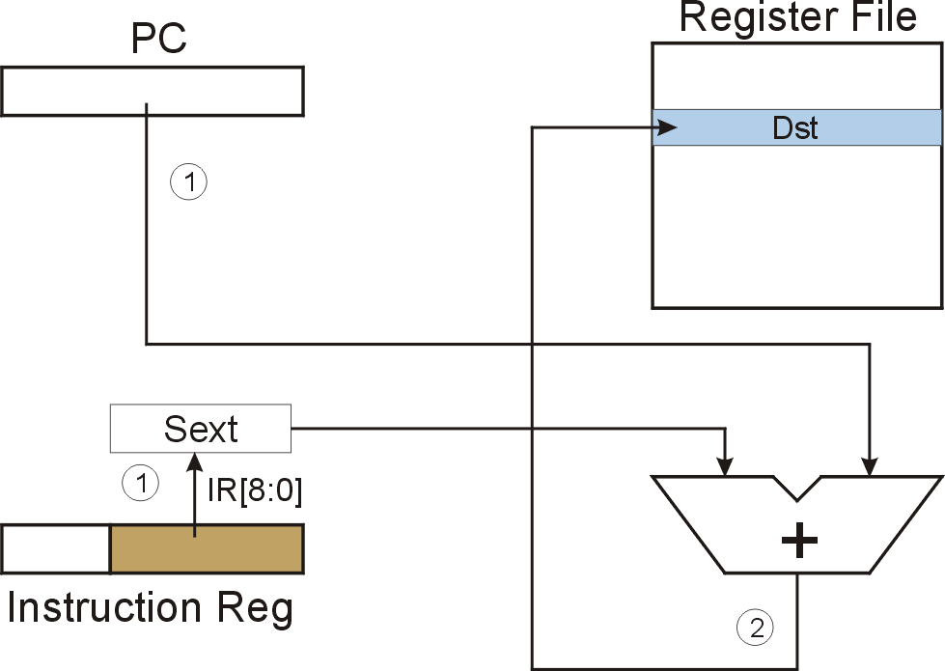
LEA (Immediate) LD DR, PCoffset9
LEA
Notes:
67

Slide 68
LEA (Immediate): LEA R1, x1AF
Register File
PC
0
1
0
0
0
0
0
0
0
0
0
1
1
0
0
1
R0
R1
0
0
1
1
1
1
1
1
1
0
1
1
1
0
0
0
R2
IR
0
0
1
0
0
0
1
1
1
0
1
0
1
1
1
1
R3
①
①
R4
IR[8:0]=110101111
R5
SEXT
R6
1111111110101111 = xFFAF
R7
x4019
A
B
+
PC = x4018
PC+1 = x4019
X4019 + xFFAF = x3FC8
②
x3FC8
Notes:
68

Slide 69
F
D
EA
LEA (Immediate)
OP
16
GatePC
16
GateMARMUX
EX
LD.PC
PC
DR
3
MARMUX
+1
REG FILE
16
2
PCMUX
16
16
16
16
16
LD.REG
S
[7:0]
SR2
SR2
OUT
SR1
OUT
SR1
SEXT
+
3
3
ADDR2MUX
MUX
MUX
ADDR1MUX
16
16
[10:0]
16
16
16
16
16
SEXT
[8:0]
LD.CC
16
SEXT
FINITE STATE MACHINE
SR2MUX
[5:0]
SEXT
16
N
Z
P
ALUK
A
B
[4:0]
SEXT
2
ALU
LD.IR
IR
LOGIC
…
16
16
16
RUN
GateALU
16
GateMDR
16
LD.MDR
MDR
MEMORY
MAR
LD.MAR
16
INPUT
OUTPUT
MIO.EN
MUX
16
MEM.EN,R,W

Slide 70
F
D
EA
LEA (Immediate)
OP
16
GatePC
16
GateMARMUX
EX
LD.PC
PC
DR
3
MARMUX
+1
REG FILE
16
2
PCMUX
16
16
16
16
16
LD.REG
S
[7:0]
SR2
SR2
OUT
SR1
OUT
SR1
SEXT
+
3
3
ADDR2MUX
MUX
MUX
ADDR1MUX
16
16
[10:0]
16
16
16
16
16
SEXT
[8:0]
LD.CC
16
SEXT
FINITE STATE MACHINE
SR2MUX
[5:0]
SEXT
16
N
Z
P
ALUK
A
B
[4:0]
SEXT
2
ALU
LD.IR
IR
LOGIC
…
16
16
16
RUN
GateALU
16
GateMDR
16
LD.MDR
MDR
MEMORY
MAR
LD.MAR
16
INPUT
OUTPUT
MIO.EN
MUX
16
MEM.EN,R,W

Slide 71
F
D
EA
LEA (Immediate)
OP
16
GatePC
16
GateMARMUX
EX
LD.PC
PC
DR
3
MARMUX
+1
REG FILE
16
2
PCMUX
16
16
16
16
16
LD.REG
S
[7:0]
SR2
SR2
OUT
SR1
OUT
SR1
SEXT
+
3
3
ADDR2MUX
MUX
MUX
ADDR1MUX
16
16
[10:0]
16
16
16
16
16
SEXT
[8:0]
LD.CC
16
SEXT
FINITE STATE MACHINE
SR2MUX
[5:0]
SEXT
16
N
Z
P
ALUK
A
B
[4:0]
SEXT
2
ALU
LD.IR
IR
LOGIC
…
16
16
16
RUN
GateALU
16
GateMDR
16
LD.MDR
MDR
MEMORY
MAR
LD.MAR
16
INPUT
OUTPUT
MIO.EN
MUX
16
MEM.EN,R,W

Slide 72
LEA (Immediate)
F
D
EA
OP
EX
S
16
GatePC
16
GateMARMUX
LD.PC
PC
DR
3
MARMUX
+1
REG FILE
16
2
PCMUX
16
16
16
16
16
LD.REG
[7:0]
SR2
SR2
OUT
SR1
OUT
SR1
SEXT
+
3
3
ADDR2MUX
MUX
MUX
ADDR1MUX
16
16
[10:0]
16
16
16
16
16
SEXT
[8:0]
LD.CC
16
SEXT
FINITE STATE MACHINE
SR2MUX
[5:0]
SEXT
16
N
Z
P
ALUK
A
B
[4:0]
SEXT
2
ALU
LD.IR
IR
LOGIC
…
16
16
16
RUN
GateALU
16
GateMDR
16
LD.MDR
MDR
MEMORY
MAR
LD.MAR
16
INPUT
OUTPUT
MIO.EN
MUX
16
MEM.EN,R,W

Slide 73
Example
Address | Instruction | Comments
x30F6 | 1 1 1 0 0 0 1 1 1 1 1 1 1 1 0 1 | R1 ← PC – 3 = x30F4
x30F7 | 0 0 0 1 0 1 0 0 0 1 1 0 1 1 1 0 | R2 ← R1 + 14 = x3102
x30F8 | 0 0 1 1 0 1 0 1 1 1 1 1 1 0 1 1 | M[PC - 5] ← R2; i.e. M[x30F4] ← x3102
x30F9 | 0 1 0 1 0 1 0 0 1 0 1 0 0 0 0 0 | R2 ← 0
x30FA | 0 0 0 1 0 1 0 0 1 0 1 0 0 1 0 1 | R2 ← R2 + 5 = 5
x30FB | 0 1 1 1 0 1 0 0 0 1 0 0 1 1 1 0 | M[R1+14] ← R2; i.e. M[x3102] ← 5
x30FC | 1 0 1 0 0 1 1 1 1 1 1 1 0 1 1 1 | R3 ← M[M[PC-9]] = M[M[x30F4]] = M[x3102] = 5
opcode
Notes:
73

Slide 74
Outline
1
Review
2
LC-3 PC-Relative Load/Store
3
LC-3 Indirect, Base+offset Load/Store
4
Summary

Slide 75
Today: Data Movement Instructions
取数指令
15
14
13
12
11
10
9
8
7
6
5
4
3
2
1
0
LD
0
0
1
0
DR
PCoffset9
LDR
0
1
1
0
DR
BaseR
PCoffset6
LDI
1
0
1
0
DR
PCoffset9
LEA
1
1
1
0
DR
PCoffset9
存数指令
15
14
13
12
11
10
9
8
7
6
5
4
3
2
1
0
ST
0
0
1
1
SR
PCoffset9
STR
0
1
1
1
SR
BaseR
PCoffset6
STI
1
0
1
1
SR
PCoffset9

Slide 76
LC-3 Data Path After Operate Instruction
₁₆
GatePC
₁₆
GateMARMUX
LD.PC
PC
DR
₃
MARMUX
+1
REG FILE
₁₆
₂
PCMUX
₁₆
₁₆
₁₆
₁₆
₁₆
LD.REG
[7:0]
SR2
SR2
OUT
SR1
OUT
SR1
SEXT
₊
₃
₃
ADDR2MUX
MUX
MUX
ADDR1MUX
₁₆
₁₆
[10:0]
₁₆
₁₆
₁₆
₁₆
₁₆
SEXT
[8:0]
LD.CC
₁₆
SEXT
FINITE STATE MACHINE
SR2MUX
[5:0]
SEXT
₁₆
N
Z
P
ALUK
_{A}
_{B}
[4:0]
SEXT
₂
ALU
LD.IR
IR
LOGIC
…
₁₆
₁₆
₁₆
RUN
GateALU
₁₆
GateMDR
₁₆
LD.MDR
MDR
MEMORY
MAR
LD.MAR
₁₆
INPUT
OUTPUT
MIO.EN
MUX
₁₆
MEM.EN,R,W

Slide 77
LC-3 Data Path After Load/Store Instruction
16
GatePC
16
GateMARMUX
LD.PC
PC
DR
3
MARMUX
+1
REG FILE
16
2
PCMUX
16
16
16
16
16
LD.REG
[7:0]
SR2
SR2
OUT
SR1
OUT
SR1
SEXT
+
3
3
ADDR2MUX
MUX
MUX
ADDR1MUX
16
16
[10:0]
16
16
16
16
16
SEXT
[8:0]
LD.CC
16
SEXT
FINITE STATE MACHINE
SR2MUX
[5:0]
SEXT
16
N
Z
P
ADD/AND
A
B
[4:0]
SEXT
2
ALU
LD.IR
IR
LOGIC
…
16
16
16
RUN
GateALU
16
GateMDR
16
LD.MDR
MDR
MEMORY
MAR
LD.MAR
16
INPUT
OUTPUT
MIO.EN
MUX
16
MEM.EN,R,W

Slide 78
Next Lecture: Control Instructions
15
14
13
12
11
10
9
8
7
6
5
4
3
2
1
0
BR
0
0
0
0
n
z
p
PCoffset9
JSR
0
1
0
0
1
PCoffset11
JSRR
0
1
0
0
0
0
0
BaseR
0
0
0
0
0
0
RTI
1
0
0
0
0
0
0
0
0
0
0
0
0
0
0
0
JMP
1
1
0
0
0
0
0
BaseR
0
0
0
0
0
0
RET
1
1
0
0
0
0
0
1
1
1
0
0
0
0
0
0
TRAP
1
1
1
1
0
0
0
0
TrapVector8

