Slide 1
Chapter 9-2
Operating System Service Routines
计算系统概论A
Introduction to Computing Systems
（ CS1002A.01 ）
计算机科学与技术学院
School of Computer Science and Technology

Slide 2
Outline
1
1
Review
Review
1
2
Review
TRAP Routines
3
3
A Machine Structure：von Neumann Model
Operating System Service Routines

Slide 3
Today: CONTROL in Von Neumann Model

Slide 4
Control Instructions for System Calls
15
14
13
12
11
10
9
8
7
6
5
4
3
2
1
0
BR
0
0
0
0
n
z
p
PCoffset9
JSR
0
1
0
0
1
PCoffset11
JSRR
0
1
0
0
0
0
0
BaseR
0
0
0
0
0
0
RTI
1
0
0
0
0
0
0
0
0
0
0
0
0
0
0
0
JMP
1
1
0
0
0
0
0
BaseR
0
0
0
0
0
0
RET
1
1
0
0
0
0
0
1
1
1
0
0
0
0
0
0
TRAP
1
1
1
1
0
0
0
0
TrapVector8

Slide 5
Today: CONTROL in LC-3 Data Path
₁₆
GatePC
₁₆
GateMARMUX
LD.PC
PC
DR
₃
MARMUX
+1
REG FILE
₁₆
₂
PCMUX
₁₆
₁₆
₁₆
₁₆
₁₆
LD.REG
Control Unit
SR2
OUT
SR1
OUT
[7:0]
SEXT
SR2
₃
SR1
₊
₃
ADDR2MUX
MUX
MUX
ADDR1MUX
₁₆
₁₆
[10:0]
₁₆
₁₆
₁₆
₁₆
₁₆
SEXT
[8:0]
LD.CC
₁₆
SEXT
FINITE STATE MACHINE
SR2MUX
[5:0]
SEXT
₁₆
N
Z
P
ALUK
_{A}
_{B}
[4:0]
SEXT
₂
ALU
LD.IR
IR
LOGIC
…
₁₆
₁₆
₁₆
RUN
GateALU
₁₆
GateMDR
₁₆
LD.MDR
MDR
MEMORY
MAR
LD.MAR
₁₆
INPUT
OUTPUT
MIO.EN
MUX
₁₆
MEM.EN,R,W

Slide 6
Outline
1
1
Review
Review
1
2
Review
TRAP Routines
3
3
A Machine Structure：von Neumann Model
Operating System Service Routines

Slide 7
System Calls
Some operations require specialized knowledge and protection
  Understanding IO device registers and how to use them poses a challenge to most application programmers.
  I/O registers are shared by many programs, and in general it is
  ill-advised (不明智的) to give user programmers access to these registers.
Solution: service routines or system calls
  Low-level, privileged operations performed by operating system
    1. User program invokes (调用) system call
    2. Operating system code:
      Saves registers
      Performs operation
      Restores registers
    3. Returns control to user program

Slide 8
LC-3 TRAP Mechanism
Provides a set of service routines
  Part of operating system
  routines start at arbitrary (任意) addresses
  Up to 256 (why?) routines
Requires a table of starting addresses
  Stored in memory (x0000 through x00FF)
  Used to associate code with trap number
  Called Trap Vector Table (or System Control Block)
Uses the TRAP instruction
  When a user program wishes to
  have the operating system execute a specific service routine on behalf of the user program
  and then return control to the user program
Uses a linkage mechanism
  For returning control to the user program
  Execution resumes immediately after the TRAP instruction
  Routines use the RTI instruction

Slide 9
LC-3 TRAP Routines(service routines)
  GETC (TRAP x20)
    Read a single character from keyboard.
    The character is not echoed to the console.
    ASCII copied into R0 and R0[15:8] is cleared.
  OUT (TRAP x21)
    Write R0[7:0] to the console display.
  PUTS (TRAP x22)
    Write a string of ASCII characters to the console display.
    String address in R0.
    Writing terminates with the occurrence of x0000
  IN (TRAP x23)
    Print a prompt on the screen and read a single character from the keyboard.
    Character is echoed to the console. .
    ASCII copied into R0 and R0[15:8] is cleared.
  HALT (TRAP x25)
    Halt execution and print a message on the console.
x0000
_{预留代码空间}
_{(实用代码空间)}
:
:
:
x0020
x0400
48
x0021
x0430
32(14)
x0022
x0450
96
x0023
x04A0
64(42)
x0024
x04E0
x0025
x0520
:
:
:
x00FF
The LC-3 Trap Vector Table

Slide 10
TRAP Instruction
15 14 13 12
11 10 9 8
7 6 5 4 3 2 1 0
TRAP
1 1 1 1
0 0 0 0
trap vector
Trap vector
  Identifies which service routine the user program wants the operating system to execute on its behalf
  8-bit trap vector zero-extended to form 16-bit address, serves as index into table of service routine addresses
Where to go
  Lookup starting address from table
Enabling return
  Push the address of next instruction after TRAP together with the PSR to the system stack (Poped by the RTI instruction)
x0000
:
:
x0020
x0400
x0021
x0430
x0022
x0450
x0023
x04A0
x0024
x04E0
x0025
x0520
:
:
x00FF
The LC-3 Trap Vector Table

Slide 11
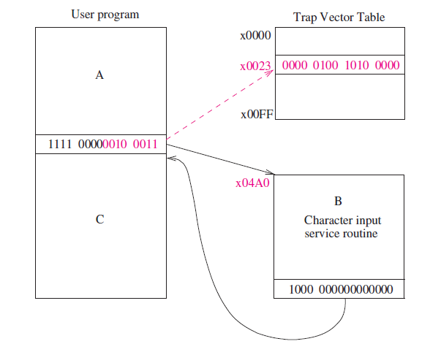
TRAP Mechanism Operation
①
②
③
RTI

Slide 12
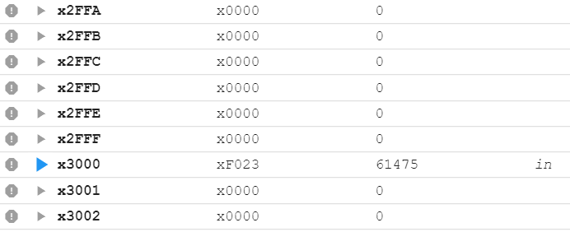
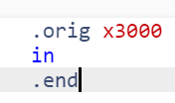
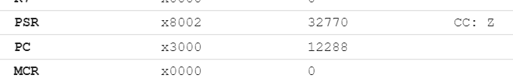
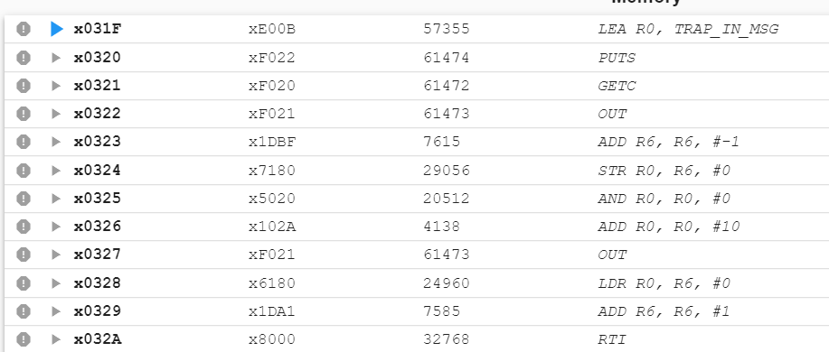
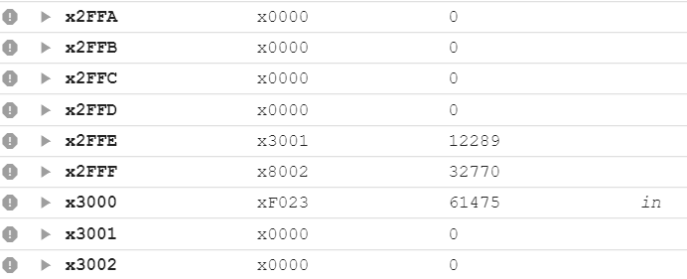
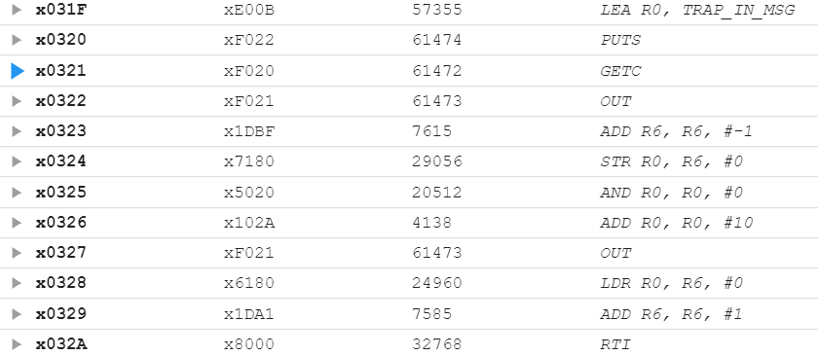
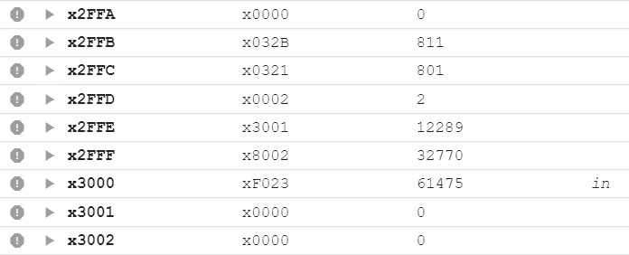
TRAP Mechanism Operation

Slide 13
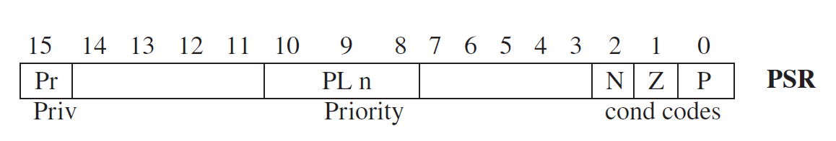
TRAP Mechanism Operation
  OLD_PSR=PSR;
  if (PSR[15] == 1) { // called by a user program
  Saved_USP ← R6;
  R6 ← Saved_SSP; //SSP：系统栈指针
  }
  PSR[15]=0; // switch to supervisor mode
  Push OLD_PSR, PC+1 on the system stack
  PC = mem[ZEXT(trapvect8)]; // set PC
  PSR[15]=0 means supervisor privilege, and PSR[15]=1 means unprivileged.

Slide 14
RTI instruction
RTI instruction – Return from Trap or Interrupt
15 14 13 12
11 10 9 8 7 6
5 4 3 2 1 0
RTI
1 0 0 0
0000 0000 0000

Slide 15
RTI instruction
// now ,we need to be in the supervisor mode
if (PSR[15] == 1) // which means we are in the user mode
//RTI cannot be called by user program
Initiate a privilege mode exception;
else
PC = mem[R6]; // R6 is the SSP, PC is restored
R6 = R6+1;
OLD_PSR = mem[R6]; // OLD_PSR is restored
R6 = R6+1; //system stack completes POP before saved PSR //is restored
PSR = OLD_PSR ; //PSR is restored
if (PSR[15] == 1) // supervisor mode → user mode
saved_SSP=R6;
R6=Saved_USP;

Slide 16
An example of using TRAP
.ORIG x3000
LD R2,TERM ; Load –’7’
LD R3,ASCII ; Load ASCII difference
AGAIN TRAP x23 ; Request keyboard input
ADD R1,R2,R0 ; Test for terminating
BRz EXIT ; character
ADD R0,R0,R3 ; Change to lowercase
TRAP x21 ; Output to the monitor
BRnzp AGAIN ; ... and do it again!
TERM .FILL xFFC9 ; FFC9 is negative of ASCII ‘7’
ASCII .FILL x0020
EXIT TRAP x25 ; Halt
.END

Slide 17
Outline
1
1
Review
Review
1
2
Review
TRAP Routines
3
3
A Machine Structure：von Neumann Model
Operating System Service Routines

Slide 18
Character Input Service Routine (IN, TRAP x23)
01 ; Service Routine for Keyboard Input
02 ;
03 .ORIG x04A0
04 START ST R1,SaveR1 ; Save the values in the registers
05 ST R2,SaveR2 ; that are used so that they
06 ST R3,SaveR3 ; can be restored before RTI
07 ;
08 LD R2,Newline ; Newline: ASCII code for newline x000A
09 L1 LDI R3,DSR ; Check DDR -- is it free?
0A BRzp L1 ; Display is free when DSR is negative
0B STI R2,DDR ; Move cursor to new clean line
0C ;
0D LEA R1,Prompt ; Prompt is starting address
0E ; of prompt string
1F Loop LDR R0,R1,#0 ; Get next prompt character
10 BRz Input ; Check for end of prompt string, nul
11 L2 LDI R3,DSR ; Check DDR -- is it free?
12 BRzp L2
13 STI R0,DDR ; Write next char
14 ; prompt string
15 ADD R1,R1,#1 ; Increment prompt pointer
16 BRnzp Loop
17 ;
  IN (TRAP x23)
    Print a prompt on the screen and read a single character from the keyboard.
    Character is echoed to the console. .
    ASCII copied into R0 and R0[15:8] is cleared.

Slide 19
Character Input Service Routine (IN, TRAP x23)
18 Input LDI R3,KBSR ; Has a character been typed?
19 BRzp Input ; When typed, KBSR is negative
1A LDI R0,KBDR ; Load it into R0
1B L3 LDI R3,DSR
1C BRzp L3 ; Display is free when DSR is negative
1D STI R0,DDR ; Echo input character
1E ; to the monitor
1F ;
20 L4 LDI R3,DSR
21 BRzp L4 ; Display is free when DSR is negative
22 STI R2,DDR ; Move cursor to new clean line
23 LD R1,SaveR1 ; Service routine done, restore
24 LD R2,SaveR2 ; original values in registers.
25 LD R3,SaveR3
26 RTI ; Return from Trap
27 ;
28 SaveR1 .BLKW 1
29 SaveR2 .BLKW 1
2A SaveR3 .BLKW 1
2B DSR .FILL xFE04
2C DDR .FILL xFE06
2D KBSR .FILL xFE00
2E KBDR .FILL xFE02
2F Newline .FILL x000A ; ASCII code for newline
30 Prompt .STRINGZ "Input a character>"
31 .END
  IN (TRAP x23)
    Print a prompt on the screen and read a single character from the keyboard.
    Character is echoed to the console. .
    ASCII copied into R0 and R0[15:8] is cleared.

Slide 20
A String Output Service Routine (OUT,TRAP x21)
01 .ORIG x0420 ; System call starting address
02 ST R1, SaveR1 ; R1 will be used to poll the DSR
03 ; hardware
04 ; Write the character
05 TryWrite LDI R1, DSR ; Get status
06 BRzp TryWrite ;Display is free when DSR is negative
07 WriteIt STI R0, DDR ; Write character
08
09; return from trap
0A Return LD R1, SaveR1 ; Restore registers
0B RTI ; Return from trap
0C DSR .FILL xFE04 ; Address of display status register
0D DDR .FILL xFE06 ; Address of display data register
0E SaveR1 .BLKW 1
0F .END
  OUT (TRAP x21)
    Write R0[7:0] to the console display.

Slide 21
A String Output Service Routine (PUTS,TRAP x22)
05 .ORIG x0460
06 ST R0, SaveR0 ; Save registers that
07 ST R1, SaveR1 ; are needed by this
08 ST R3, SaveR3 ; trap service routine
0A ; Loop through each character in the array
0C Loop LDR R1, R0, #0 ; Retrieve the character(s)
0D BRz Return ; If it is 0, done
0E L2 LDI R3,DSR
0F BRzp L2 ;Display is free when DSR is negative
10 STI R1, DDR ; Write the character
11 ADD R0, R0, #1 ; Increment pointer
12 BRnzp Loop ; Do it all over again
13 ;
14 ; Return from the request for service call
15 Return LD R3, SaveR3
16 LD R1, SaveR1
17 LD R0, SaveR0
18 RTI
19 ;
1A ; Register locations
1B DSR .FILL xFE04
1C DDR .FILL xFE06
1D SaveR0 .FILL x0000
1E SaveR1 .FILL x0000
1F SaveR3 .FILL x0000
20 .END
  PUTS (TRAP x22)
    Write a string of ASCII characters to the console display.
    String address in R0.
    Writing terminates with the occurrence of x0000

Slide 22
Halt the machine(HALT,TRAP x25)
01 .ORIG x0520 ; Where this routine resides
02 ST R1, SaveR1 ; R1: a temp for MC register
03 ST R0, SaveR0 ; R0 is used as working space
04
05 ; print message that machine is halting
06
07 LD R0, ASCIINewLine ;out x000A
08 TRAP x21
09 LEA R0, Message ;puts “Halting the machine."
0A TRAP x22
0B LD R0, ASCIINewLine ;out x000A
0C TRAP x21
0D ;
0E ; clear bit 15 at xFFFE (Master Control Register, MCR )to stop the machine, i.e., MCR[15] = 0
0F ;
10 LDI R1, MCR ; Load MC register into R1
11 LD R0, MASK ; R0 = x7FFF
12 AND R0, R1, R0 ; Mask to clear the top bit
13 STI R0, MCR ; Store R0 into MC register
  HALT (TRAP x25)
    Halt execution and print a message on the console.

Slide 23
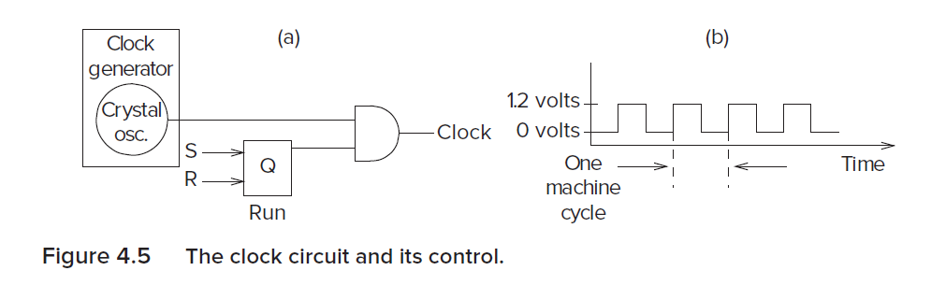
Halt the machine(HALT,TRAP x25)
14 ;
15 ; return from HALT routine.
16 ; (how can this routine return if the machine is halted above?)
17 ;
18 LD R1, SaveR1 ; Restore registers
19 LD R0, SaveR0
1A RTI
1B ;
1C ; Some constants
1D ;
1E ASCIINewLine .FILL x000A
1F SaveR0 .BLKW 1
20 SaveR1 .BLKW 1
21 Message .STRINGZ "Halting the machine."
22 MCR .FILL xFFFE ; Address of MCR
23 MASK .FILL x7FFF ; Mask to clear the top bit
24 .END
  HALT (TRAP x25)
    Halt execution and print a message on the console.

Slide 24
Using subroutines to implement (IN, TRAP x23)
01 .ORIG x04A0
02 START JSR SaveReg
03 LD R2,Newline
04 JSR WriteChar
05 LEA R1,PROMPT
06 ;
07 ;
08 Loop LDR R2,R1,#0 ; Get next prompt char
09 BRz Input
0A JSR WriteChar
0B ADD R1,R1,#1
0C BRnzp Loop
0D ;
……
1A WriteChar
LDI R3,DSR
1B BRzp WriteChar
1C STI R2,DDR
1D RET ; JMP R7 terminates subroutine
1E DSR .FILL xFE04
1F DDR .FILL xFE06
20 ;
……
  IN (TRAP x23)
    Print a prompt on the screen and read a single character from the keyboard.
    Character is echoed to the console. .
    ASCII copied into R0 and R0[15:8] is cleared.

Slide 25
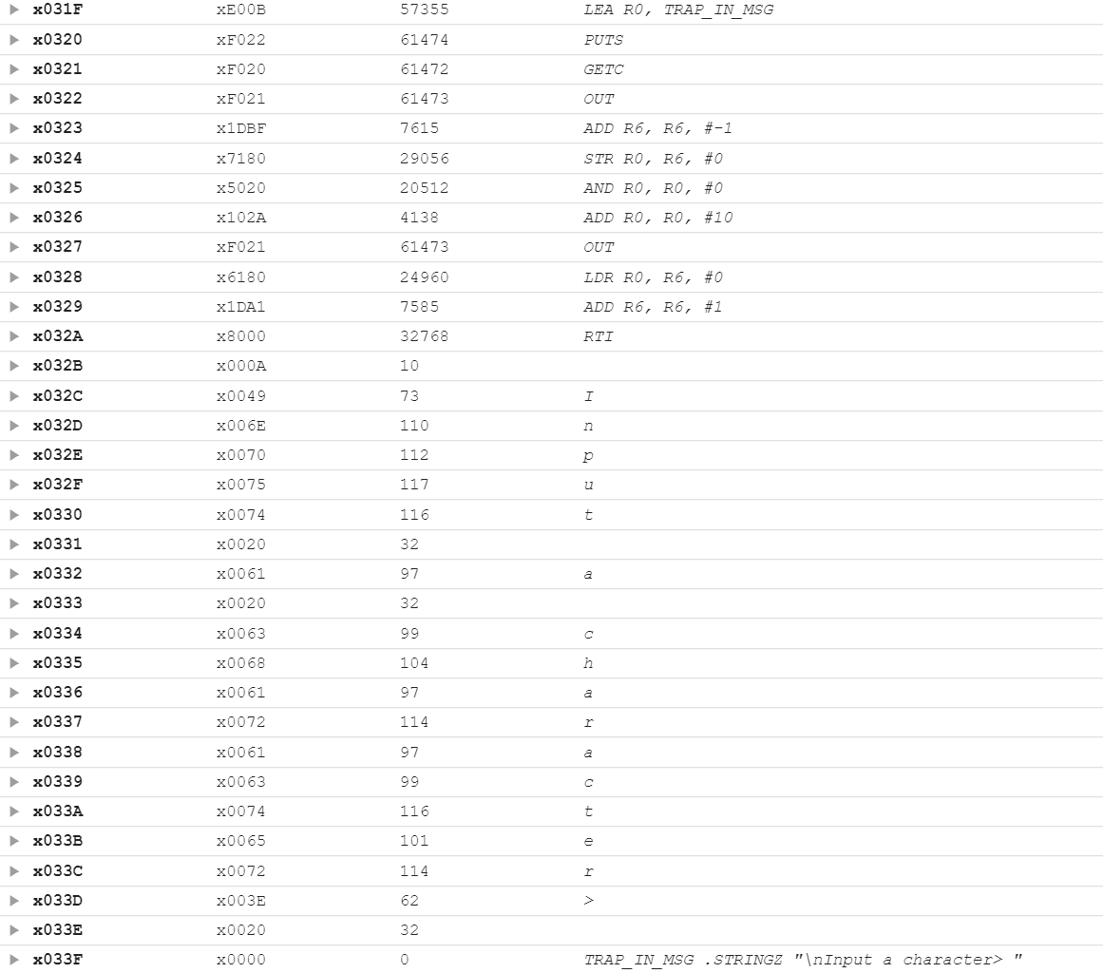
Using Traps to implement (IN, TRAP x23)

Slide 26
Data Type Conversion
I/O
  Keyboard input routines read ASCII characters (not binary values)
  Console output routines write ASCII (‘s’ not “x73”)
Consider this program:
TRAP x23 ; input from keyboard
ADD R1, R0, #0 ; move to R1
TRAP x23 ; input from keyboard
ADD R0, R1, R0 ; add two inputs
TRAP x21 ; display result
TRAP x25 ; HALT
User inputs ‘2’ and ‘3’ -- what happens?
Result displayed: ‘e’
Why?
  ASCII '2' (x32) + ASCII '3' (x33) = ASCII 'e' (x65)

Slide 27
ASCII to Binary
Single digit numbers are trivial (subtract x30)
  E.g., ‘7’ is ASCII x37, x37 - x30 = x7
Input
  Assume we've read three ASCII digits (e.g., "259") into a memory buffer
How do we convert this to a number we can use?
  Convert first character to digit (subtract x30) and multiply by 100
  Convert second character to digit and multiply by 10
  Convert third character to digit
  Add the three digits together

Slide 28
ASCII to Binary Conversion Algorithm

Slide 29
Multiplication
How can we multiply a number by 10?
  Approach 0
    Use the MUL instruction
  Approach 1
    Add <number> to itself 10 times
  Approach 2
    Add 10 to itself <number> times (better if number < 10)
  Approach 3
    Look it up! Only practical if number of multiplicands is small

Slide 30
Code for Lookup Table
; multiply R0 by 100, using lookup table
;
LEA R1, Lookup100 ; R1 = table base
ADD R1, R1, R0 ; add index (R0)
LDR R0, R1, #0 ; load from M[R1]
...
Lookup100 .FILL #0 ; entry 0
.FILL #100 ; entry 1
.FILL #200 ; entry 2
.FILL #300 ; entry 3
.FILL #400 ; entry 4
.FILL #500 ; entry 5
.FILL #600 ; entry 6
.FILL #700 ; entry 7
.FILL #800 ; entry 8
.FILL #900 ; entry 9

Slide 31
Complete ASCII to Binary Conversion Code
ASCII "259” to value 259
ASCIIBUF
3
R1

Slide 32
Complete ASCII to Binary Conversion Code (1 of 3)
; Three-digit buffer at ASCIIBUF.
; R1 tells how many digits to convert.
; Put resulting decimal number in R0.
ASCIItoBinary AND R0, R0, #0 ;clear result
ADD R1, R1, #0 ;test # digits
BRz DoneAtoB ;done if no digits
;
LD R3, NegZero ;R3 = -x30
LEA R2, ASCIIBUF ;ptr to the first digit
ADD R2, R2, R1 ;R2 =(R2)+(R1)
ADD R2, R2, #-1 ;points to ones digit
;
LDR R4, R2, #0 ;load digit
ADD R4, R4, R3 ;convert to number
ADD R0, R0, R4 ;add ones contribution
;

Slide 33
Complete ASCII to Binary Conversion Code(2 of 3)
ADD R1, R1, #-1 ;one less digit
BRz DoneAtoB ;done if zero
ADD R2, R2, #-1 ;points to tens digit
;
LDR R4, R2, #0 ;load ‘tens’ digit
ADD R4, R4, R3 ;convert to number
LEA R5, Lookup10 ;multiply by 10
ADD R5, R5, R4
LDR R4, R5, #0
ADD R0, R0, R4 ;adds tens contribution to total
;
ADD R1, R1, #-1 ;one less digit
BRz DoneAtoB ;done if zero
ADD R2, R2, #-1 ;points to hundreds digit
;
LDR R4, R2, #0 ;load digit
ADD R4, R4, R3 ;convert to number
LEA R5, Lookup100 ;multiply by 100
ADD R5, R5, R4
LDR R4, R5, #0
ADD R0, R0, R4 ;adds 100's contrib

Slide 34
Complete ASCII to Binary Conversion Code(3 of 3)
DoneAtoB RET
NegZero .FILL xFFD0 ;-x30
ASCIIBUF .BLKW 4
Lookup10 .FILL #0
.FILL #10
.FILL #20
...
Lookup100 .FILL #0
.FILL #100
.FILL #200
...

Slide 35
Binary to ASCII Conversion
Converting a 2's complement binary value to
a three-digit decimal number
  Resulting characters can be output using OUT
Instead of multiplying, we need to divide by 100
to get hundreds digit.
  Why wouldn't we use a lookup table for this problem?
  Subtract 100 repeatedly from number to divide.
First, check whether number is negative.
  Write sign character (+ or -) to buffer and make positive.

Slide 36
Binary to ASCII Conversion Code (1 of 3)
; R0 is between -999 and +999.
; Put sign character in ASCIIBUF, followed by three
; ASCII digit characters.
BinaryToASCII LEA R1, ASCIIBUF ;ptr to result string
ADD R0, R0, #0 ;test sign of value
BRn NegSign
LD R2, ASCIIplus ;store '+'
STR R2, R1, #0
BR Begin100
NegSign LD R2, ASCIIneg ;store '-'
STR R2, R1, #0
NOT R0, R0 ;convert value to pos
ADD R0, R0, #1
Begin100 LD R2, ASCIIoffset
LD R3, Neg100
Loop100 ADD R0, R0, R3
BRn End100
ADD R2, R2, #1 ;add one to digit
BR Loop100

Slide 37
Binary to ASCII Conversion Code(2 of 3)
End100 STR R2, R1, #1 ;store ASCII 100's digit
LD R3, Pos100
ADD R0, R0, R3 ;restore last subtract
;
LD R2, ASCIIoffset
LD R3, Neg10
Loop10 ADD R0, R0, R3
BRn End10
ADD R2, R2, #1 ;add one to digit
BR Loop10
End10 STR R2, R1, #2 ;store ASCII 10's digit
ADD R0, R0, #10 ;restore last subtract
;
LD R2, ASCIIoffset
ADD R2, R2, R0 ;convert one's digit
STR R2, R1, #3 ;store one's digit
RET
;

Slide 38
Binary to ASCII Conversion Code(3 of 3)
ASCIIplus .FILL x002B ;plus sign ASCII code
ASCIIneg .FILL x002D ;neg sign ASCII code
ASCIIoffset .FILL x0030 ;zero’s ASCII code
Neg100 .FILL xFF9C ;-100
Pos100 .FILL x0064 ;100
Neg10 .FILL xFFF6 ;-10

