Slide 1
Chapter 9-3
Interrupt-Driven I/O
计算系统概论A
Introduction to Computing Systems
（ CS1002A.01 ）
计算机科学与技术学院
School of Computer Science and Technology

Slide 2
What is Interrupt-Driven I/O?
Program A is executing instruction n
Program A is executing instruction n+1
Program A is executing instruction n+2
Program A is executing instruction n+3
Program A is executing instruction n+4
  ……
  ……
  ……

Slide 3
What is Interrupt-Driven I/O?
Program A is executing instruction n
Program A is executing instruction n+1
Program A is executing instruction n+2
Interrupt!!!
Program A is executing instruction n+3
Program A is executing instruction n+4
  ……
  ……
  ……

Slide 4
What is Interrupt-Driven I/O?
Program A is executing instruction n
Program A is executing instruction n+1
Program A is executing instruction n+2
1: Interrupt signal is detected
1: Program A is put into suspended animation
1: PC is loaded with the starting address of Program B
2: Program B starts satisfying I/O device’s needs
2: Program B continues satisfying I/O device’s needs
2: Program B continues satisfying I/O device’s needs
2: Program B finishes satisfying I/O device’s needs
3: Program A is brought back to life
Program A is executing instruction n+3
Program A is executing instruction n+4
  ……
  ……
  ……
Notes:
suspended animation 假死

Slide 5
What is Interrupt-Driven I/O?
Program A is executing instruction n
Program A is executing instruction n+1
Program A is executing instruction n+2
Program A is executing instruction n+3
Program A is executing instruction n+4
  ……
  ……
  ……

Slide 6
Why Have Interrupt-Driven I/O?
Polling
  Polling requires the processor to waste a lot of time spinning its wheels, re-executing again and again the LDI and BR instructions until the ready bit is set.
Interrupt-driven I/O
  With interrupt-driven I/O, none of that testing and branching has to go on.
  Interrupt-driven I/O allows the processor to spend its time doing what is hopefully useful work, executing some other program perhaps, until it is notified that some I/O device needs attention.

Slide 7
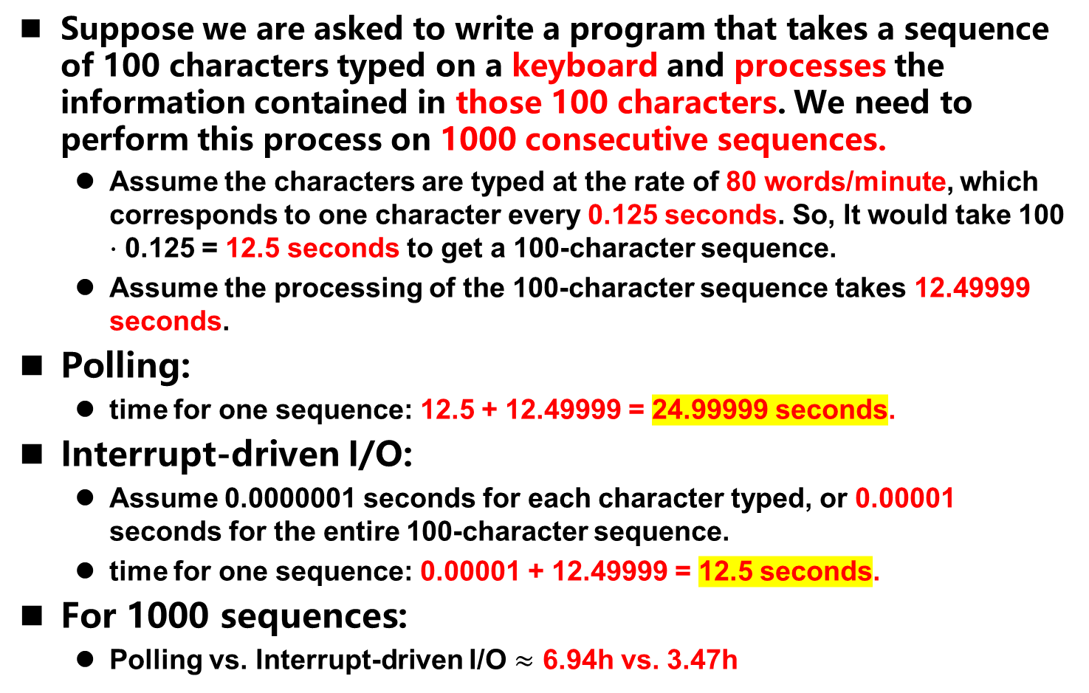
Why Have Interrupt-Driven I/O? An Example
Suppose we are asked to write a program that takes a sequence of 100 characters typed on a keyboard and processes the information contained in those 100 characters. We need to perform this process on 1000 consecutive sequences.
  Assume the characters are typed at the rate of 80 words/minute, which corresponds to one character every 0.125 seconds. So, It would take 100 ⋅ 0.125 = 12.5 seconds to get a 100-character sequence.
  Assume the processing of the 100-character sequence takes 12.49999 seconds.
Polling:
  time for one sequence: 12.5 + 12.49999 = 24.99999 seconds.
Interrupt-driven I/O:
  Assume 0.0000001 seconds for each character typed, or 0.00001 seconds for the entire 100-character sequence.
  time for one sequence: 0.00001 + 12.49999 = 12.5 seconds.
For 1000 sequences:
  Polling vs. Interrupt-driven I/O $≈$ 6.94h vs. 3.47h

Slide 8

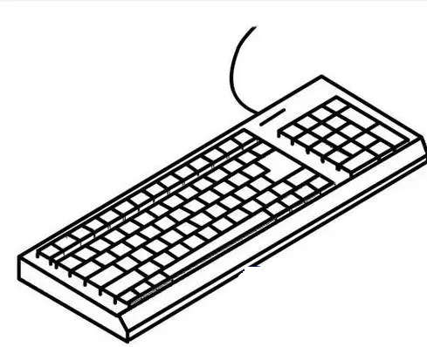

Two Parts to interrupt-driven I/O
Part1.
  the mechanism that enables an I/O device to interrupt the processor
Part2.
  the mechanism that handles the interrupt request.

Slide 9

Part I: Causing the Interrupt to Occur
Several things must be true for an I/O device to actually interrupt the program that is running:
  C1. The I/O device must want service.
  C2. The device must have the right to request the service.
  C3. The device request must be more urgent than what the processor is currently doing.
If all three elements are present, the processor stops executing the program that is running and takes care of the interrupt.

Slide 10

Part I: Causing the Interrupt to Occur
C1. The I/O device must want service.
  Keyboard: someone has typed a character
  Monitor: have successfully completed the display of the last character

Slide 11
Part I: Causing the Interrupt to Occur
C2. The device must have the right to request the service: the interrupt enable bit
  the interrupt enable bit, which can be set or cleared by the processor (usually by the operating system).
  In most I/O devices, this interrupt enable (IE) bit is part of the device status register(SR).
interrupt enable bit
15
0
14
13
ready bit
KBSR
interrupt signal
to processor
interrupt enable bit
15
0
14
13
ready bit
DSR
interrupt signal
to processor

Slide 12
Part I: Causing the Interrupt to Occur
C3. The Urgency of the Request
  To interrupt the running program, the device must have a higher priority than the program that is currently running.
  There may be many devices that want to interrupt the processor at a specific time. To succeed, the device must have a higher priority level than all other demands for use of the processor.
  PL7 > PL6 > … > PL0
The Processor Status Register
15
14
13
12
11
10
9
8
7
6
5
4
3
2
1
0
Pr
PL
N
Z
P
PSR
Priv Mode
Priority Level
Cond Codes

Slide 13
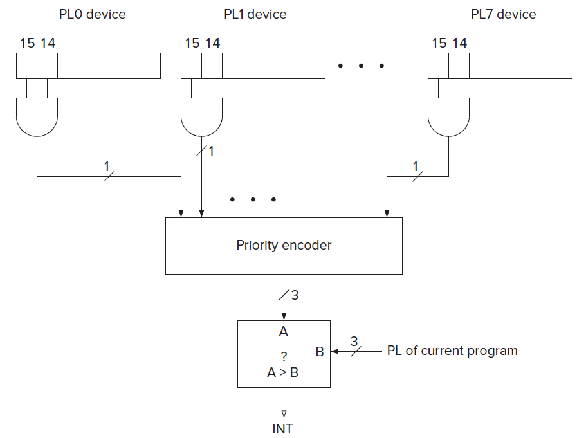
Part I: Causing the Interrupt to Occur
The INT signal: To stop the processor from continuing execution of its currently running program and service an interrupt request, the INT signal must be asserted.
  The interrupt request signals are input to a priority encoder, a combinational logic structure that selects the highest priority request from all those asserted.
  PL: Priority Level

Slide 14

Part I: Causing the Interrupt to Occur
The test for INT
  Instead of always going from the last state of one instruction cycle to the first state of the FETCH phase of the next instruction, the next state depends on the INT signal.
  If not asserted, continues with next instruction
  If INT is asserted, then the next state is the first state of Part II, handling the interrupt request.
F
NO
D
interrupt
signal?
Why not here ?
Part II
YES
EA
OP
EX
S

Slide 15
Part II: Handling the Interrupt Request
Three stages
  Initiate the interrupt
    1: Interrupt signal is detected
    1: Program A is put into suspended animation
    1: PC is loaded with the starting address of Program B
  2. Service the interrupt
    2: Program B starts satisfying I/O device’s needs
    2: Program B continues satisfying I/O device’s needs
    2: Program B continues satisfying I/O device’s needs
    2: Program B finishes satisfying I/O device’s needs
  3. Return from the interrupt
  3: Program A is brought back to life

Slide 16
Part II: Handling the Interrupt Request
Stage1: Initiate the interrupt
  (1) save the state of the interrupted program so it can pick up where it left off after the requirements of the interrupt have been completed
    The state includes the contents of the memory locations that are part of the program and the contents of all the general purpose registers. It also includes the PC and PSR.
    Assume that the service routine will always save the contents of any general purpose register that it needs before using it. The only state information the LC-3 saves are the PC and PSR.
    The LC-3 saves this state information on the supervisor stack in the same way the PC and PSR are saved when a TRAP instruction is executed.

Slide 17
Part II: Handling the Interrupt Request
Stage1: Initiate the interrupt
  (2) load the state of the higher priority interrupting program so it can start satisfying its request.
    Interrupt service routines are similar to the trap service routines. They are program fragments stored in system space.
    Most processors use the mechanism of vectored interrupts. The I/O device transmits to the processor an eight-bit interrupt vector (INTV) along with its interrupt request signal and its priority level.
    The Interrupt Vector Table consists of memory locations x0100 to x01FF, each containing the starting address of an interrupt service routine (ISR).
      Trap vector table : x0000 to x00FF
      Interrupt vector table: x0100 to x01FF
    The PSR is loaded as follows:
      Since no instructions in the service routine have yet executed, PSR[2:0] contains no meaningful information. We arbitrarily load it initially with 010.
      Since the interrupt service routine runs in privileged mode, PSR[15] is set to 0.
      PSR[10:8] is set to the priority level associated with the interrupt request.

Slide 18
Part II: Handling the Interrupt Request
Stage2: Service the Interrupt
  The PC contains the starting address of the interrupt service routine
  The service routine will execute, and the requirements of the I/O device will be serviced.

Slide 19
Part II: Handling the Interrupt Request
Stage3: Return from the Interrupt
  The last instruction in every interrupt service routine is RTI, return from trap or interrupt.
    RTI pops the PC and the PSR from the supervisor stack and restoring them to their rightful places in the processor.
    If the privilege level of the interrupted program is unprivileged, the stack pointers must be adjusted, that is, the Supervisor Stack Pointer saved, and the User Stack Pointer loaded into R6.
    The PC is restored to the address of the instruction that would have been executed next if the program had not been interrupted.

Slide 20
An Example (1)
Suppose program A is executing when I/O device B, having a PL higher than that of A, requests service.
During the execution of the service routine for I/O device B, a still more urgent device C requests service
interrupt vector xF1: extended to x1F1
interrupt vector xF2 : extended to x1F2

Slide 21
An Example (2)
1, the supervisor stack and the PC before program A fetches the instruction at x3006.
2, R6 is pointing to the current contents of the user stack, which are not shown!
3, The INT signal (caused by an interrupt from device B) is detected at the end of execution of the instruction in x3006.
4, R6 → Saved_USP; Save_SSP → R6
5, PSR of program A → system stack
6, PC+1 →system stack
7, The interrupt vector associated with device B is expanded to 16 bits x01F1, and the contents of x01F1 (x6200) is loaded into the PC.

Slide 22
An Example (3)
8, The service routine for device B executes until a higher priority interrupt
is detected at the end of execution of the instruction at x6202.
9, The PSR of the service routine for B, which includes the condition codes produced by the AND instruction at x6202, and the address x6203 (PC +1) are pushed on the stack.
10, The interrupt vector associated with device C is expanded to 16 bits (x01F2), and the contents of x01F2 (x6300) is loaded into the PC.

Slide 23
An Example (4)
11, Assume the interrupt service routine for device C executes to completion, finishing with the RTI instruction in x6315.
12, The supervisor stack is popped twice, restoring the PC to x6203 and the PSR of the service routine for device B, including the condition codes produced by the AND instruction in x6202.

Slide 24
An Example (5)
13, The interrupt service routine for device B resumes execution at x6203 and runs to completion, finishing with the RTI instruction in x6210.
14, The supervisor stack is popped twice, restoring the PC to x3007 and the PSR of program A, including the condition codes produced by the ADD instruction in x3006.
15, Finally, since program A is in User mode, the contents of R6 is stored in Saved_SSP and R6 is loaded with the contents of Saved_USP.
16, Program A resumes execution with the instruction at x3007.

Slide 25
Interrupts deal with more than I/O devices.
Any event that has a higher priority and is external to the program that is running can interrupt the computer.
  It does so by supplying its INT signal, its INTV vector, and its priority level.
  If it is the highest priority event that wishes to interrupt the computer, it does so in the same way that I/O devices do as described above.
Examples:
  timer interrupt interrupts the program that is running in order to note the passage of a unit of time.
  The machine check interrupt calls attention to the fact that some part of the computer system is not functioning properly.
  ……

Slide 26
Polling Revisited
Interrupt Mask
  When set, a processor can ignore INT signal
How to implement interrupt mask in LC3?
  09 LDI R1, PSR
  0A LD R2,INTMASK
  0B AND R2,R1,R2 ; R1=original PSR, R2=PSR with interrupts disabled
  0C
  0D POLL STI R1,PSR ; enable interrupts (if they were enabled to begin)
  0E STI R2,PSR ; disable interrupts
  0F LDI R3,DSR
  10 BRzp POLL ; Poll the DSR
  11 STI R0,DDR ; Store the character into the DDR
  STI R1,PSR ; Restore original PSR
  1D INTMASK .FILL xBFFF ; 1011 1111 1111 1111
  1E PSR .FILL xFFFC
  1F DSR .FILL xFE04
  20 DDR .FILL xFE06
15
14
13
12
11
10
9
8
7
6
5
4
3
2
1
0
Pr
PL
N
Z
P
PSR
Priv Mode
Priority Level
Cond Codes

Slide 27
ARM CPSR
ARM V5及以上，DSP溢出状态标志位
条件代码标志
保留
控制位
31 30 29 28 27 26 8 7 6 5 4 3 2 1 0
N
N
Z
Z
C
C
V
V
Q
—
. . .
—
I
I
F
F
T
T
M4
M4
M3
M3
M2
M2
M1
M1
M0
M0
溢出标志
进位或借位扩展
模式位
零
状态位:T=1,Thumb
负或小于
FIQ禁止
IRQ禁止

